Slide 1
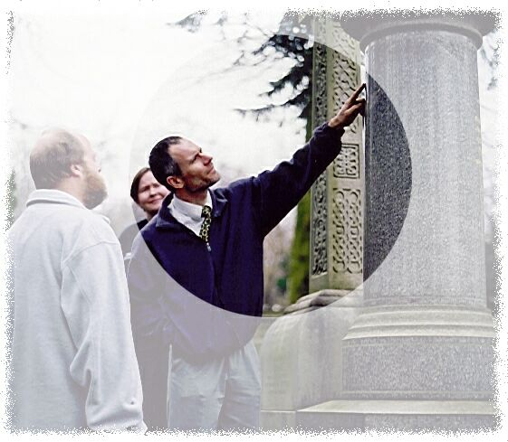
Developed from the Earth Science Education Unit ‘Will my gravestone last?”, with permission
Will My Gravestone Last?
Earth science out of doors
for KS3 science/geography
© Copyright is waived for original material contained in this workshop if it is required for use within the laboratory or classroom. Copyright material contained herein from other publishers rests with them. Any organisation wishing to use this material should contact the Earthlearningidea team.

Slide 2
Earthlearningidea online video workshops
Purpose – ESEU background
Most Earthlearningidea online video workshops are based, with permission, on workshops originally developed by the Earth Science Education Unit (ESEU).
These were designed as interactive workshops for teachers and trainees, involving interaction, discussion and presentations by participants to others.
Global research into professional development workshops shows that these aspects are critical to success.
ESEU research shows that this workshop approach is highly successful in changing teaching in schools; evaluation feedback has also been very strong.

Slide 3
Earthlearningidea online video workshops
Purpose – Earthlearningidea development
The Earthlearningidea Team has developed the ESEU workshops into online video workshops for those unable to take part in face to face interactive workshops
Most workshops are led by a PowerPoint presentation and have an accompanying booklet that contains all the activity background details, resource lists, risk assessments, etc.
The individual workshop activities have been published for open access online at the website: https://www.earthlearningidea.com/
Each workshop activity has a question script and a video keyed into CASE principles, that can be accessed through the PowerPoint hyperlinks.
The aim is to facilitate online Earth science learning.

Slide 4
Will my gravestone last?– using CASE
Teaching Earth science using the Cognitive Acceleration through Science (CASE) approach
The activities in this workshop are keyed into the CASE approach – to develop thinking skills while teaching key Earth science material
If you are unfamiliar with the case approach, you can access a video introduction at: https://www.earthlearningidea.com/Video/CASE.html
An exemplar Earth science teaching activity with a question script using the CASE approach is at: https://www.earthlearningidea.com/Video/Atmosphere_ocean.html

Slide 5
Will my gravestone last?
Workshop video run times | m | s | m | s
CASE – Cognitive Acceleration through Science Education |  |  | 21 | 51
Using CASE: | 6 | 24
Atmosphere and ocean: | 15 | 27
Will my gravestone last? |  |  | 33 | 20
1. Initial briefing |  |  | 4 | 28
2. Recent gravestones |  |  | 2 | 44
3. Surveying |  |  | 3 | 13
4. Identifying rocks |  |  | 3 | 32
5. Weathering |  |  | 5 | 38
6. Oldest gravestones |  |  | 3 | 32
7. Summary |  |  | 6 | 51
8. Your choice |  |  | 3 | 02

Slide 6
Links to gravestone videos – (i)
Initial briefing: https://www.earthlearningidea.com/Video/V14_Gravestones1.html
Recent gravestones: https://www.earthlearningidea.com/Video/V14_Gravestones2.html
Surveying: https://www.earthlearningidea.com/Video/V14_Gravestones3.html
Identifying rocks: https://www.earthlearningidea.com/Video/V14_Gravestones4.html
Weathering: https://www.earthlearningidea.com/Video/V14_Gravestones5.html

Slide 7
Links to gravestone videos – (ii)
6. Oldest gravestones: https://www.earthlearningidea.com/Video/V14_Gravestones6.html
7. Summary: https://www.earthlearningidea.com/Video/V14_Gravestones7.html
8. Your choice: https://www.earthlearningidea.com/Video/V14_Gravestones8.html
For further information on some of the rock types see Virtual Rock Kit: https://www.earthlearningidea.com/virtual_rock_kit/START.htm

Slide 8
Will my gravestone last?
Summary
Preparation for a ‘field visit’ to a local graveyard to use the wealth of opportunities available for scientific investigation, out of doors, in an Earth science context.
Suitable sites include public cemeteries, mostly administered by Local Authorities and burial grounds attached to churches and administered by them.
The case study videos were filmed in Ecclesall Churchyard, Sheffield, UK.

Slide 9
Will my gravestone last?
Workshop outcomes
The churchyard visit provides the following outcomes:
identification of a range of rock types;
knowledge and understanding about weathering processes;
the opportunity for pupils to test their own hypotheses regarding rates of weathering;
ability to sample data from a wide range of different rock types and environments within the churchyard;
experience of bridging school-based learning with the outside environment.

Slide 10
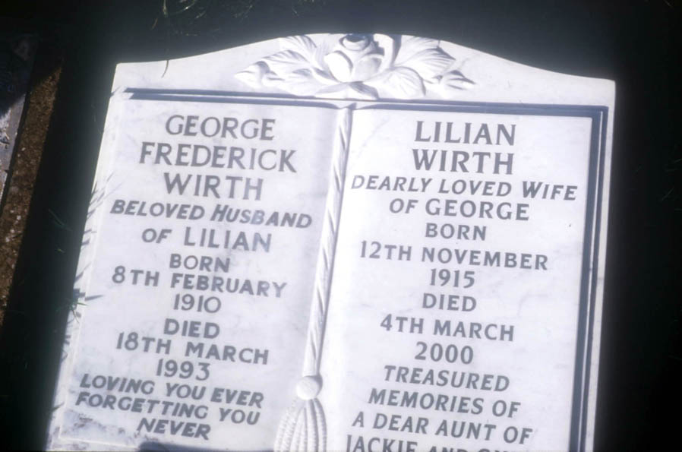
What gravestones in unweathered conditions can look like (slides 9 to 19) For further information on some of these rock types see Virtual Rock Kit https://www.earthlearningidea.com/virtual_rock_kit/START.htm
Will my gravestone last?

Slide 11
Will my gravestone last?
Igneous rocks used for gravestones
- a few examples from a wide range of igneous rocks from across the world

Slide 12
Will my gravestone last?
“Balmoral Red” Granite, from Scandinavia

Slide 13
Will my gravestone last?
Red granite detail. Coin is 2cm diameter

Slide 14
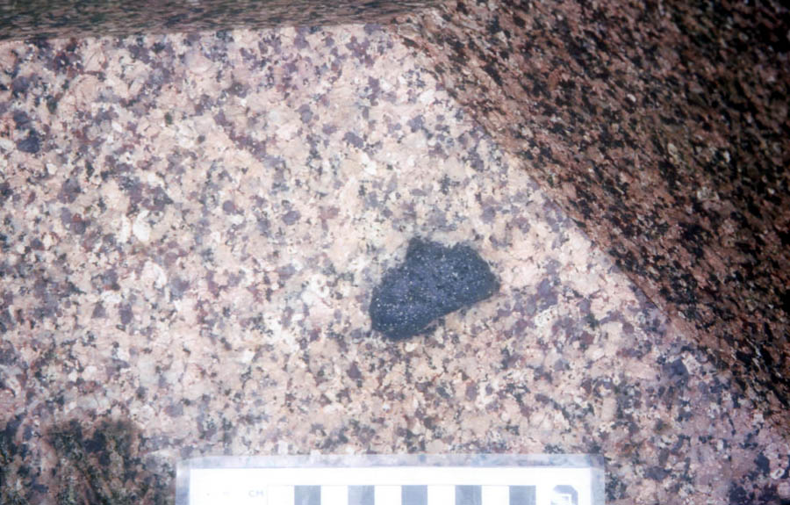
Will my gravestone last?
Peterhead Granite, from Scotland, UK, containing a metamorphosed fragment of an older rock

Slide 15
Will my gravestone last?
Larvikite
– an iridescent igneous rock from Oslofjord in Norway
‘’Iridescent = crystals glitter with rainbow-like colours

Slide 16
Metamorphic rocks used for gravestones

Slide 17
Will my gravestone last?
Carrara Marble, from Italy, with lead lettering, inset to the marble surface

Slide 18
Will my gravestone last?
Gneiss, from India

Slide 19
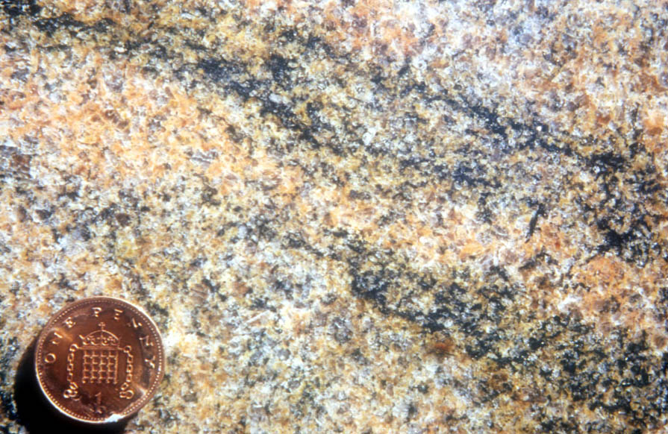
Will my gravestone last?
Red gneiss detail showing mineral banding

Slide 20
Will my gravestone last?
Sedimentary rocks used for gravestones

Slide 21
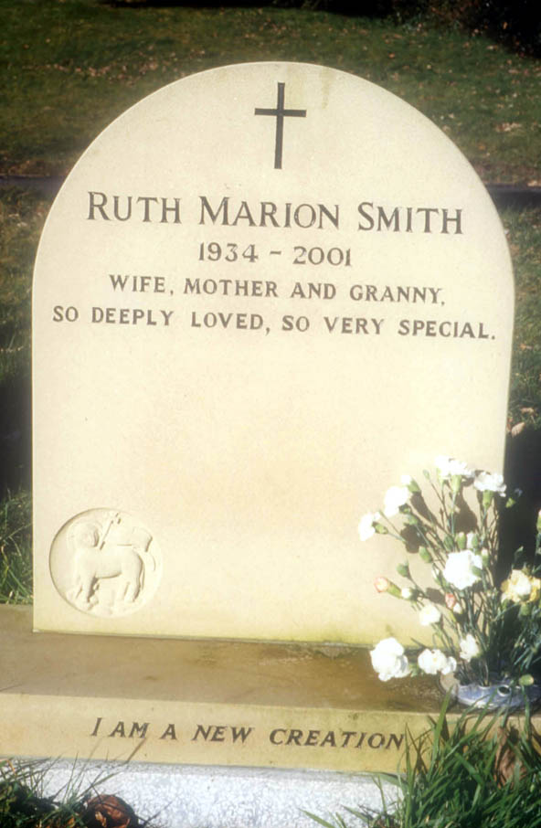
Will my gravestone last?
Sandstone, from the Millstone Grit Series rocks of Derbyshire, central England, UK

Slide 22
Will my gravestone last?
Some different environments within a churchyard

Slide 23
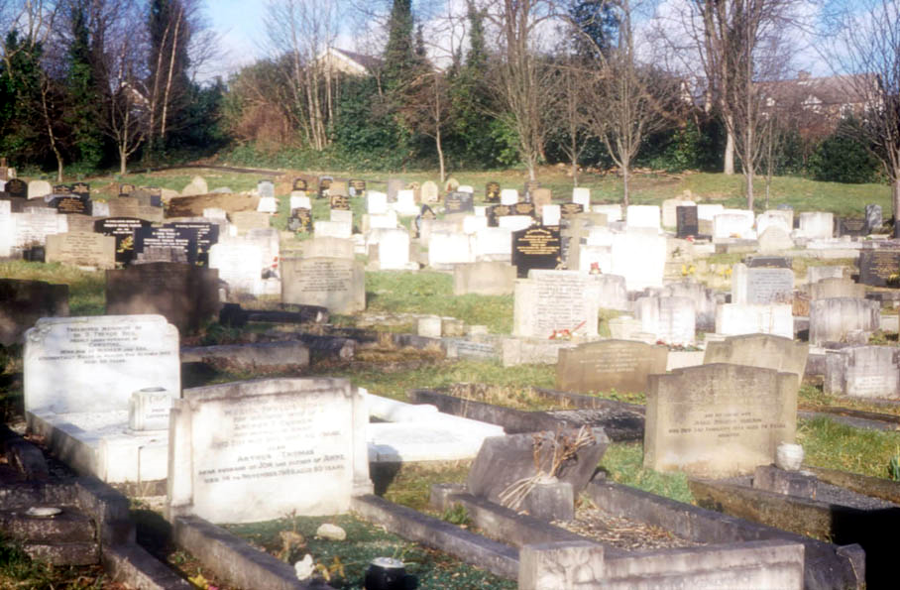
Will my gravestone last?
The newest, unvegetated part,
still used for burials

Slide 24
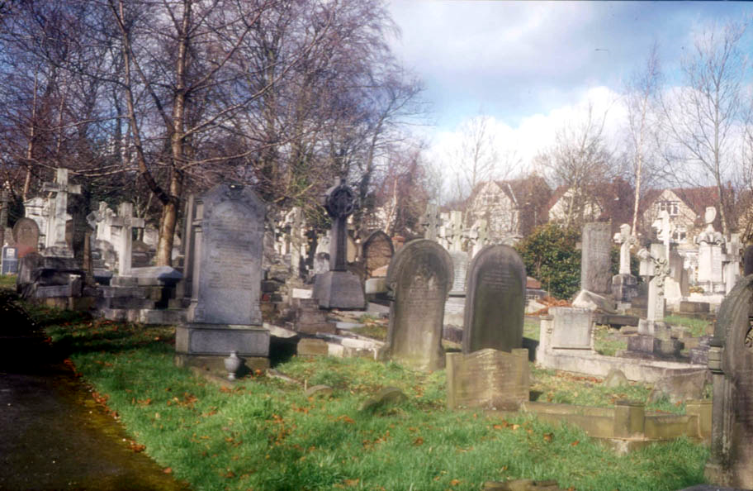
Will my gravestone last?
The part used between the 1880s and the 1950s, with planted trees

Slide 25
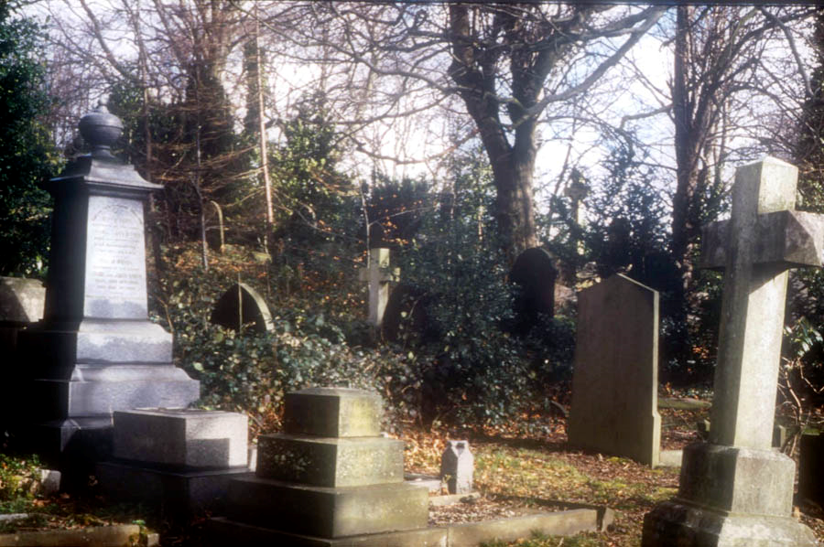
Will my gravestone last?
The overgrown Victorian part

Slide 26
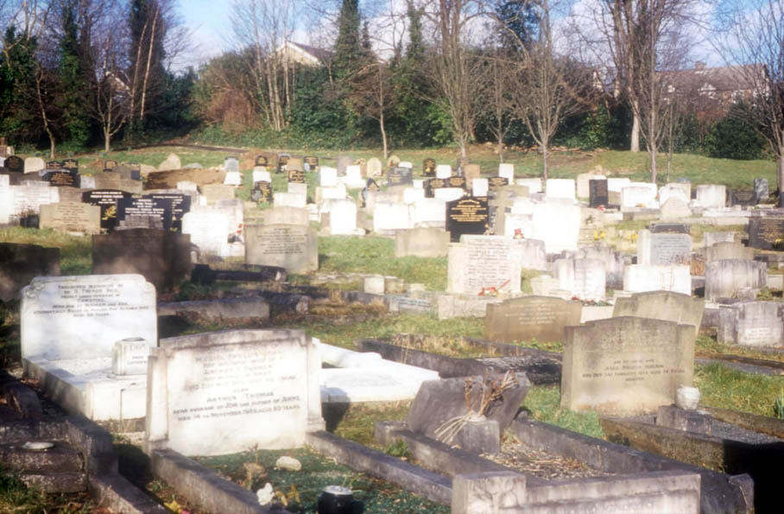
Will my gravestone last?
The response of
gravestones to
weathering

Slide 27
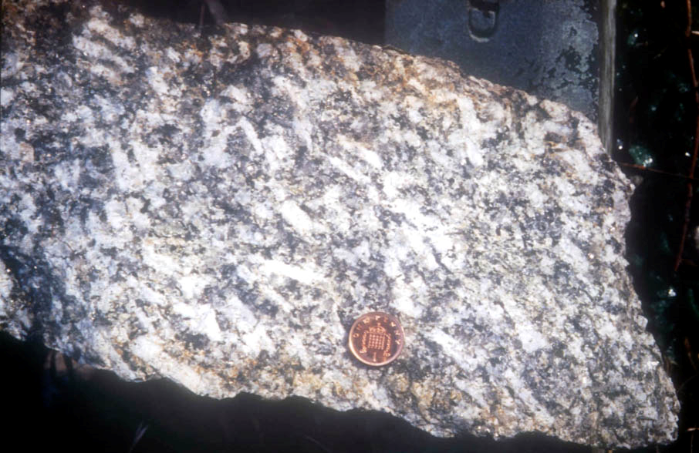
Will my gravestone last?
Chemical (oxidation) weathering, shown by orange discolouration on the edges of a broken Cornish granite

Slide 28
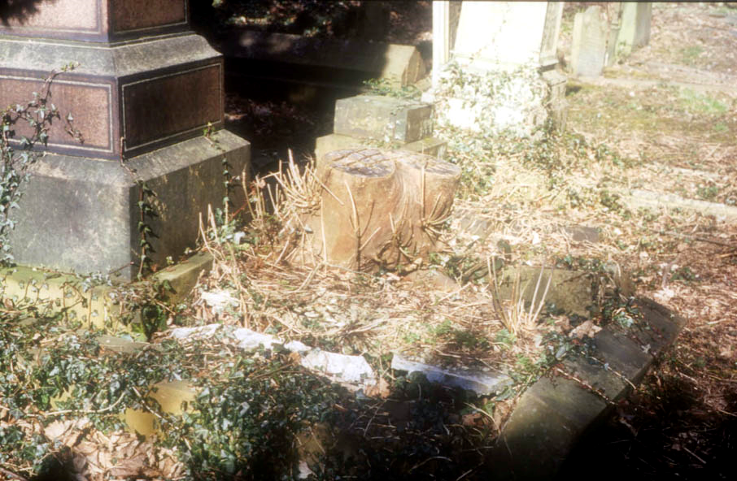
Will my gravestone last?
Tree roots forcing apart gravestones

Slide 29
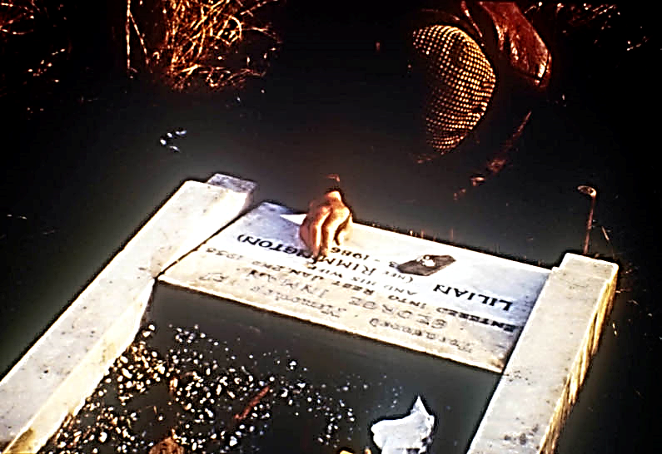
Will my gravestone last?
The mason adding a new name to a weathered marble slab

Slide 30
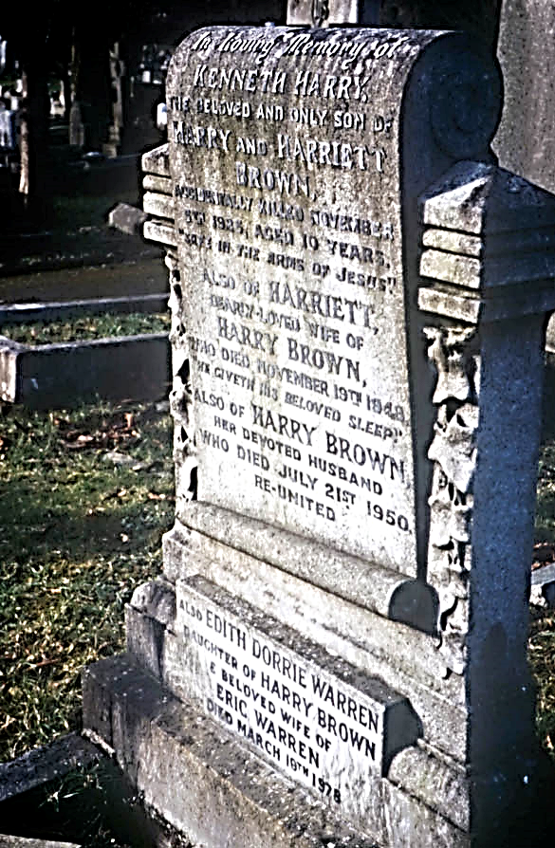
Will my gravestone last?
Marble, showing more weathering by carbonation-solution on the top surface than on the vertical surface, (shown by the lead letters standing further out from the marble on the top)

Slide 31
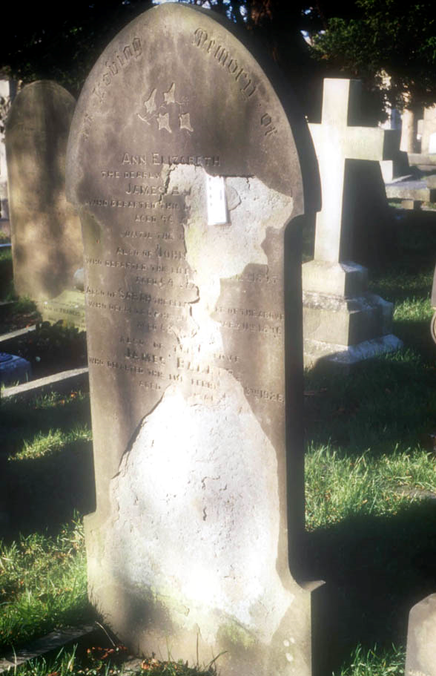
Will my gravestone last?
“Spalling”
on the east-facing side of a sandstone slab
‘Spalling = the breaking away of weakened flakes

Slide 32
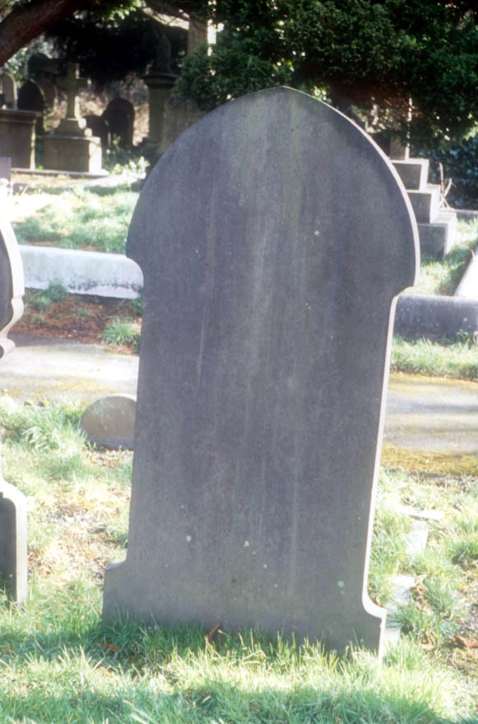
Will my gravestone last?
The undamaged west-facing side of the same slab

Slide 33
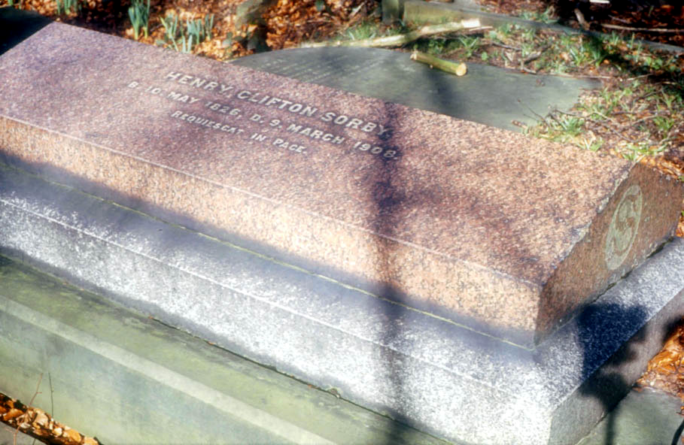
Will my gravestone last?
Henry Clifton Sorby, a famous Victorian geologist – spot the different rock types!

Slide 34
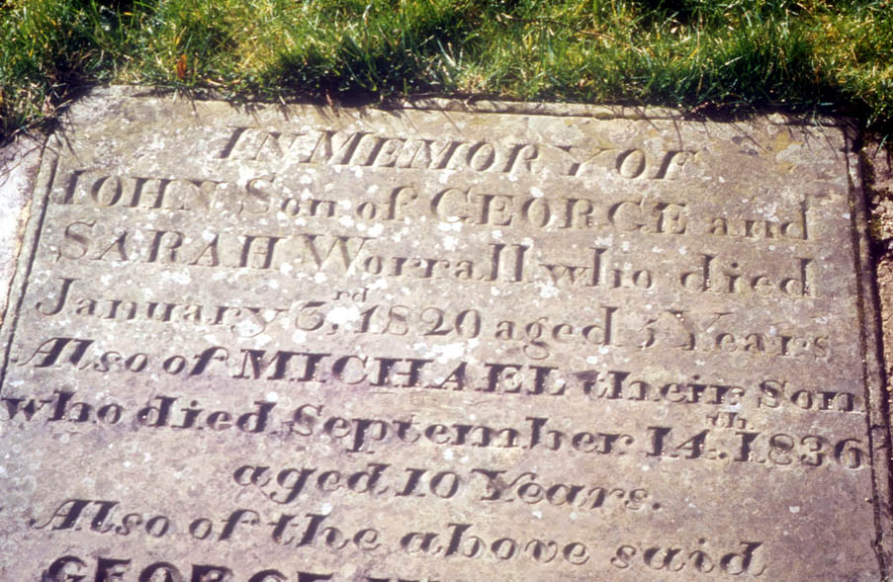
Will my gravestone last?
A local sandstone tells of family tragedy in earlier eras – discuss!

Slide 35
Will my gravestone last?
All photographs © Peter Kennett, Earthlearningidea

Slide 36
Will my gravestone last?
Workshop outcomes
The churchyard visit provides the following outcomes:
identification of a range of rock types;
knowledge and understanding about weathering processes;
the opportunity for pupils to test their own hypotheses regarding rates of weathering;
experience of bridging school-based learning with the outside environment;
ability to sample data from a wide range of different rock types and environments within the churchyard.

Slide 37
Developed from the Earth Science Education Unit ‘Will my gravestone last?”, with permission
Will My Gravestone Last?
Earth science out of doors
for KS3 science/geography
© Copyright is waived for original material contained in this workshop if it is required for use within the laboratory or classroom. Copyright material contained herein from other publishers rests with them. Any organisation wishing to use this material should contact the Earthlearningidea team.

