Slide 1
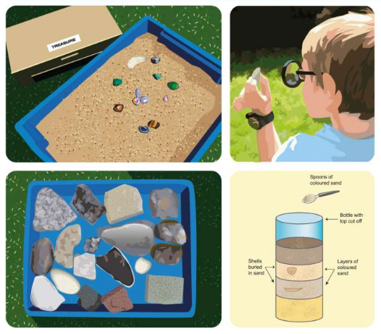
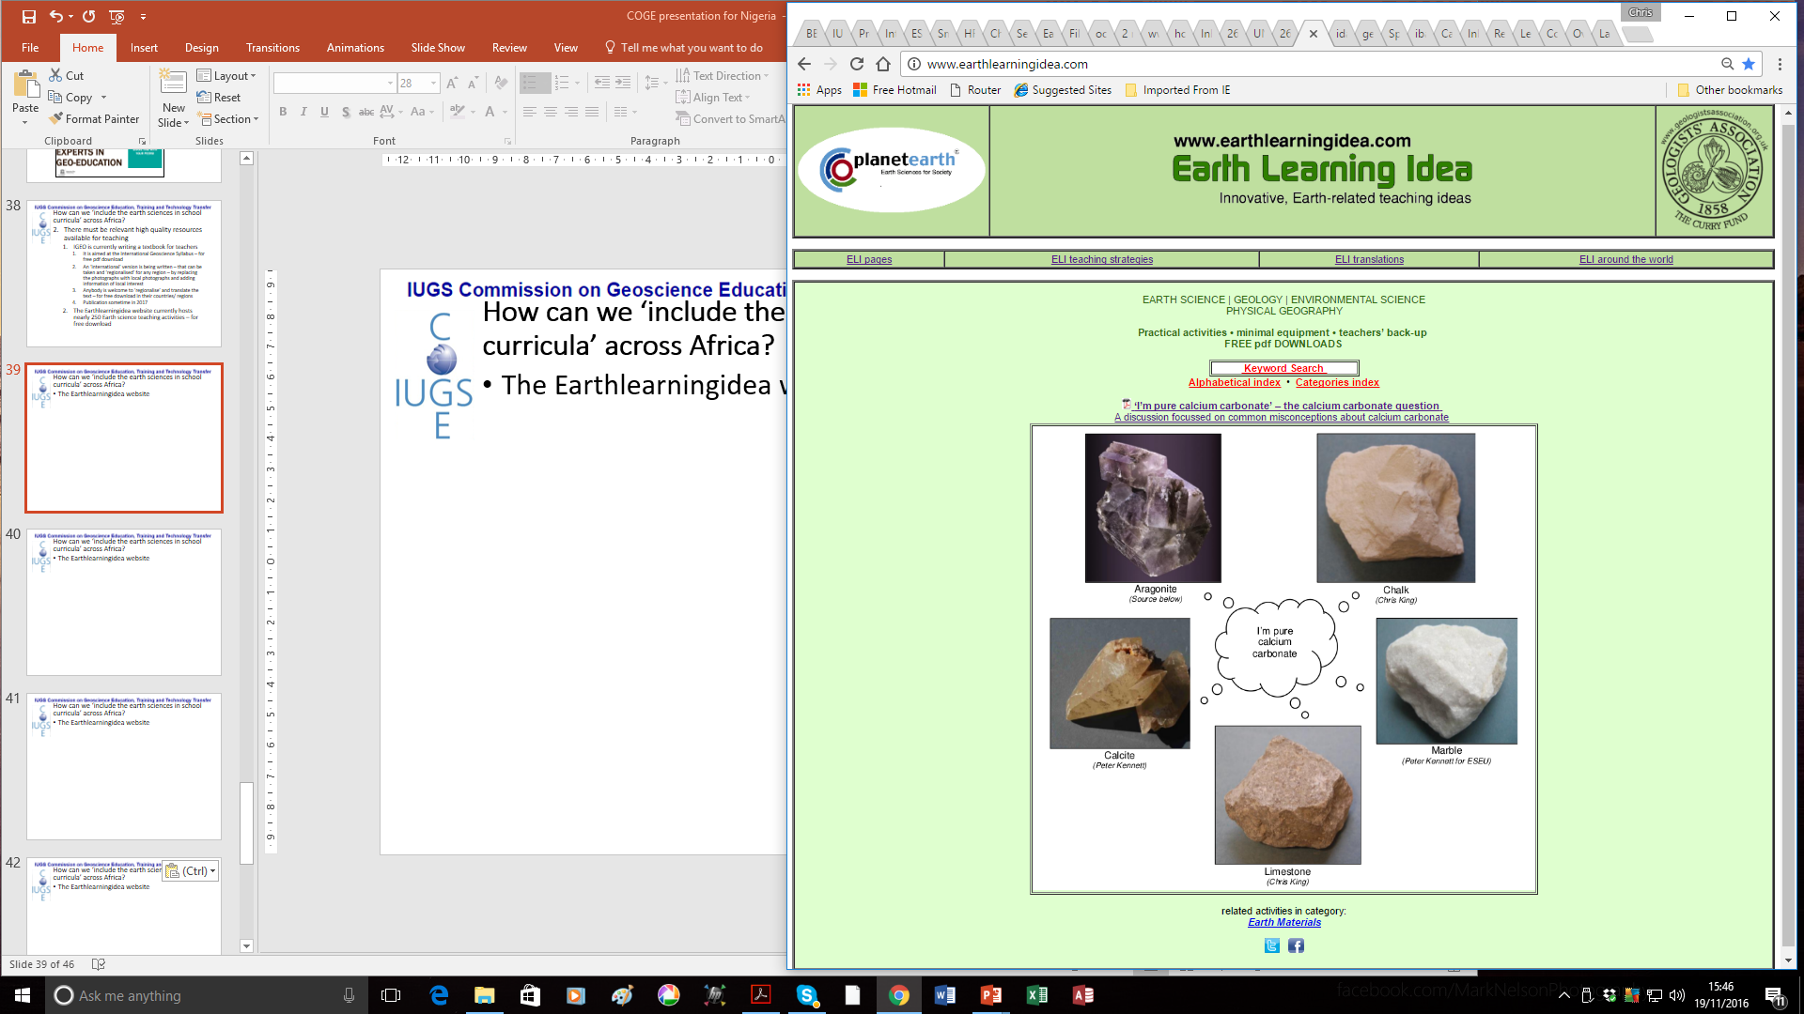
The rock circus – online
For ages 5 to 7
Developed from the Earth Science Education Unit
‘The rock circus’ workshop, with permission
© Copyright is waived for original material contained in this workshop if it is required for use within the laboratory or classroom. Copyright material contained herein from other publishers rests with them. Any organisation wishing to use this material should contact the Earthlearningidea team.
Notes:
<number>

Slide 2

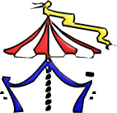


The rock circus
Join our circus and explore the world!
Tackle the rocky part of the KS1 National Curriculum the scientific way.
Test the rocks, test to find out what they can tell us about the Earth we live on.
Try different interactive and hands-on practical activities that spotlight rocks as you may never have seen them before.
… and
Enjoy the thrills and spills of ‘The rock circus’ in your own classroom.

Slide 3
The rock circus
Summary
Try a series of ‘hands-on’ activities that involve identifying, sorting and classifying a range of things ‘found in the ground’. Through the circus activities, focus first on minerals, then fossils, then rocks, before applying your identification skills to the ‘Found in the ground’ activity to distinguish all three. Then use this experience to build your own sedimentary rock and to identify natural materials in and around the school.

Slide 4
The rock circus
Workshop outcomes
The workshop and its activities provide the following outcomes:
insights into how minerals, rocks, fossils and other things ‘found in the ground’ can be sorted, classified and identified most effectively;
the use of evidence to distinguish fossils from non-fossils;
an opportunity to explore the vicinity of the school for the natural materials found there;
an opportunity to investigate sedimentary rock formation processes;
the potential to use Earth materials for a wide range of cross-curricular and creative activities;
practical activities that develop skills of exploration, discussion, argumentation and creativity;
guidance on how the elements of Earth science in the curriculum can be taught most effectively.

Slide 5
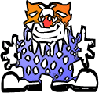
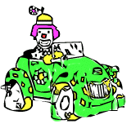
The rock circus
Lay-dees and Gentlemen
– presenting the rock circus activity list ….
Starter: Pirates and Buried Treasure
Circus activity 1: Fossil or not?
Circus activity 2: Rock explorer
Circus activity 3: Found in the ground
Circus activity 4: Rock builder
Circus activity 5: Rocks at school and beyond
Plenary: Sensory treasure hunt

Slide 6
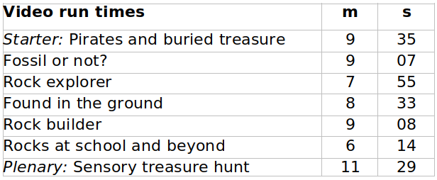
The rock circus
s

Slide 7
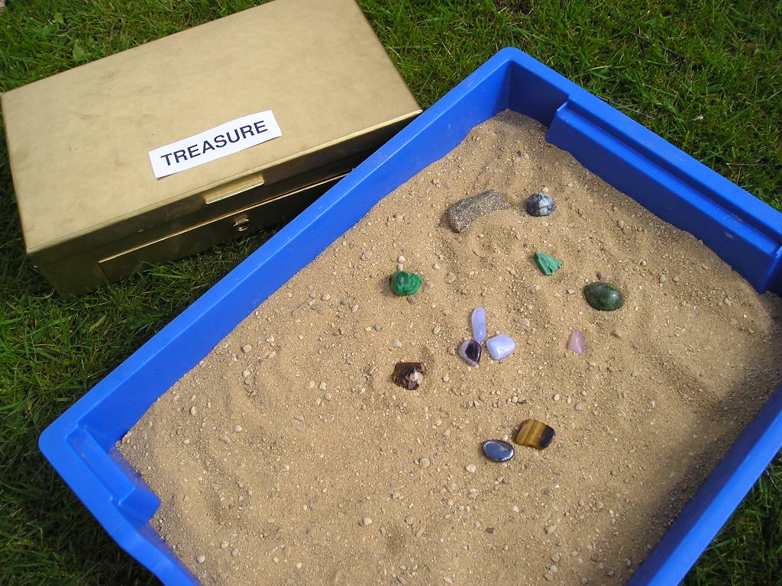
The rock circus
Starter: Pirates and buried treasure
Go to video hyperlink:
https://www.earthlearningidea.com/Video/Pr_Pirates.html

Slide 8
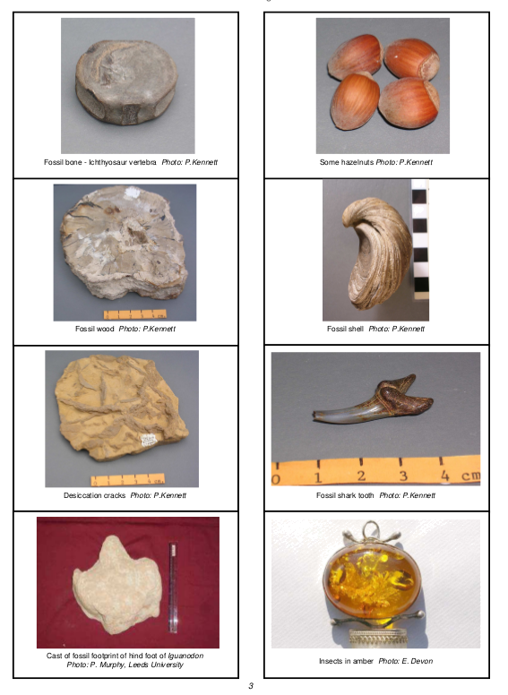
The rock circus
Circus activity 1: Fossil or not?
Go to video hyperlink:
https://www.earthlearningidea.com/Video/Pr_Fossil_or_not.html

Slide 9
The rock circus
Circus activity 1: Fossil or not?
A body fossil: |  | A body fossil: is the remains of the body of an animal or plant, or the imprint or cast of it
A trace fossil: |  | A trace fossil: indicates that an animal or plant was there, but is not a body fossil; it includes footprints, burrows, signs of roots, tooth marks, etc.
Not a fossil: |  | A fossil: is any preserved sign of past life more than 10,000 years old

Slide 10
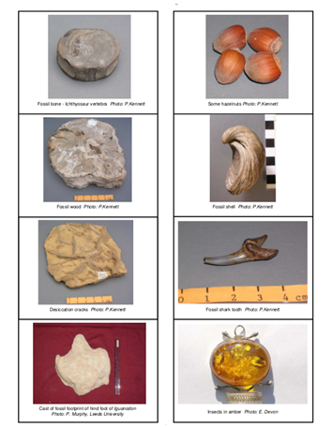
The rock circus
Circus activity 1: Fossil or not?
The pictures are of:
fossil bone
hazelnuts
fossilised wood
fossil shell
desiccation cracks
fossil tooth
dinosaur footprint
insects in amber

Slide 11
The rock circus
Circus activity 1: Fossil or not?
Which of the following are fossils?
4000 year-old footprints like ours as found in mud north of Liverpool, UK | not old enough to be a trace fossil
a squirrel killed on the road | not a fossil, not old enough
3500 million year old cell filaments | body fossil
a petrified tree stump | body fossil
the trail of a trilobite in 530 million year-old rocks | trace fossil
‘tree-like’, dendritic mineral growths | not a fossil – not produced by life
a beach pebble with holes bored by marine organisms | probably not a fossil, unless the boring took place more than 10,000 years ago, in which case the boring is a trace fossil
a human shape preserved in volcanic ash at Pompeii | not old enough to be a fossil – Vesuvius erupted, burying Pompeii, in AD79
a piece of dinosaur skin | body fossil

Slide 12
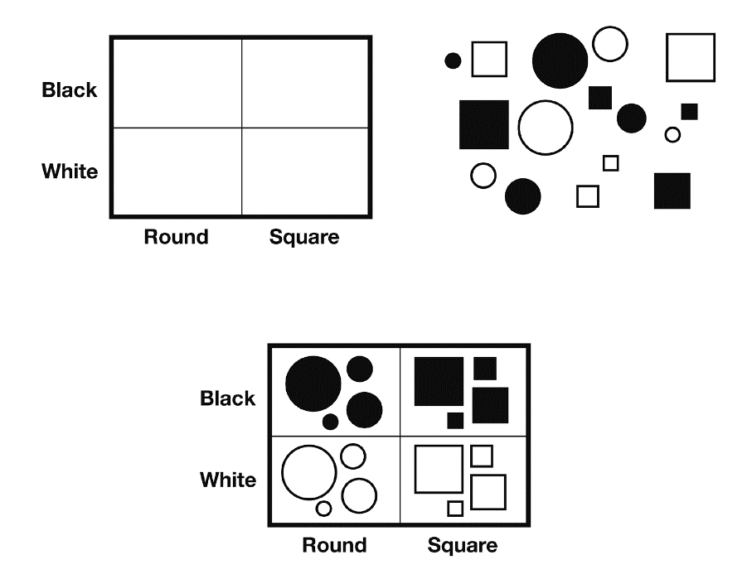
The rock circus
Circus activity 2: Rock explorer
Go to video hyperlink:
https://www.earthlearningidea.com/Video/Pr_Rock_explorer.html

Slide 13
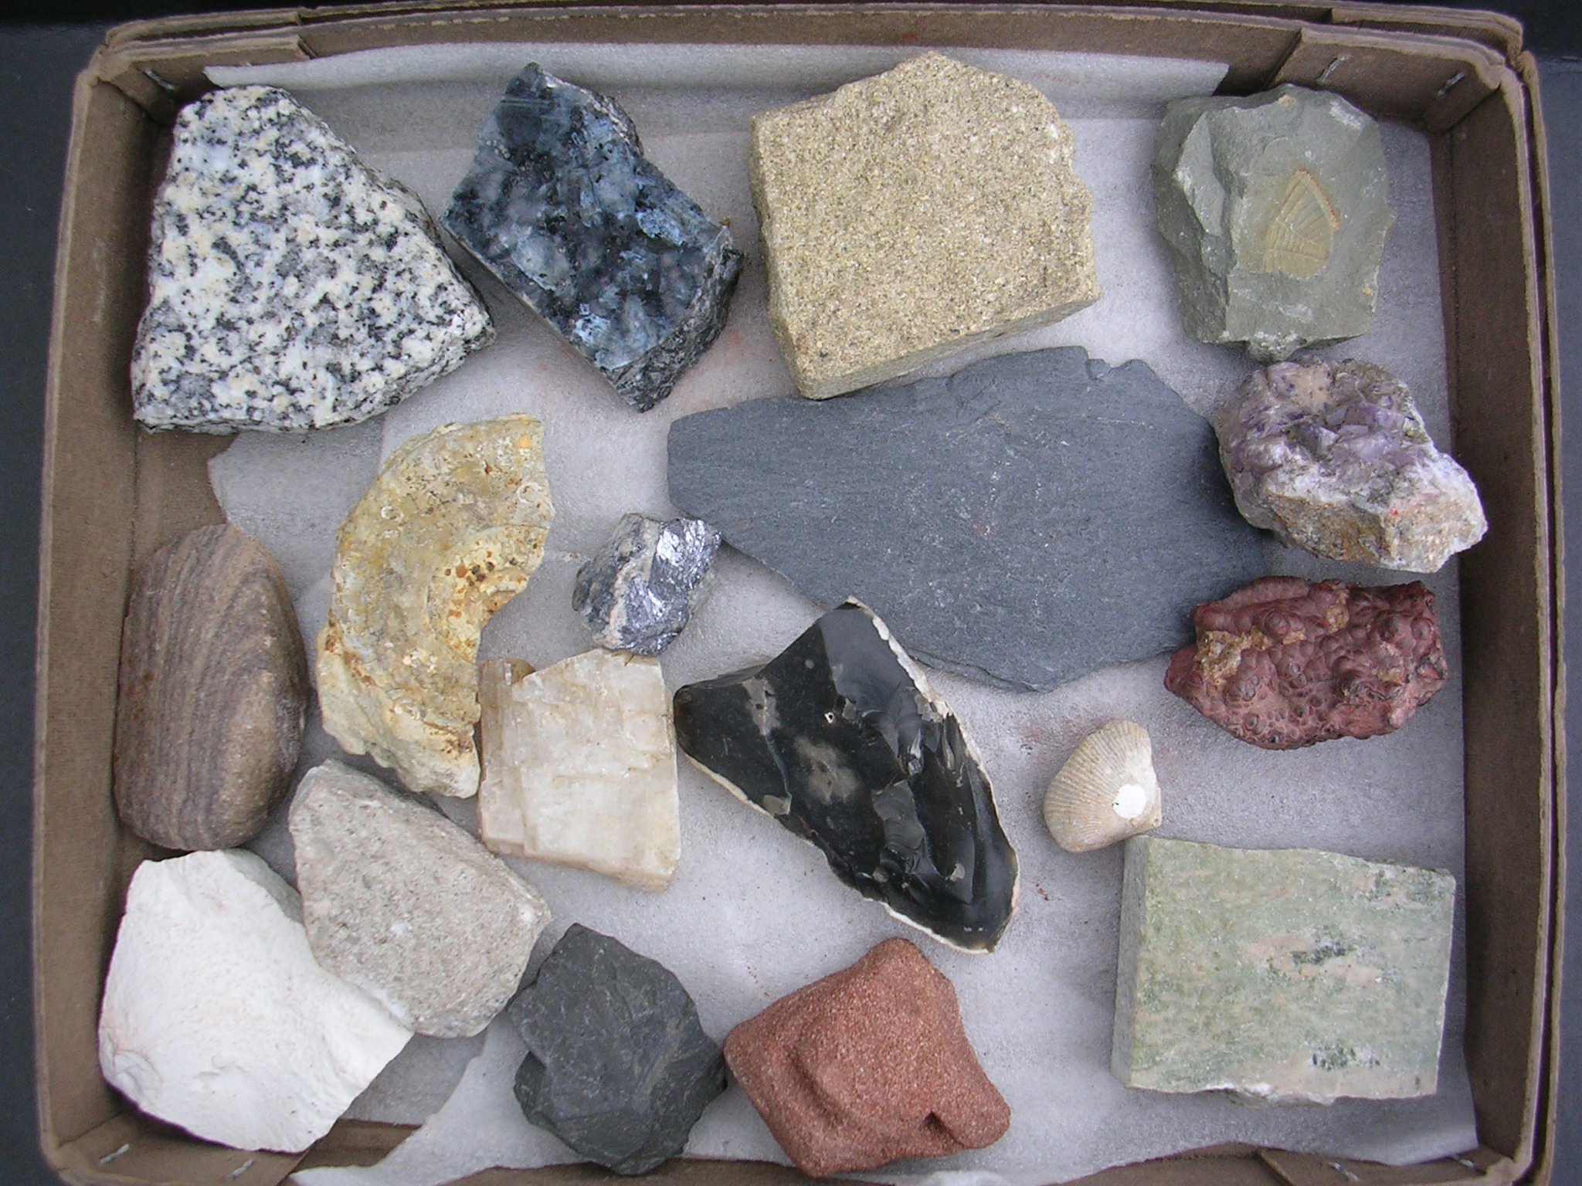
The rock circus
Circus activity 3: Found in the ground
Go to video hyperlink:
https://www.earthlearningidea.com/Video/Pr_Found_in_ground.html

Slide 14
The rock circus
Circus activity 3: Found in the ground – helpful cards
Pupil success criteria card (Found in the ground) Sort them out To do this in the best way, you will: Group the samples into about two or three ‘categories’ with at least two things in each ‘category’; Not have a group which is made of ‘things that couldn’t be fitted into the other groups’; Make your choices based on the properties of the samples
Rock natural and made of ‘bits’ called grains |  | Non-rock may or may not be natural and are usually not formed of ‘bits’
Mineral natural chemicals with the same properties all the way through |  | Fossil any preserved sign of past life more than 10,000 years old

Slide 15
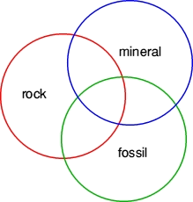
The rock circus
Circus activity 3: Found in the ground
- using the Venn diagram approach

Slide 16
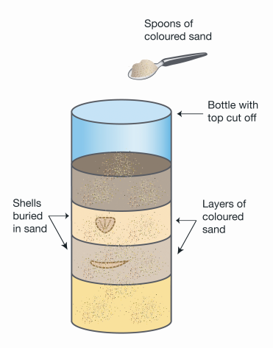
The rock circus
Circus activity 4: Rock builder
Go to video hyperlink:
https://www.earthlearningidea.com/Video/Pr_Rock_builder.html

Slide 17
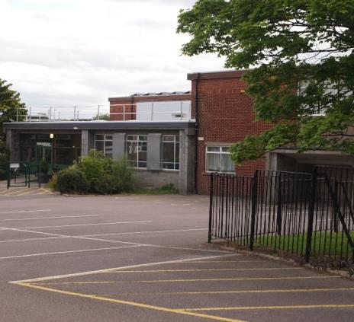
The rock circus
Circus activity 5: Rocks at school and beyond
Go to video hyperlink:
https://www.earthlearningidea.com/Video/Pr_Rocks_school.html

Slide 18
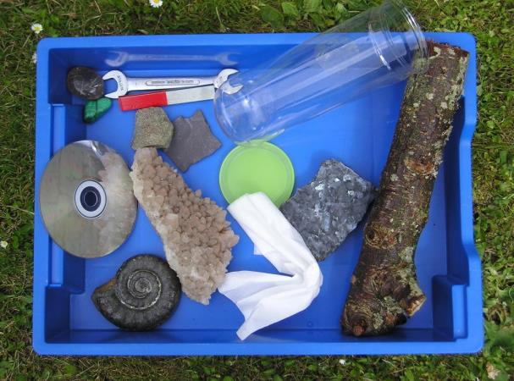
The rock circus
Plenary: Sensory treasure hunt
Go to video hyperlink:
https://www.earthlearningidea.com/Video/Pr_Sensory_treasure.html

Slide 19
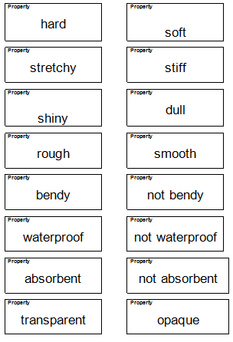
The rock circus
Plenary: Sensory treasure hunt

Slide 20
The rock circus
Workshop outcomes
The workshop and its activities provide the following outcomes:
insights into how minerals, rocks, fossils and other things ‘found in the ground’ can be sorted, classified and identified most effectively;
the use of evidence to distinguish fossils from non-fossils;
an opportunity to explore the vicinity of the school for the natural materials found there;
an opportunity to investigate sedimentary rock formation processes;
the potential to use Earth materials for a wide range of cross-curricular and creative activities;
practical activities that develop skills of exploration, discussion, argumentation and creativity;
guidance on how the elements of Earth science in the curriculum can be taught most effectively.

Slide 21
The rock circus – online
For ages 5 to 7
Developed from the Earth Science Education Unit
‘The rock circus’ workshop, with permission
© Copyright is waived for original material contained in this workshop if it is required for use within the laboratory or classroom. Copyright material contained herein from other publishers rests with them. Any organisation wishing to use this material should contact the Earthlearningidea team.
Notes:
<number>

