Slide 1
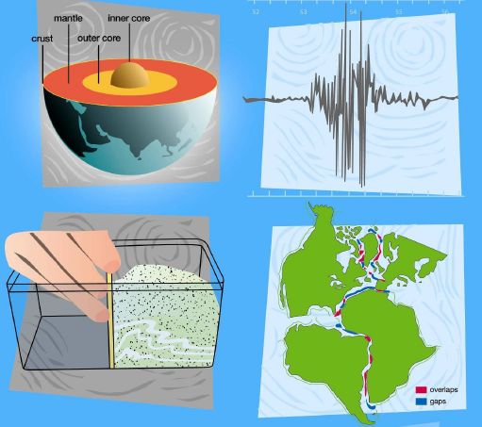
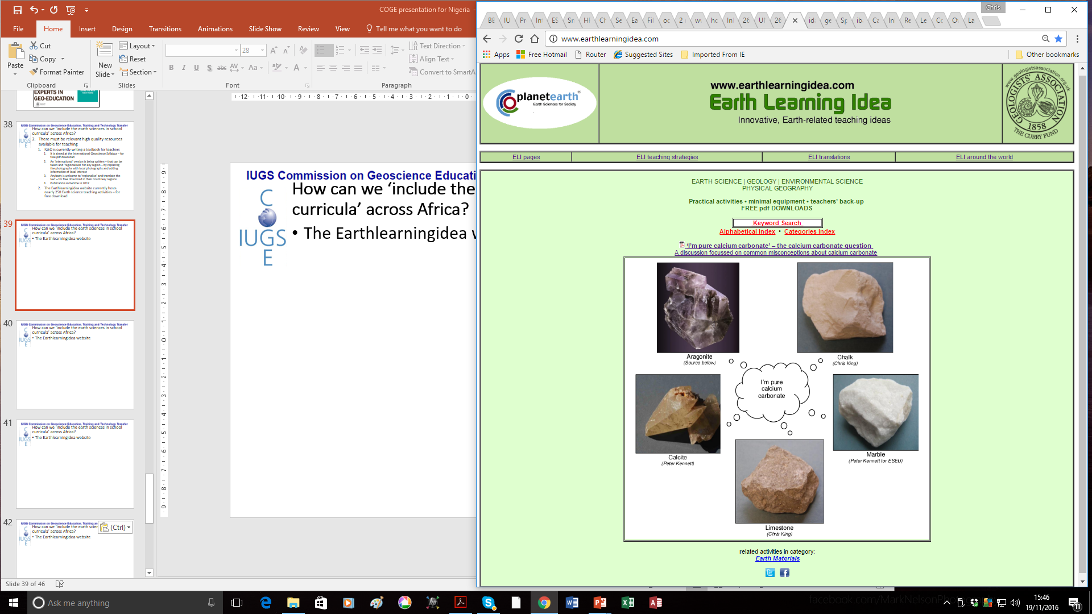
The Earth and plate tectonics – online
Part 2
Earth Science for science and geography
– video workshop
Developed from the Earth Science Education Unit ‘The Earth and plate tectonics’ workshop, with permission
© Copyright is waived for original material contained in this workshop if it is required for use within the laboratory or classroom. Copyright material contained herein from other publishers rests with them. Any organisation wishing to use this material should contact the Earthlearningidea team.

Slide 2
Teaching Earthlearningideas
The plate tectonic story
Divergent margins
Go to: https://www.earthlearningidea.com/Video/V29_Divergent_margins1.html hyperlink

Slide 3
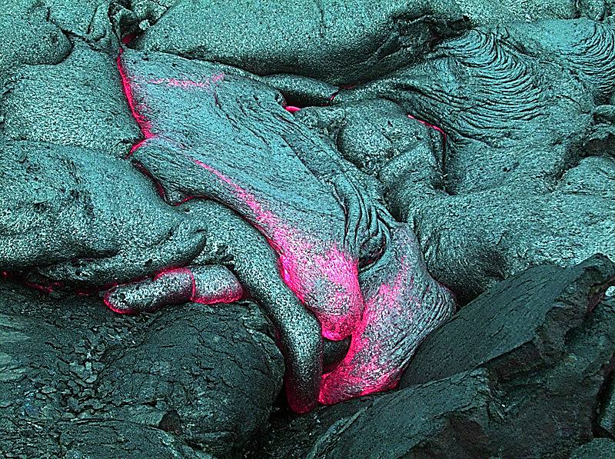
The Earth and plate tectonics
Divergent plate margins -
adding new plate material
Underwater basalt lava at a divergent margin in the public domain by Vintei

Slide 4
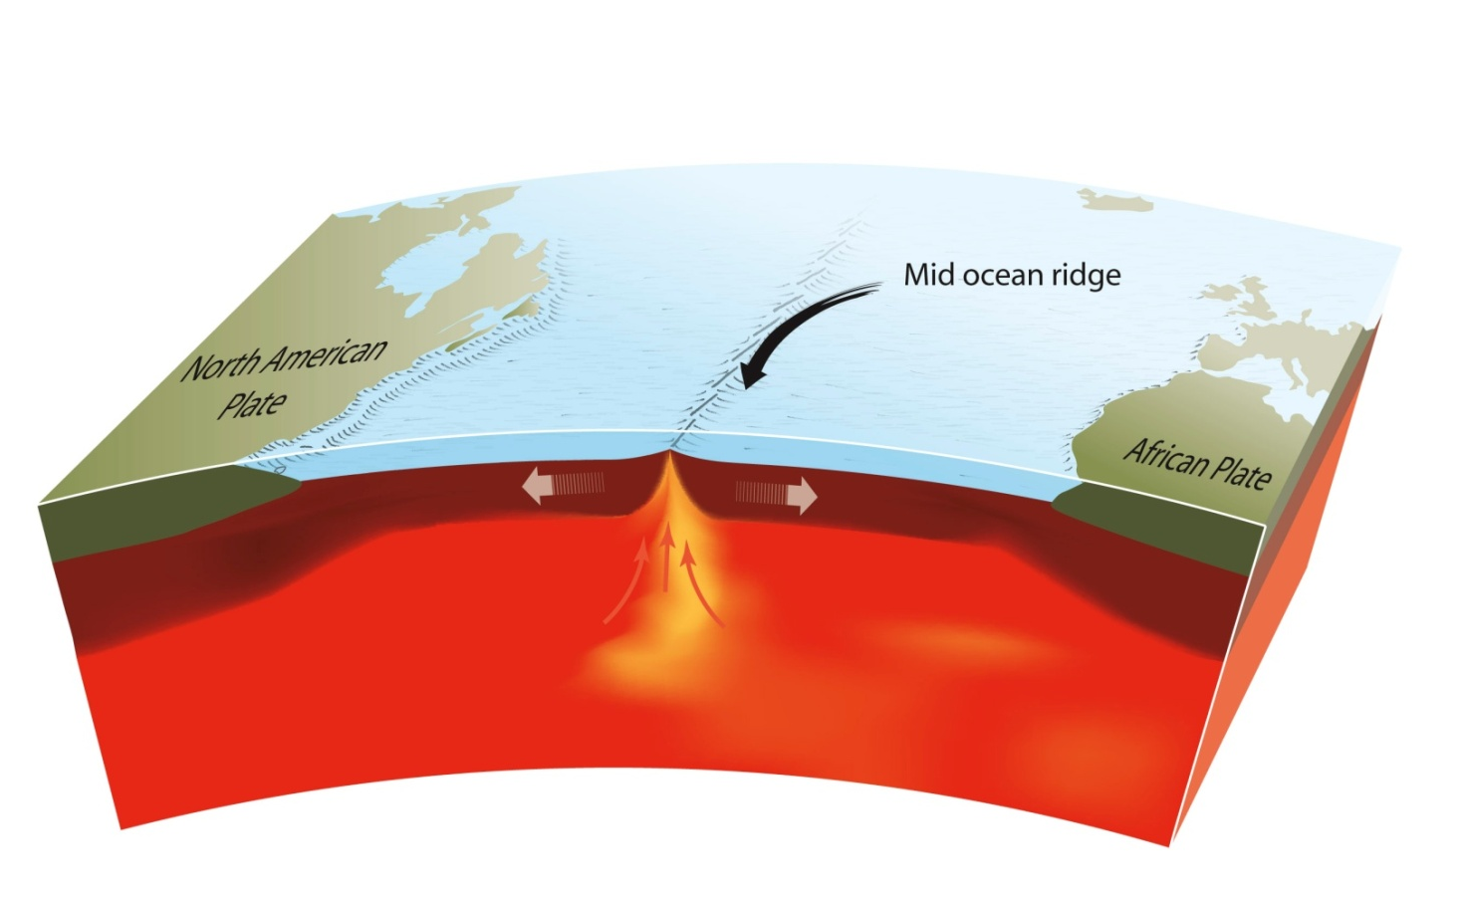
The Earth and plate tectonics
Activity at an oceanic ridge – a divergent plate margin
An oceanic ridge © Press & Siever, redrawn by ESEU

Slide 5
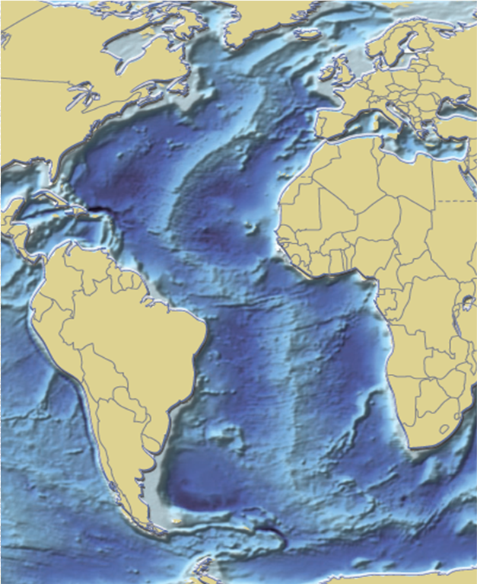
The Earth and plate tectonics
Mid-Atlantic ridge
http://maps.grida.no/go/graphic/world-ocean-bathymetric-map
(Hugo Ahlenius, UNEP/GRID-Arendal)

Slide 6
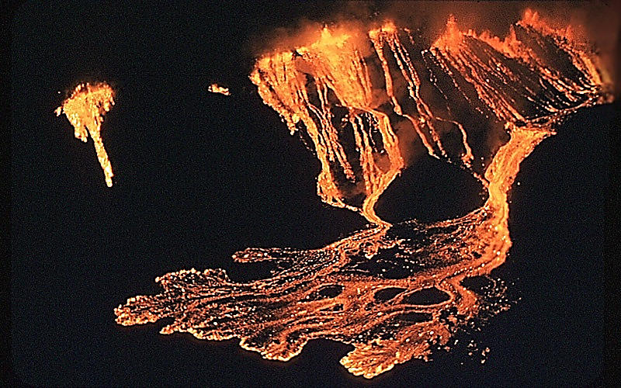
The Earth and plate tectonics
Icelandic-type eruption
Icelandic-type eruption - reproduced with kind permission of U.S. Department of Interior, USGS
Notes:
Basaltic effusive eruptions (Pic is actually Hawaii!)

Slide 7
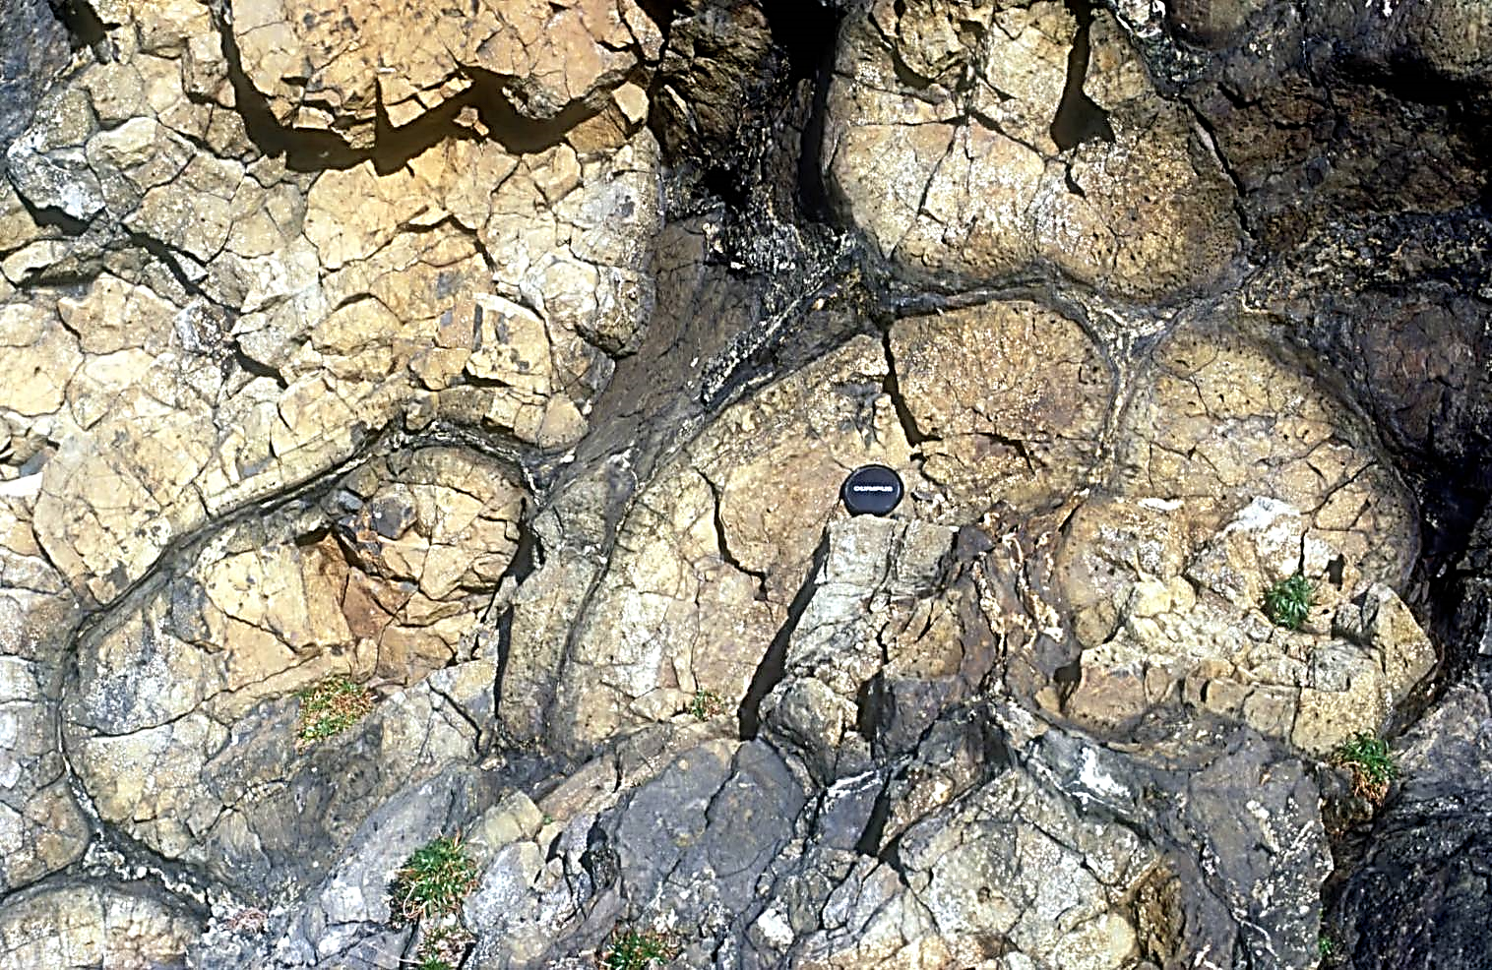
The Earth and plate tectonics
Ancient pillow lavas
Ancient Pillow lavas © Peter Kennett
Notes:
Strumble Head, Pembrokeshire – 50mm lens cap for scale

Slide 8
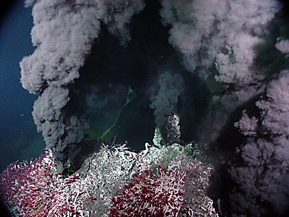
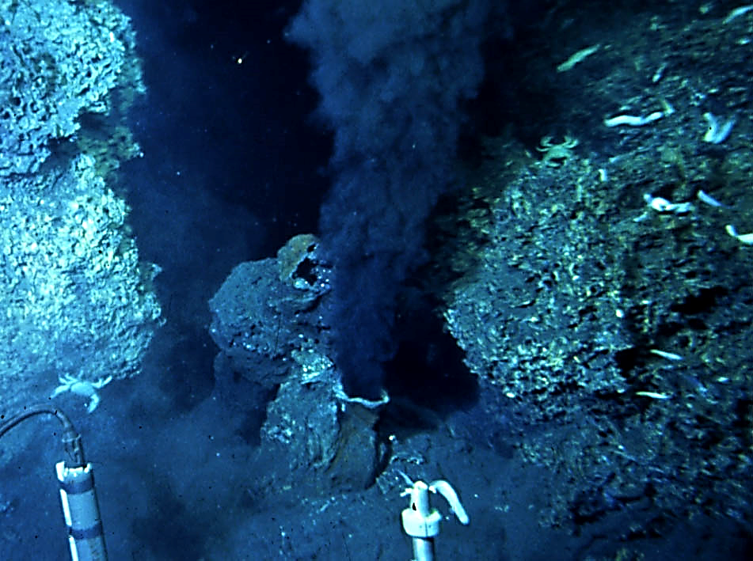
The Earth and plate tectonics
Black smoker activity
Black Smoker’ by US National Oceanic & Atmospheric Administration (public domain)
Notes:
View of the first high-temperature vent (380 °C) ever seen by scientists during a dive of the deep-sea submersible Alvin on the East Pacific Rise (latitude 21° north) in 1979. Such geothermal vents--called smokers because they resemble chimneys--spew dark, mineral-rich, fluids heated by contact with the newly formed, still-hot oceanic crust. This photograph shows a black smoker, but smokers can also be white, grey, or clear depending on the material being ejected. (Photograph by Dudley Foster from RISE expedition, courtesy of William R. Normark, USGS.)

Slide 9
Teaching Earthlearningideas
The plate tectonic story
Faults in a Mars™ bar
Go to: https://www.earthlearningidea.com/Video/V29_Divergent_margins2.html hyperlink

Slide 10
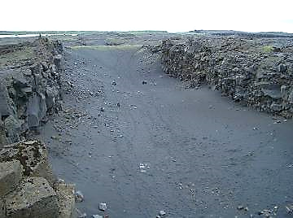
The Earth and plate tectonics
Faults in a Mars™ Bar
Modelling a divergent plate margin
Gap between the North American and Eurasian continental plates © Randomskk

Slide 11
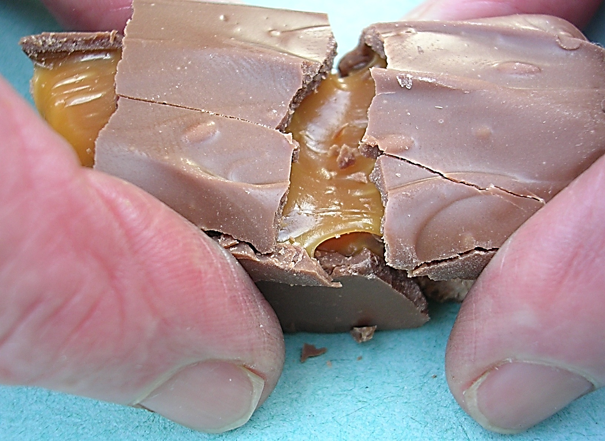
The Earth and plate tectonics
Faults in a Mars™ Bar
Faults in a MarsTM Bar (A rift valley) © Peter Kennett

Slide 12
The Earth and plate tectonics
Faults in a Mars™ Bar
central ‘rift valley'
rigid ‘lithosphere’ moving left
rigid ‘lithosphere’ moving right
ductile flowing ‘astheno-sphere'
solid ‘mantle'
Faults in a MarsTM Bar (A rift valley) © Peter Kennett

Slide 13
The Earth and plate tectonics
A divergent margin rift valley on land
Iceland
Gap between the North American and Eurasian continental plates © Randomskk

Slide 14
Teaching Earthlearningideas
The plate tectonic story
Magnetic stripes
Go to: https://www.earthlearningidea.com/Video/V30_Magnetic_stripes.html hyperlink

Slide 15
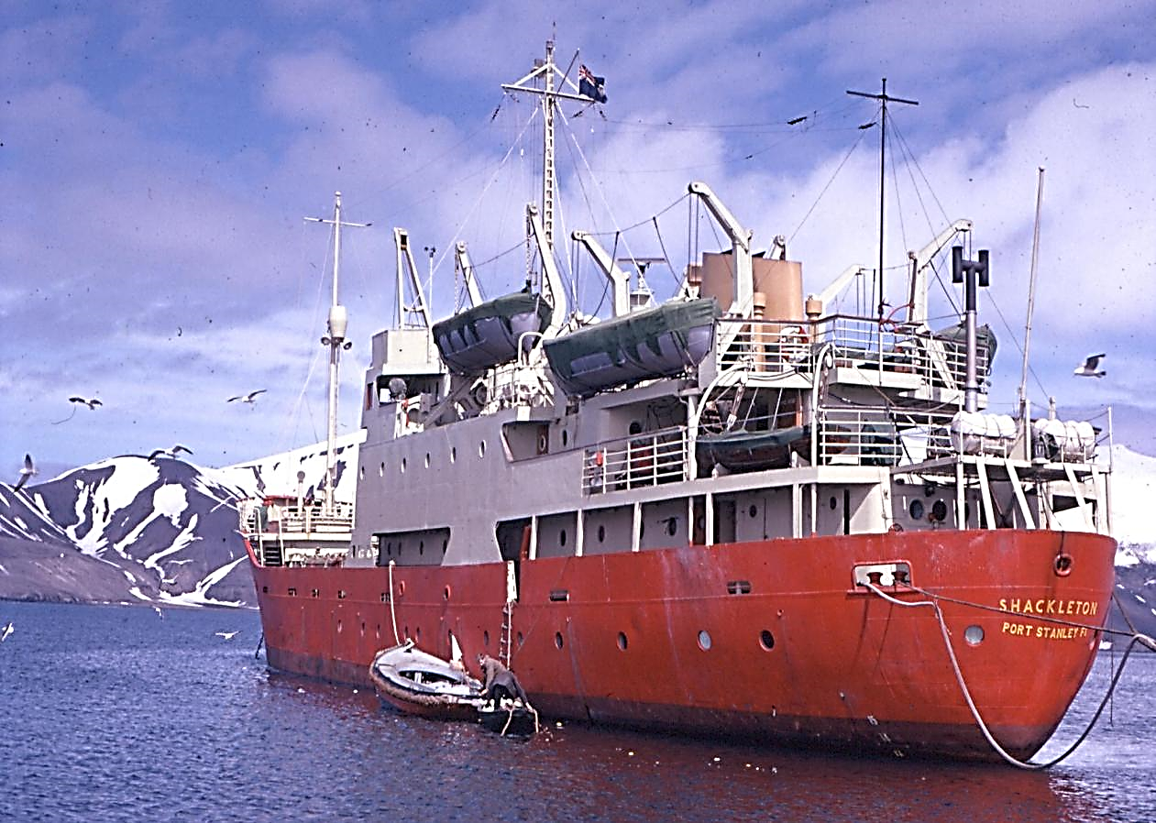
The magnetic stripes evidence
Research ship used to tow magnetometer
© Peter Kennett
Notes:
Vital evidence from 1963. Research ship, used to tow magnetometer

Slide 16
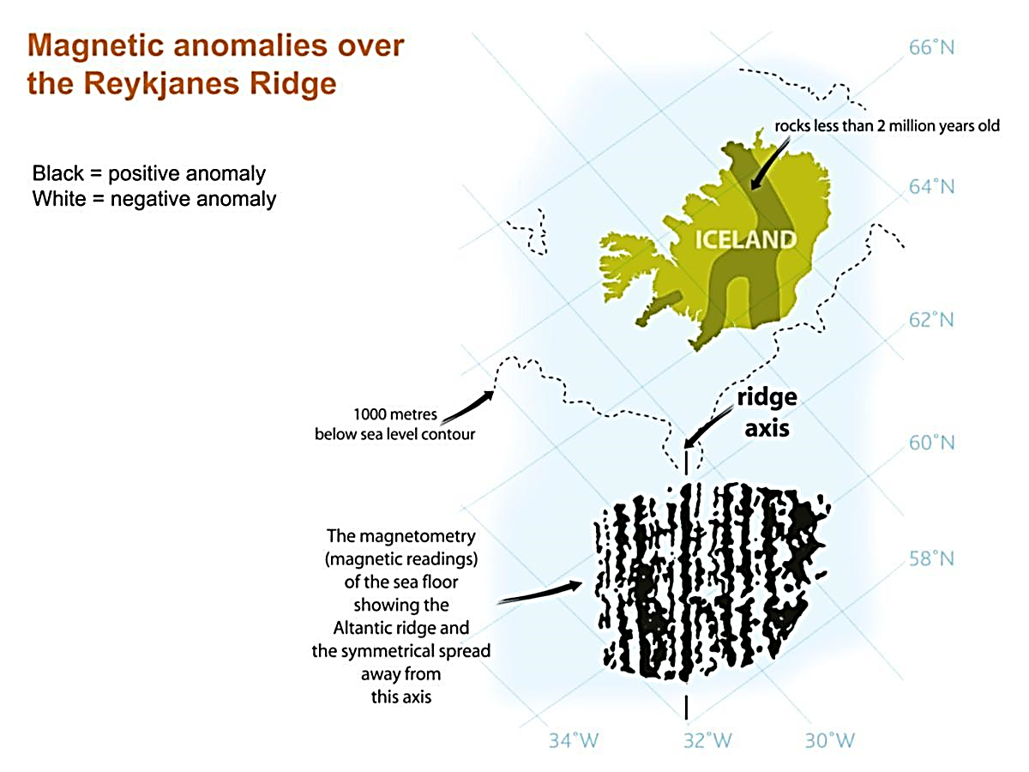
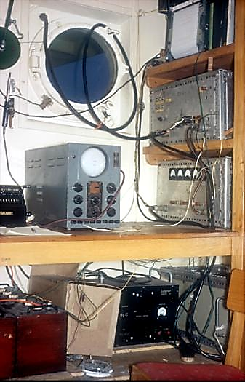
The equipment used to show magnetic anomalies © Peter Kennett
Magnetic anomalies over the Reykjanes Ridge © Geoscience, redrawn by ESEU
Notes:
Magnetometer from 1960. Reykjanes Ridge magnetic anomalies.

Slide 17
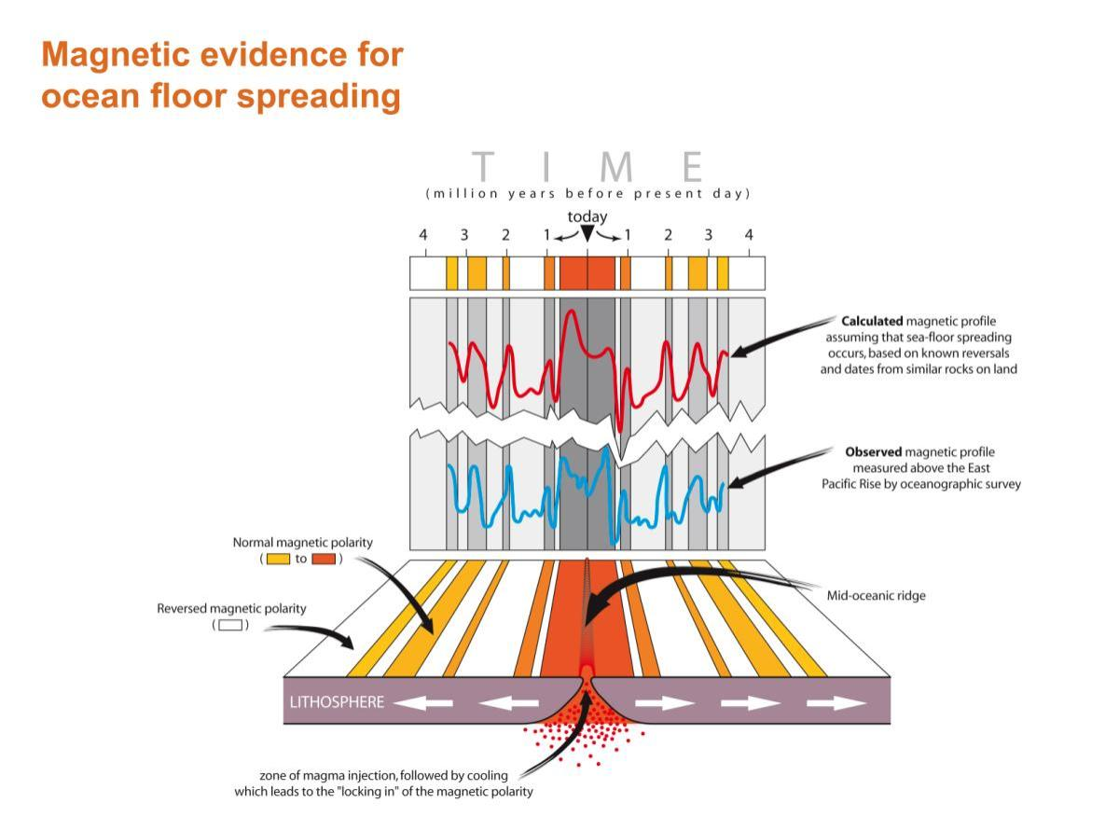
Magnetic evidence for ocean floor spreading © This Dynamic Earth: the Story of Plate Tectonics, USGS, redrawn by ESEU
Notes:
Symmetrical magnetic “stripes” on the ocean floor. The blue line shows a magnetic profile measured above the East Pacific Rise. It is matched to a profile calculated for alternatively normally and reversely magnetised rocks of the ocean floor (red). The model uses known reversals and dates from similar rocks on land e.g. in Iceland.

Slide 18
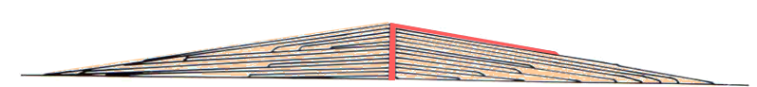
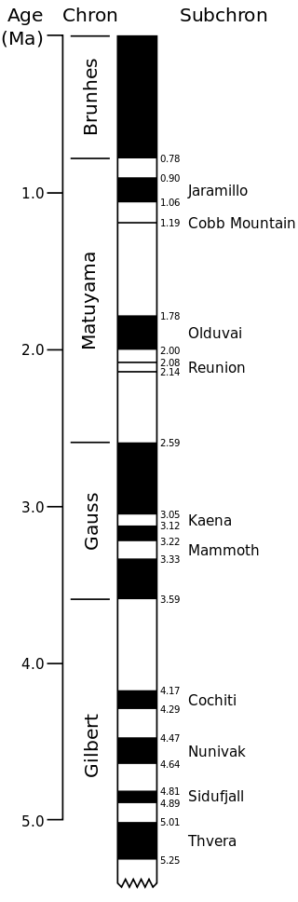
Meanwhile, it had been found from sequences of volcanic lava flows that the Earth’s magnetic field had ‘flipped’ many times in the geological past
N
Magnetisation preserved in rocks – like the petri dish wax magnetic field – but reversed at intervals because of magnetic pole flips
S
S
N
N
S

Slide 19
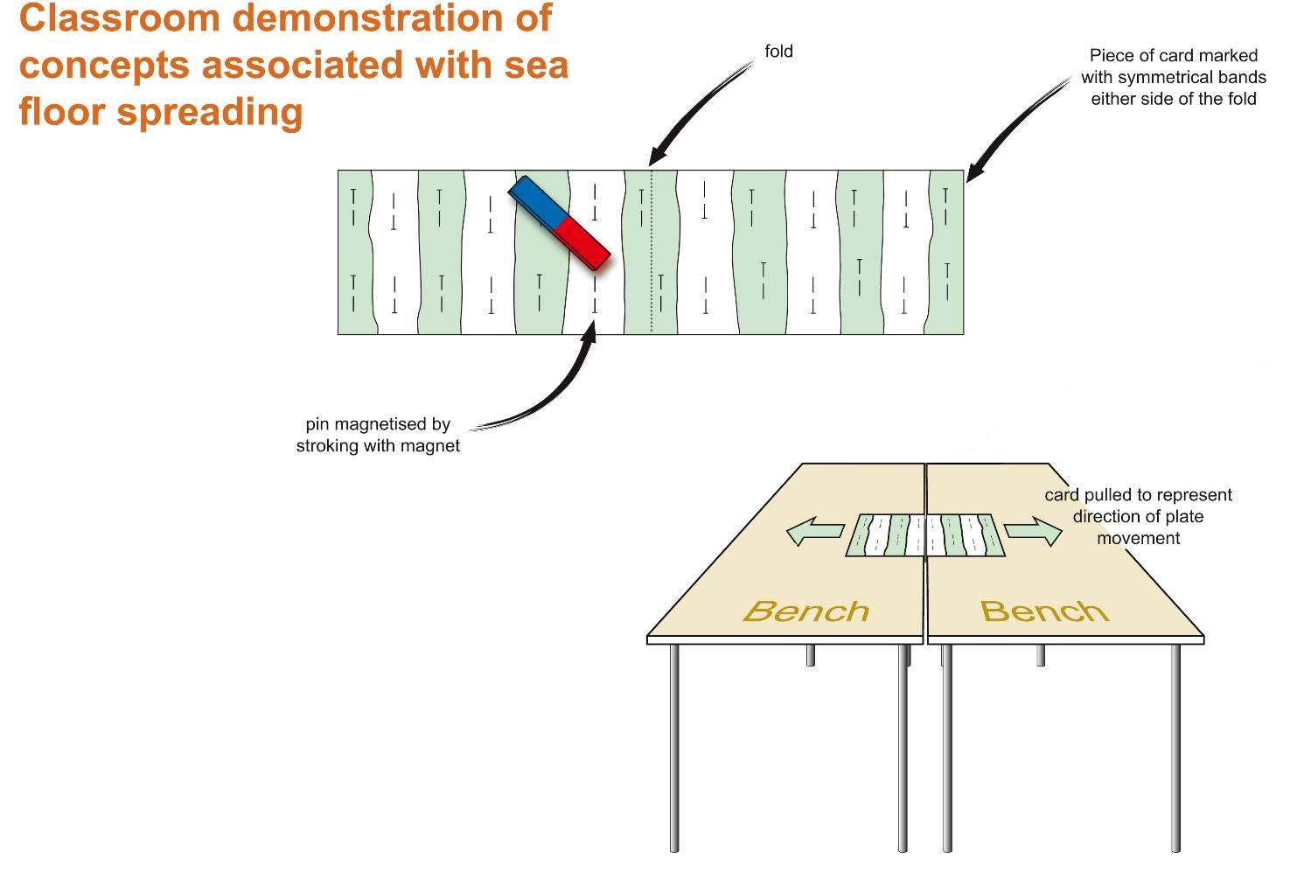
Classroom demonstration of concepts associated with sea floor spreading © ESTA redrawn by ESEU

Slide 20
The equipment used to show magnetic anomalies © Peter Kennett
Magnetic anomalies over the Reykjanes Ridge © Geoscience, redrawn by ESEU
Notes:
Magnetometer from 1960. Reykjanes Ridge magnetic anomalies.

Slide 21
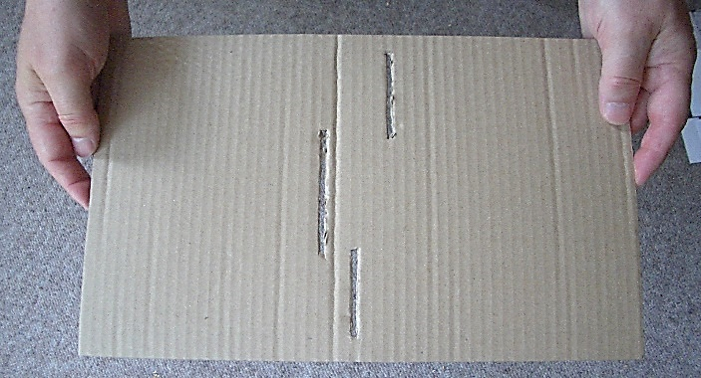
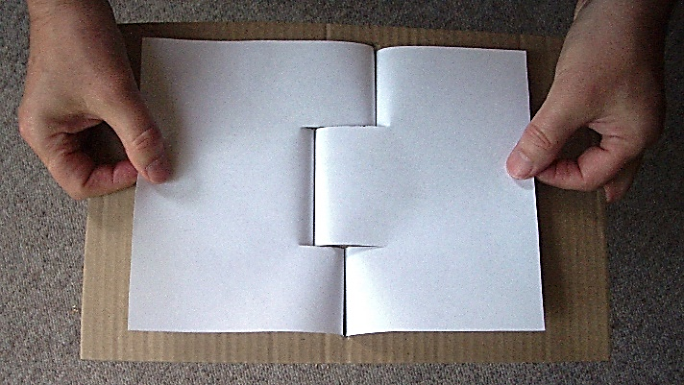
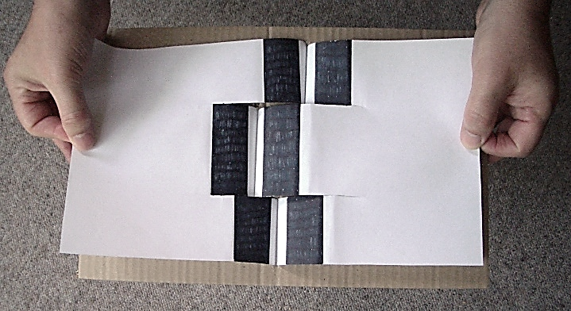
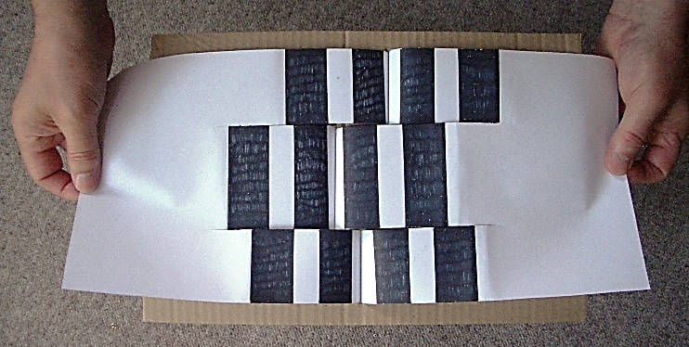
The magnetic stripes are offset by transform faults – conservative or sliding plate margins

Slide 22
Teaching Earthlearningideas
The plate tectonic story
Convergent margins
Go to: https://www.earthlearningidea.com/Video/V31_Convergent_margins.html hyperlink

Slide 23
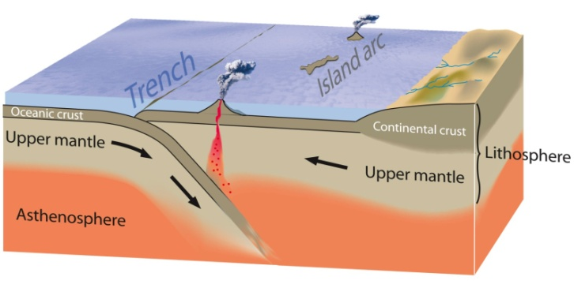
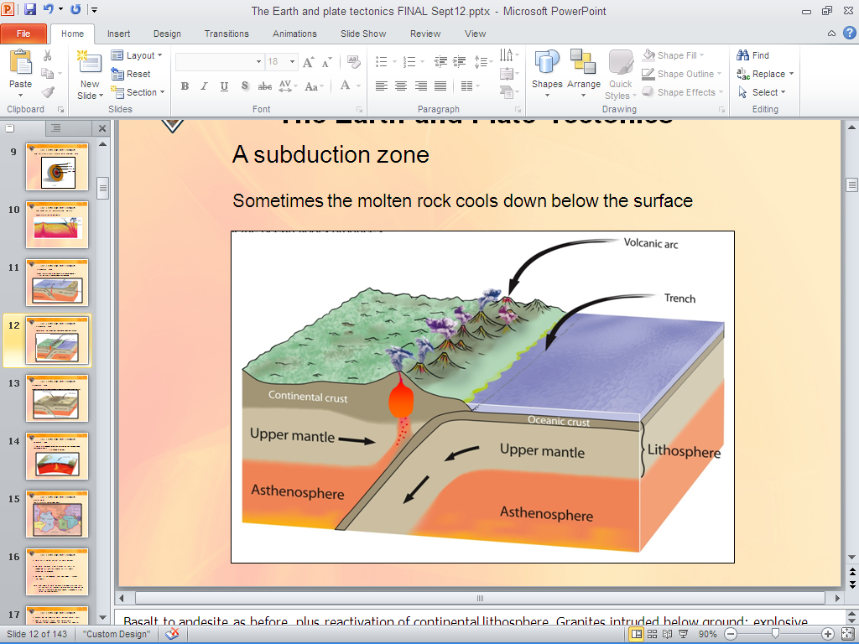
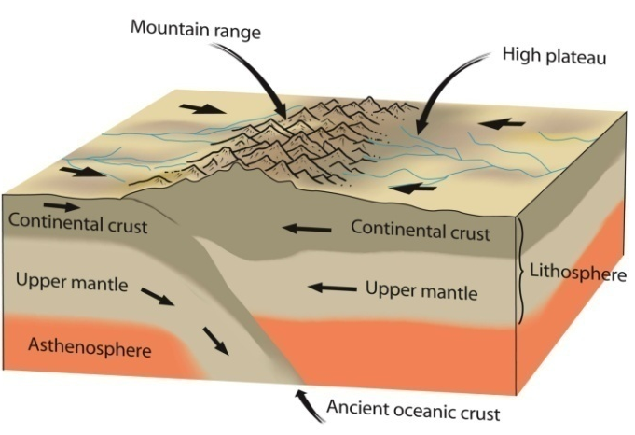
The Earth and plate tectonics
Convergent plate margins - recycling material
Continental plate collision zone. Reproduced with kind permission of USGS, redrawn by ESEU
Subduction zone (‘partially melts and volcanoes are produced’ ‘molten rock cools down below the surface’) - reproduced with kind permission of USGS, redrawn by ESEU
Continental plate collision zone. Reproduced with kind permission of USGS, redrawn by ESEU

Slide 24
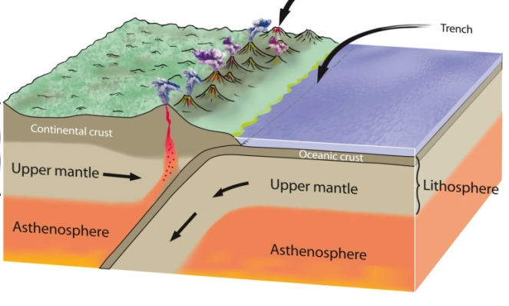
The Earth and plate tectonics
Convergent plate margins - recycling material
Ocean v ocean
convergent plate margin
– one oceanic plate subducted beneath another
Ocean v continent convergent plate margin – an oceanic plate subducted beneath a continental plate
Continent v continent convergent plate margin – two continental plates colliding

Slide 25

The Earth and plate tectonics
Ocean-ocean convergence
Continental plate collision zone. Reproduced with kind permission of USGS, redrawn by ESEU
Notes:
Denser plate goes down: Partial melting of basalt to give andesite

Slide 26
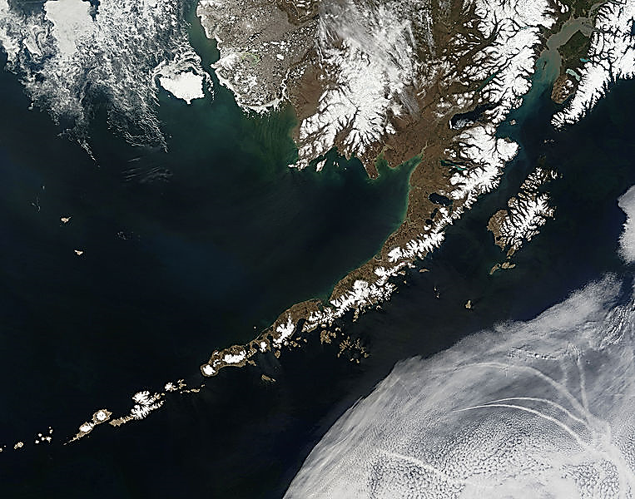
The Earth and plate tectonics
Convergent plate margins:
where plate material is recycled
‘A satellite view of the Aleutian Islands, Pacific Ocean’ by NASA (public domain)

Slide 27
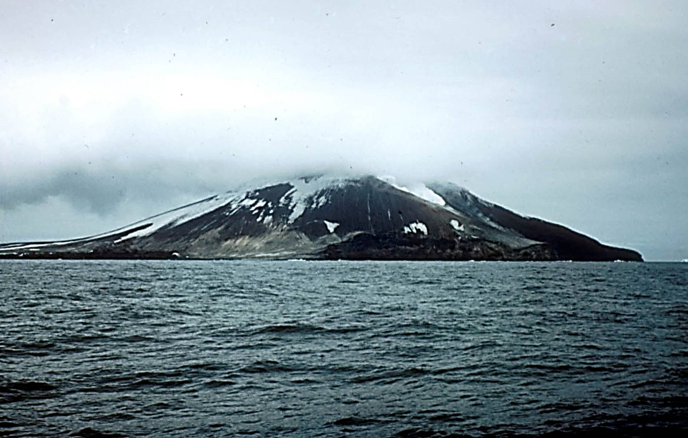
The Earth and plate tectonics
Island arc volcanism
Zavodovski Island, South Sandwich Island, South Atlantic (Peter Kennett)
Notes:
Zavadovski Island – South Sandwich Islands (Southern Atlantic). Home to 1 million Chinstrap penguins. Andesitic lava and ash.

Slide 28

The Earth and plate tectonics
Ocean-continent convergence
Subduction zone (‘partially melts and volcanoes are produced’ ‘molten rock cools down below the surface’)
- reproduced with kind permission of USGS, redrawn by ESEU

Slide 29
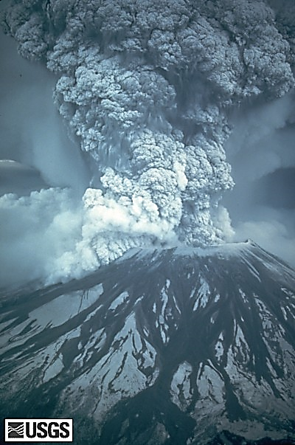
The Earth and plate tectonics
Ocean-continent convergence: Mount St Helens
Mount St Helens © USGS/Cascades Volcano Observatory
Notes:
Bang!

Slide 30

The Earth and plate tectonics
Continent-continent convergence
Continental plate collision zone. Reproduced with kind permission of USGS, redrawn by ESEU
Notes:
Plate collision until it locks. India to Asia, now going at 5 mm per year.

Slide 31
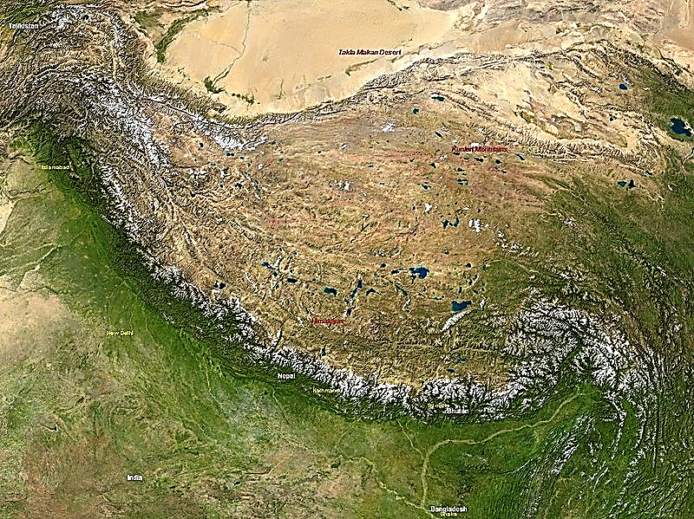
The Earth and plate tectonics
Plates in motion – cardboard replica
A working model of how colliding continents
produce mountain chains – like this one
‘The Tibetan Plateau, Himalayas’ by NASA – image in the public domain ‘The Tibetan Plateau, Himalayas’ by NASA (public domain)

Slide 32
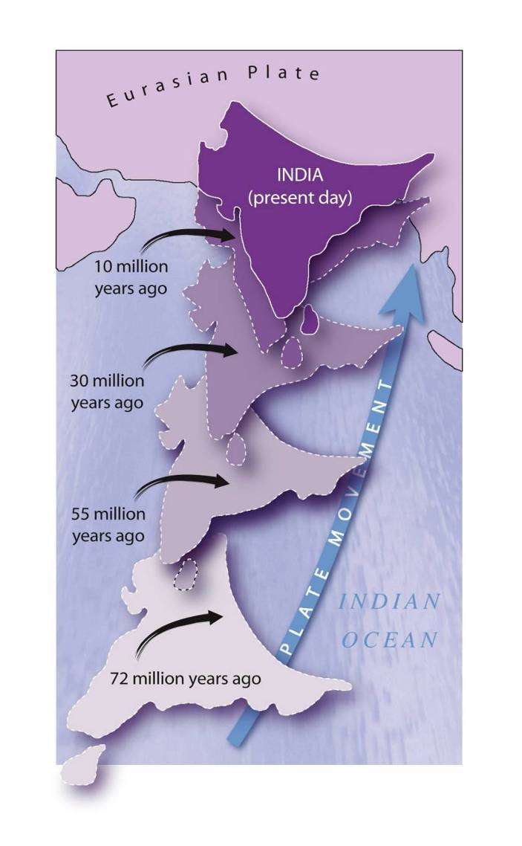
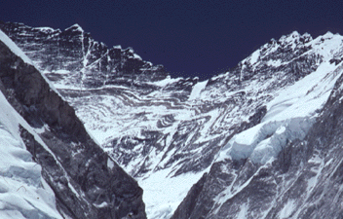
The Earth and plate tectonics
Continent-continent convergence
The rapid northward drift of the Indian plate (at 15-40cm per year) produced the Himalayas and Tibetan Plateau when it collided with the Eurasian plate.
Folds at Lhotse (Himalayas) by Michael Searle © University of Oxford
Eurasian Plate (India's movement) © This Dynamic Earth: the Story of Plate Tectonics, USGS, redrawn by ESEU
Notes:
Folds at Lhotse (Himalayas); India moving at 15-40cm per year.

Slide 33
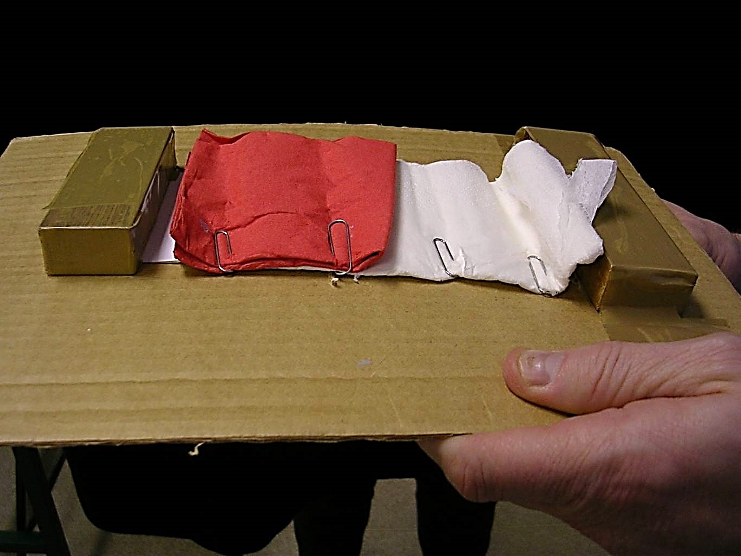
The Earth and plate tectonics
Plates in motion:
cardboard replica plates in motion
Cardboard replica of plates in motion (photograph) © ESEU
Notes:
33

Slide 34
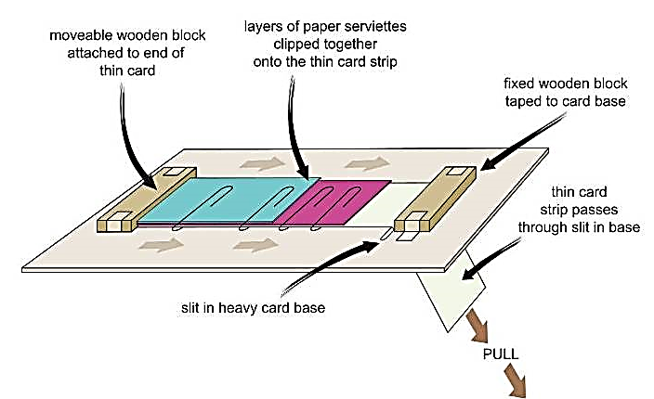
The Earth and plate tectonics
Plates in motion:
cardboard replica plates in motion
Cardboard replica of plates in motion (diagram) © ESTA, redrawn by ESEU
Notes:
34

Slide 35
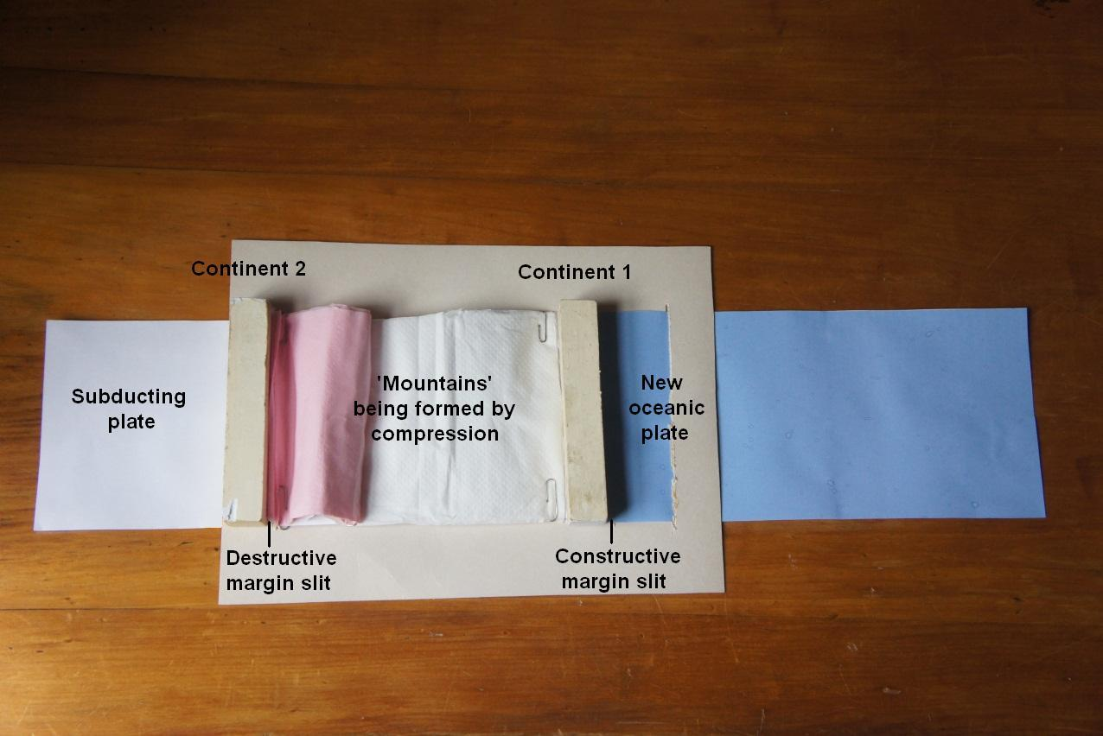
The Earth and plate tectonics
Plates in motion:
cardboard replica plates in motion
Photograph of plates in motion © Chris King
Notes:
35

Slide 36
Teaching Earthlearningideas
The plate tectonic story
Deformation
Go to: https://www.earthlearningidea.com/Video/V31_Deformation2.html hyperlink

Slide 37
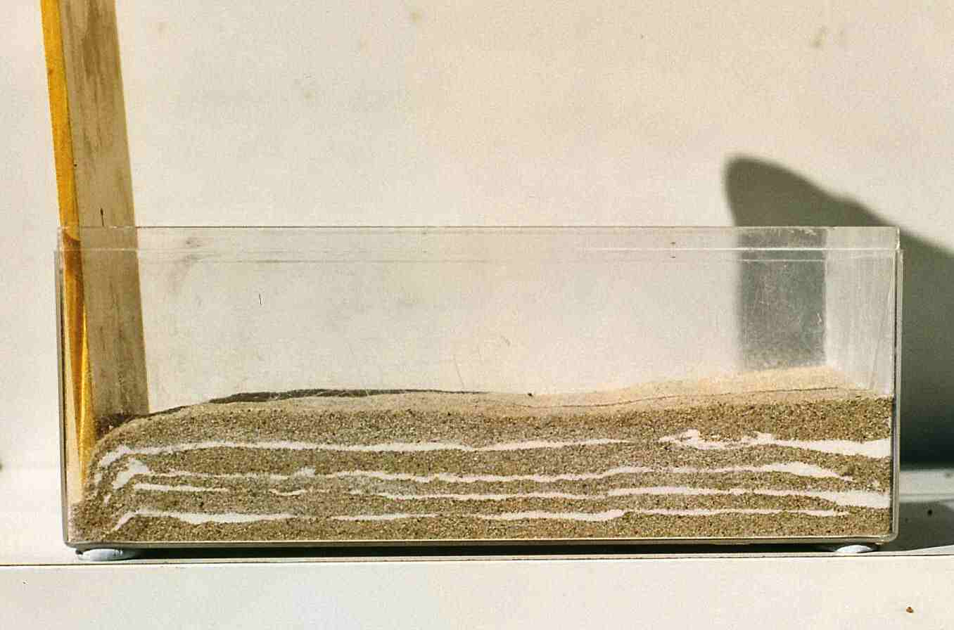
The Earth and plate tectonics
Deformation – make your own folds and faults
The Himalayas in 30s…

Slide 38
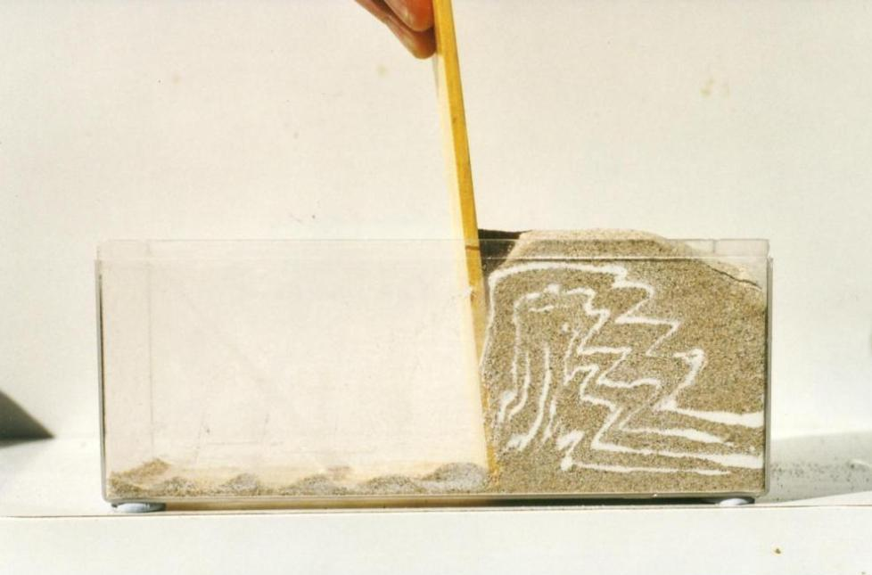
The Earth and plate tectonics
Deformation – make your own folds and faults
The Himalayas in 30s

Slide 39

The Earth and plate tectonics
Deformation – make your own folds and faults
The Himalayas in 30s

Slide 40
Teaching Earthlearningideas
The plate tectonic story
Continental jigsaw puzzles
Go to: https://www.earthlearningidea.com/Video/V32_Jigsaw_puzzles.html hyperlink

Slide 41
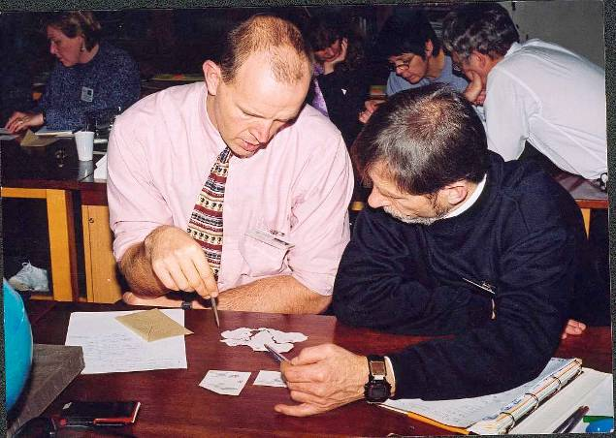
The Earth and plate tectonics
Continental jigsaw puzzles - the ‘matching’ evidence
Debating the reconstruction of the supercontinent of ‘Gondwana’ © Peter Kennett

Slide 42
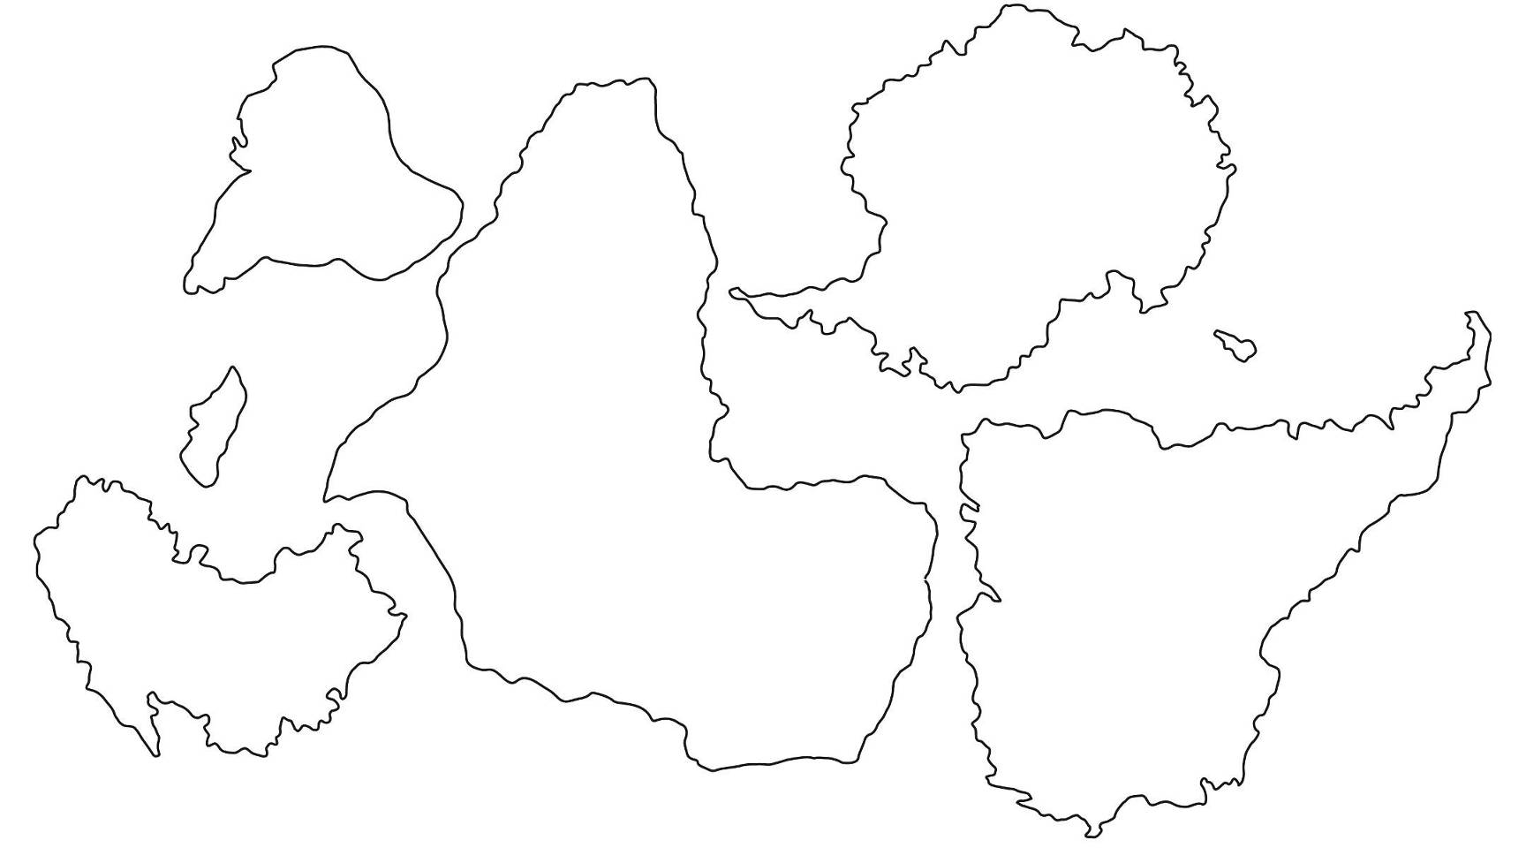
The Earth and plate tectonics
The continental jigsaw puzzles (the outlines of the Gondwana continents)
The continental jigsaw puzzle (the outlines of the Gondwana continents) © Author/origin unknown – redraw by Peter Kennett
Notes:
Jigsaw puzzles - overlap occurs where features have grown in geologically recent times

Slide 43
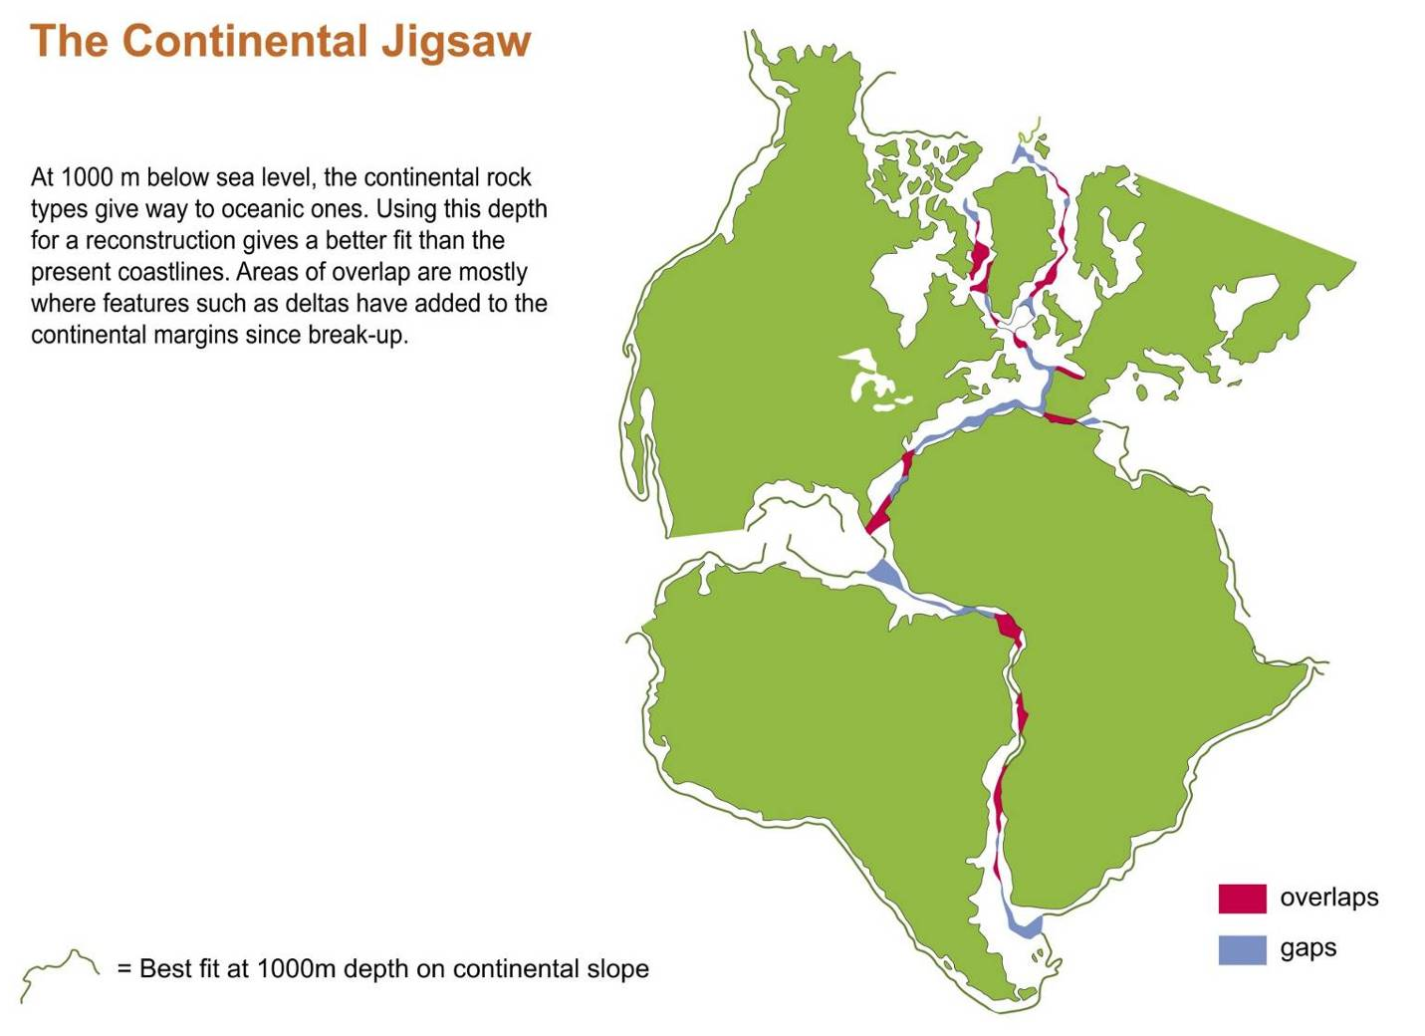
The Earth and plate tectonics
The continental jigsaw puzzles (continental shelf match at 1000m depth below sea level)
The continental jigsaw puzzle, continental shelf (best fit at 1000m) © Andrew McLeish in ‘Geological Science’
Notes:
43
Jigsaw puzzles – overlap occurs where features have grown in geologically recent times

Slide 44
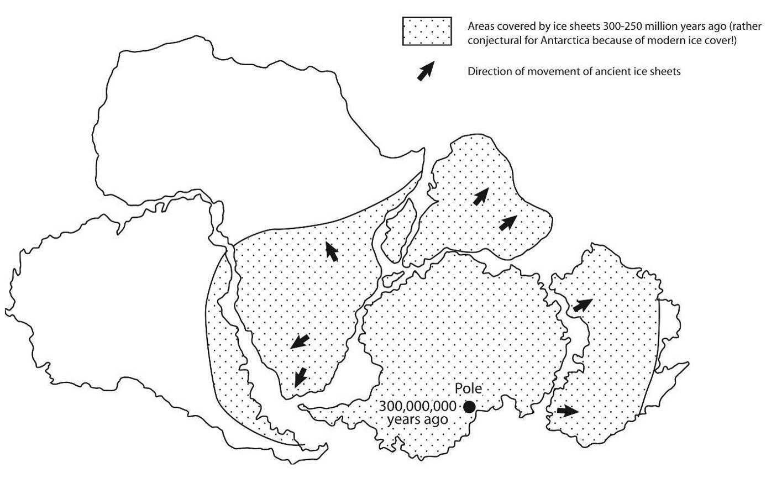
The Earth and plate tectonics
The continental jigsaw puzzles (former distribution of ice across the Gondwana continents)
The continental jigsaw puzzles (former distribution of ice across the Gondwana continents) © Andrew McLeish in ‘Geological Science’
Notes:
44

Slide 45
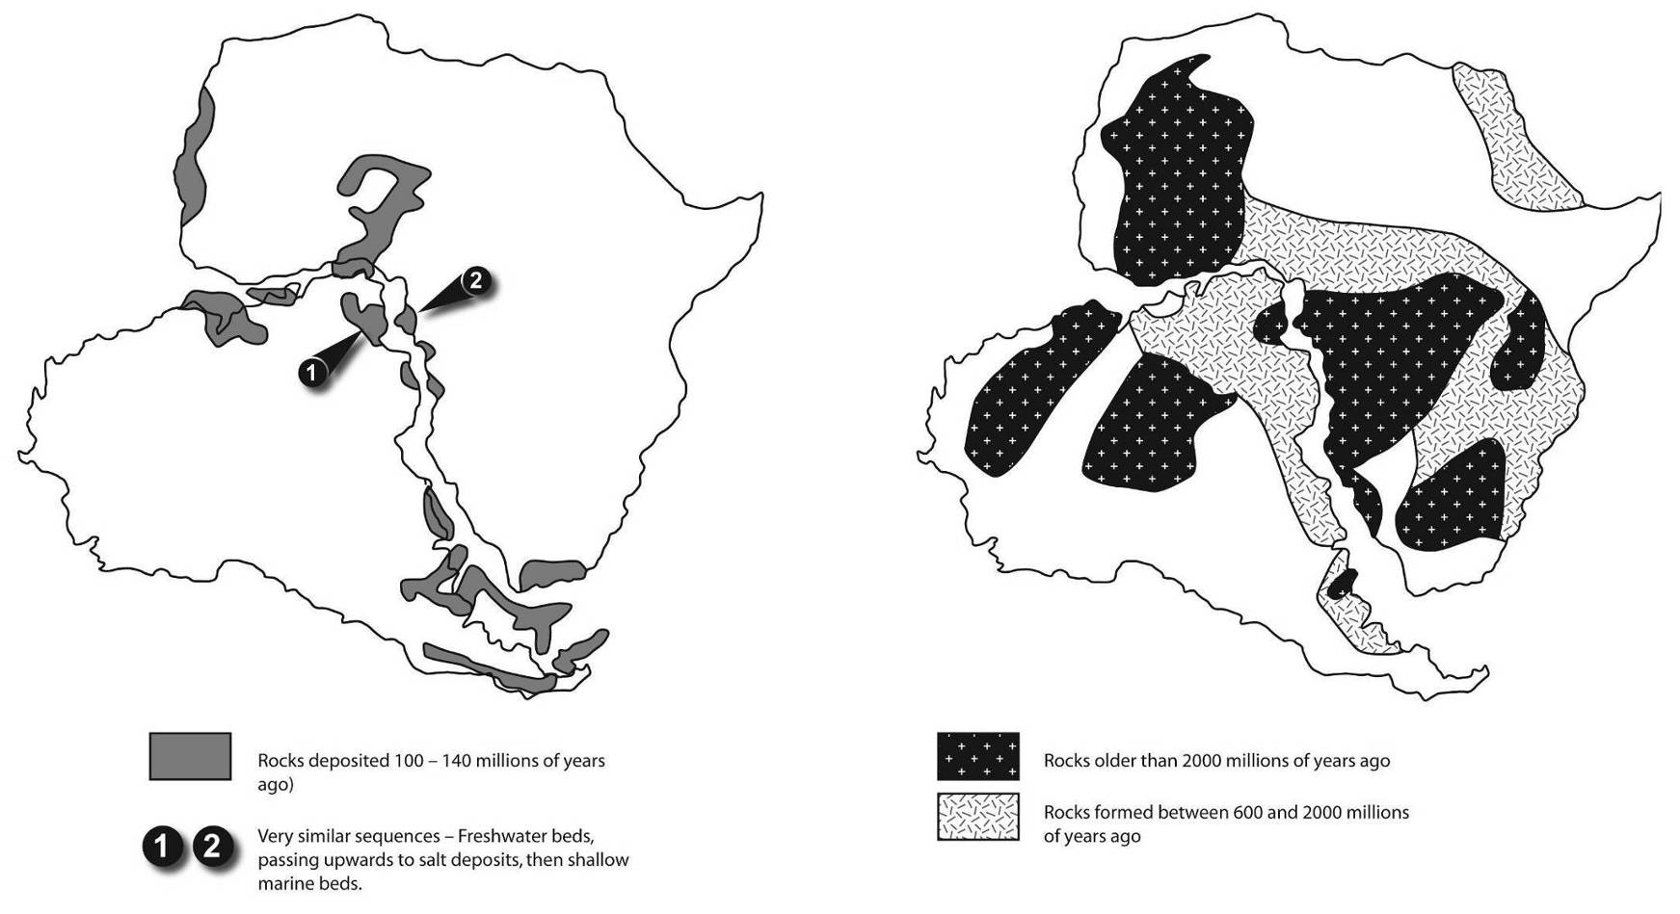
The Earth and plate tectonics
The continental jigsaw puzzles (matching ancient rock distributions)
The distribution of ancient rocks across South America and Africa
© Andrew McLeish in ‘Geological Science’
The distribution of younger rocks across South America and Africa up to the beginning of the continental split. Source unknown, redrawn by ESEU
Notes:
45

Slide 46
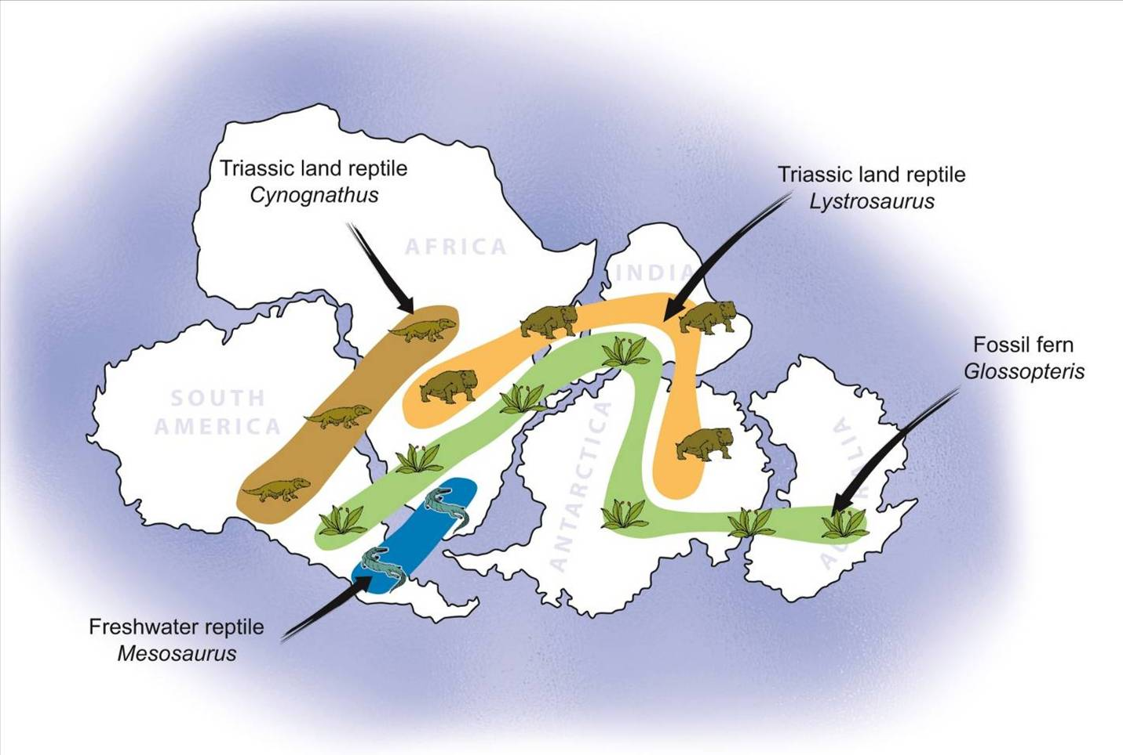
The Earth and plate tectonics
The continental jigsaw puzzles (distribution of land/freshwater animals and plants in the continents of ‘Gondwana’)
The continental jigsaw puzzles fossil distribution evidence, reproduced with kind permission of USGS

Slide 47
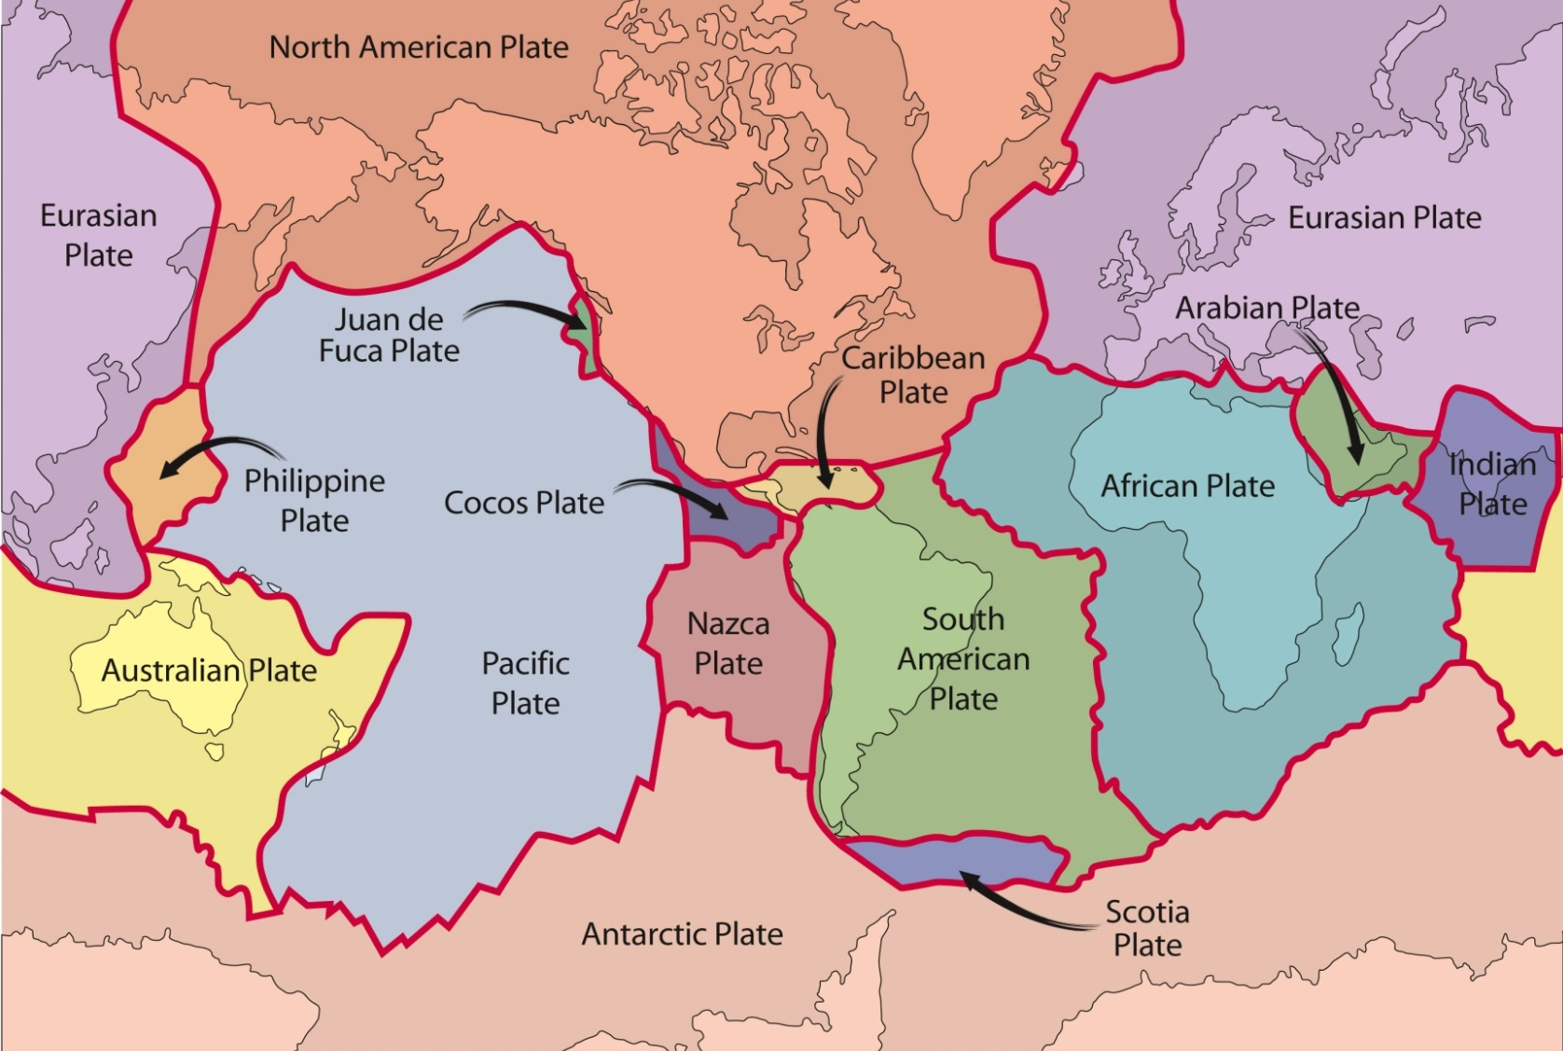
The Earth and plate tectonics
Map of plates and continental distributions today
Map of plates © This Dynamic Earth: the Story of Plate Tectonics, USGS, redrawn by ESEU
Notes:
Start by assuming some knowledge of theory – this map is the end product.

Slide 48
Teaching Earthlearningideas
Brickquake
Go to: https://www.earthlearningidea.com/Video/V33_Brickquake.html hyperlink

Slide 49
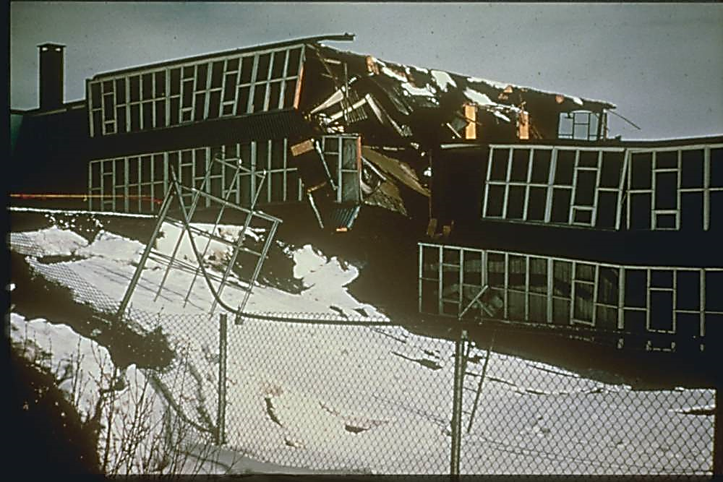
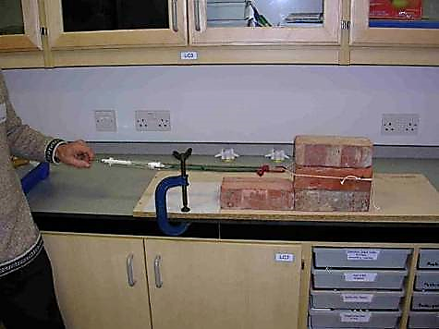
The Earth and plate tectonics
Brickquake – can earthquakes be predicted?
How earthquakes work –
and how difficult they are to predict
Ground deformation after an earthquake © National Geophysical Data Center (NGDC)
Brickquake (ESEU)

Slide 50
The Earth and plate tectonics
Brickquake – can earthquakes be predicted?
How earthquakes work –
and how difficult they are to predict
Brickquake (ESEU)

Slide 51
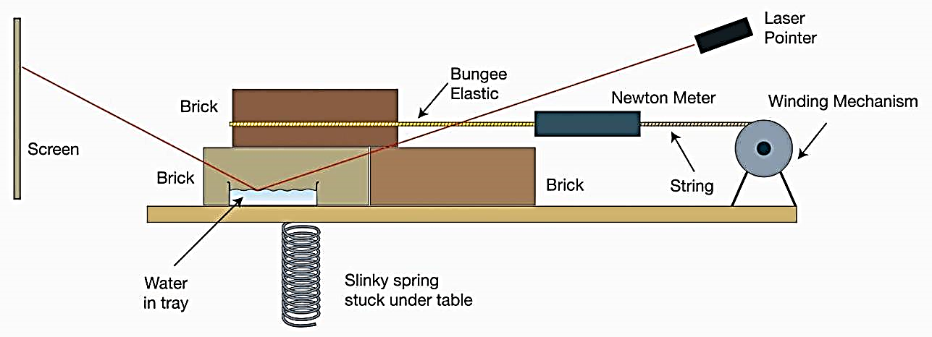
The Earth and plate tectonics
Brickquake – can earthquakes be predicted?
How earthquakes work –
and how difficult they are to predict
Brickquake – can earthquakes be predicted (diagram) © ESEU

Slide 52
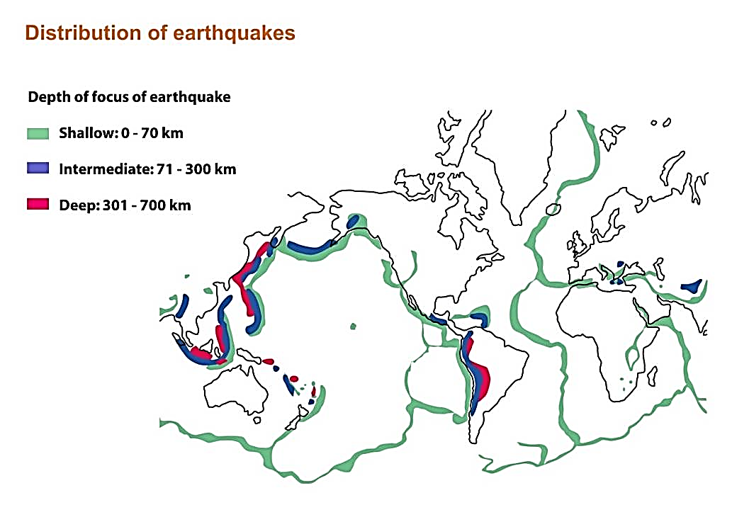
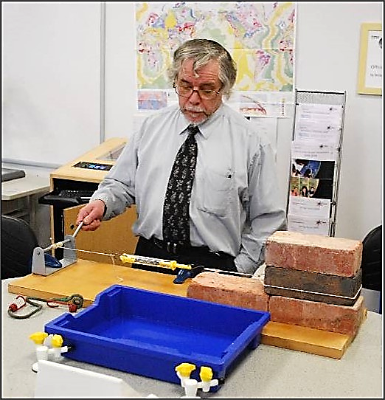
The Earth and plate tectonics
‘Brickquake’ – can earthquakes be predicted?
Distribution of earthquakes – source unknown, redrawn by ESEU
‘Brickquake’ results
Distance moved (cm) | Force (Newtons) | Relative energy released
2 | 15 | 30
7.5 | 45 | 337.5
3.5 | 35 | 122.5
4 | 25 | 100
Brickquake (ESEU)

Slide 53
Teaching Earthlearningideas
Party popper eruption
Go to: https://www.earthlearningidea.com/Video/V34_Party_poppers.html hyperlink

Slide 54
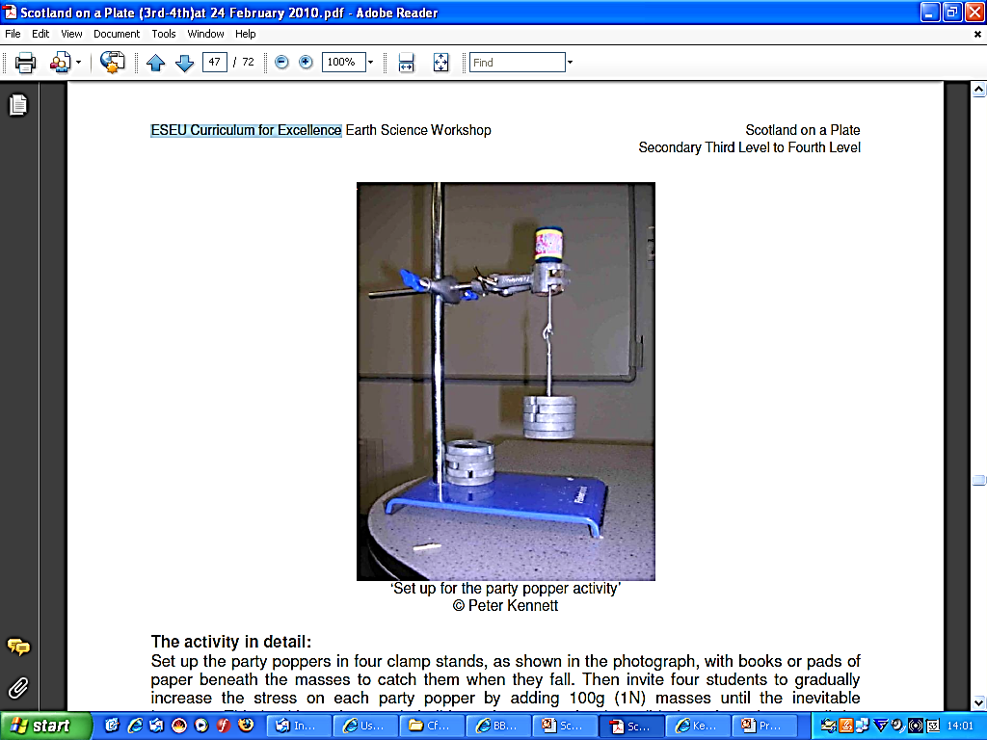
The Earth and plate tectonics
How predictable are volcanic eruptions? – party popper simulation
Set-up for the party popper activity © Peter Kennett, ESEU

Slide 55

The Earth and plate tectonics
How predictable are volcanic eruptions? – party popper simulation – the result of 156 attempts
© David Bailey, British Geological Survey

Slide 56

The Earth and plate tectonics
How predictable are volcanic eruptions? – party popper simulation
Party popper eruption ‘chance’ cards
Volcano alert ‘Chance cards’ © David Turner

Slide 57
Teaching Earthlearningideas
The plate tectonic story
Plate plenary
Go to: https://www.earthlearningidea.com/Video/V35_Plate_plenary.html hyperlink

Slide 58

The Earth and plate tectonics
What am I doing?
Published by Jim Henderson under the Creative Commons CC0 1.0 Universal Public Domain Dedication as File:30th St hiline balancing on rails jeh.jpg

Slide 59


The Earth and plate tectonics
Plate-riding
‘Surfer’ by United States Marine Corps (public domain)
Image of the Earth © Noldoaran

Slide 60
The Earth and plate tectonics
Plate-riding
‘How fast am I going?’
‘What is happening in front of me?’
‘In which direction am I travelling?’
‘How can I tell I’m moving?’
‘What is happening behind me?’
‘Surfer’ by United States Marine Corps (public domain)
Image of the Earth © Noldoaran

Slide 61
The Earth and plate tectonics
Plate-riding
‘How fast am I going?’
(as fast as our fingernails grow)
‘What is happening in front of me?’
(I’m heading towards the Japanese subduction zone, with its earthquakes, volcanoes and mountains
‘In which direction am I travelling?’
(towards the East)
‘How can I tell I’m moving?’
(GPS measurements over several years, magnetic stripe evidence, age of the sea floor evidence
‘What is happening behind me?’
(new plate material is being formed, as in Iceland
‘Surfer’ by United States Marine Corps (public domain)
Image of the Earth © Noldoaran

Slide 62







The Earth and plate tectonics
Model the five different types of plate margin with your hands
Possible answers include:
divergent margin
ocean v ocean
ocean v continent
continent v continent
conservative (transform)

Slide 63
The Earth and plate tectonics
Workshop outcomes
The workshop and its activities provide the following outcomes:
an introduction to plate tectonics;
distinction between the ‘facts’ of plate tectonics and the evidence used to support plate tectonic theory;
a survey of some of the evidence supporting plate tectonic theory;
an introduction to the evidence for the structure of the Earth and the links between the structure of the outer Earth and plate tectonics;
explanation of some of the hazards caused by plate tectonic processes - earthquakes and eruptions;
methods of teaching the abstract concepts of plate tectonics, using a wide range of teaching approaches, including practical and electronic simulations;
approaches to activities designed to develop the thinking and investigational skills of students;
an integrated overview of the plate tectonic concepts.

Slide 64
The Earth and plate tectonics
Copyright
Making a ‘brickquake’ x 3 © ESEU
Marking the points and direction of magnetism using cocktail sticks © ESEU
Set-up for the party popper activity © Peter Kennett, ESEU
Classroom demonstration of concepts associated with sea floor spreading © ESTA redrawn by ESEU
Oceanic ridge © ESTA, redrawn by ESEU
Continental plate collision zone. Reproduced with the kind permission of the USGS. Redrawn by ESEU
The Internal structure of the Earth - reproduced with kind permission of USGS, redrawn by ESEU
The upper part of the mantle and the crust © Chris King and Dee Edwards, redrawn by ESEU
Subduction zone (‘partially melts and volcanoes are produced’ ‘molten rock cools down below the surface’) - reproduced with kind permission of USGS, redrawn by ESEU
Mid ocean ridge © Press & Siever, redrawn by ESEU
Map of plates - reproduced with kind permission of USGS, redrawn by ESEU
Galunggung eruption by USGS – image in the public domain
Photograph, ‘North All Trucks’ © USGS
Battleship grid for Geobattleships © Dave Turner
Distribution of earthquakes - source unknown, redrawn by ESEU
Picture of a plate © Peter Kennett
The Structure of the Earth – from the seismic evidence – reproduced with kind permission of USGS, redrawn by ESEU
Graph of 'Velocities of P and S waves as they travel into the Earth © ESTA, redrawn by ESEU
The Internal structure of the Earth - reproduced with kind permission of USGS, redrawn by ESEU
The lithosphere, asthenosphere and below © ESEU
Ice photographs © Peter Kennett
Student pulling Potty Putty™ © ESEU
Photographs of potty putty™ x 3 © Peter Kennett
Skateboard x 2 © Peter Kennett, ESEU
Theoretical driving mechanisms of plate movement © Pete Loader

Slide 65
The Earth and plate tectonics
Copyright continued…
Slab pull x 2 © David Bailey
Petri-dish magnetic field preserved in iron filings in wax © Michèle Bourne, ESEU
Model magnetic Earth (ESEU)
Magnetic inclination plotted against latitude (graph) © Chris King
Model of the Earth’s magnetic field (drawing) © ESEU
The pattern of heat flow out of the ocean floor and the upper part of the mantle and the crust © Chris King and Dee Edwards, redrawn by ESEU
Underwater basalt lava at a divergent margin in the public domain by Vintei
‘Ancient pillow lava’ by US National Oceanic & Atmospheric Administration – image in the public domain
Photograph of 'The Geological Map of the World’ © Open University
Black Smoker © This Dynamic Earth: the Story of Plate Tectonics, USGS
'Mid-Atlantic Ridge' Map © Hugo Ahlenius, UNEP/GRID-Arendal, http://maps.grida.no/go/graphic/world-ocean-bathymetric-map
Black Smoker’ by US National Oceanic & Atmospheric Administration – image in the public domain
Icelandic-type eruption - reproduced with kind permission of U.S. Department of Interior, USGS
Ancient Pillow lavas © Peter Kennett
Gap between the North American and Eurasian continental plates © Randomskk
Faults in a MarsTM Bar (A rift valley x 2) © Peter Kennett
Research ship used to tow magnetometer © Peter Kennett
Photograph of ‘the equipment used’ to show magnetic anomalies © Peter Kennett
Magnetic anomalies over the Reykjanes Ridge © Geoscience, redrawn by ESEU
Magnetic evidence for ocean floor spreading © This Dynamic Earth: the Story of Plate Tectonics, USGS, redrawn by ESEU
Classroom demonstration of concepts … © ESTA, redrawn by ESEU
convergent Plate Margins – recycling material © US Geological Survey, redrawn by ESEU
‘A satellite view of the Aleutian Islands, Pacific Ocean’ by NASA - image in the public domain
Zavadovski Island © Peter Kennett
Mount St Helens © USGS/Cascades Volcano Observatory

Slide 66
The Earth and plate tectonics
Copyright continued…
‘The Tibetan Plateau, Himalayas’ by NASA – image in the public domain
Continent-continent convergence, India’s movement © This Dynamic Earth: the Story of Plate Tectonics, USGS, redrawn by ESEU
Folds at Lhotse (Himalayas) by Michael Searle © University of Oxford
Eurasian Plate (India's movement) © This Dynamic Earth: the Story of Plate Tectonics, USGS, redrawn by ESEU
Cardboard replica of plates in motion (photograph) © ESEU
Cardboard replica of plates in motion (diagram) © ESTA, redrawn by ESEU
Photographs of plates in motion © Chris King
Fold mountains in a chocolate box (animation and still images) © Peter Kennett
Debating the reconstruction of the super-continent of ‘Gondwanaland’ © Peter Kennett
The Continental jigsaws (the outlines of the Gondwana continents) © Author/origin unknown – redraw by Peter Kennett
The Continental jigsaw, continental shelf (best fit at 1000m) © Andrew McLeish in ‘Geological Science’
The Continental jigsaws (former distribution of ice across the Gondwana continents) © Andrew McLeish in ‘Geological Science’
Distribution of ancient rocks across South America and Africa © Andrew McLeish in ‘Geological Science’
Distribution of younger rocks across South America and Africa - source unknown, redrawn by ESEU
Distribution of land/freshwater animals and plants in the continents of ‘Gondwanaland’ - reproduced with kind permission of USGS
Map of Plates © This Dynamic Earth: the Story of Plate Tectonics, USGS, redrawn by ESEU
The Geological Map of the World © Open University
Ground deformation after an earthquake © National Geophysical Data Center (NGDC)
Brickquake – can earthquakes be predicted (diagram) © ESEU
Party popper picture © Peter Kennett
Party popper graph © David Bailey
Chance cards’ © David Turner
‘What am I doing’ (30th St hiline balancing on rails) by Jim Henderson © public domain
‘Surfer’ by United States Marine Corps – image in the public domain / Image of the Earth © Noldoaran

Slide 67
The Earth and plate tectonics – online
Earth Science for science and geography
– video workshop
Developed from the Earth Science Education Unit ‘The Earth and plate tectonics’ workshop, with permission
© Copyright is waived for original material contained in this workshop if it is required for use within the laboratory or classroom. Copyright material contained herein from other publishers rests with them. Any organisation wishing to use this material should contact the Earthlearningidea team.

