Slide 1
The Earth and plate tectonics – online
Part 1
Earth Science for science and geography
– video workshop
Developed from the Earth Science Education Unit ‘The Earth and plate tectonics’ workshop, with permission
© Copyright is waived for original material contained in this workshop if it is required for use within the laboratory or classroom. Copyright material contained herein from other publishers rests with them. Any organisation wishing to use this material should contact the Earthlearningidea team.

Slide 2
Earthlearningidea online video workshops
Purpose – ESEU background
Most Earthlearningidea online video workshops are based, with permission, on workshops originally developed by the Earth Science Education Unit (ESEU)
These were designed as interactive workshops for teachers and trainees, involving interaction, discussion and presentations by participants to others
Global research into professional development workshops shows that these aspects are critical to success
ESEU research shows that this workshop approach is highly successful in changing teaching in schools; evaluation feedback has also been very strong

Slide 3
Earthlearningidea online video workshops
Purpose – Earthlearningidea development
The Earthlearningidea Team has developed the ESEU workshops into online video workshops for those unable to take part in face to face interactive workshops
Each workshop is led by a PowerPoint presentation and has an accompanying booklet that contains all the activity background details, resource lists, risk assessments, etc.
The individual workshop activities have been published for open access online at the website: https://www.earthlearningidea.com/
Each workshop activity has a question script and a video keyed into CASE principles, that can be accessed through the PowerPoint hyperlinks
The aim is to facilitate online Earth science learning

Slide 4
Earthlearningidea online video workshops
Teaching Earth science using the Cognitive Acceleration through Science (CASE) approach
The activities in this workshop are keyed into the CASE approach – to develop thinking skills while teaching key Earth science material
If you are unfamiliar with the case approach, you can access a video introduction at: https://www.earthlearningidea.com/Video/CASE.html
An exemplar Earth science teaching activity with a question script using the CASE approach is at: https://www.earthlearningidea.com/Video/Atmosphere_ocean.html

Slide 5
Earthlearningidea online video workshops
Running Earthlearningidea online video workshops
Each workshop is led by a PowerPoint presentation
Launch the PowerPoint
Some slides contain hyperlinks to MP4 video files
Run the hyperlinked files and then return to the PowerPoint, flick through any slides you have already seen, and continue
The workshop is presented in this way so that the workshop itself, or individual videos, can be used in classroom teaching

Slide 6
The Earth and plate tectonics
Workshop video run times |  | m | s | m | s
The Earth and plate tectonics, part 1 |  |  |  | 57 | 45
From clay balls to the structure of the Earth |  |  |  | 10 | 01
From, an orange to the whole Earth |  |  |  | 2 | 30
Earthquakes – the slinky simulation |  |  |  | 3 | 37
Wave motion – the pupil molecules |  |  |  | 3 | 07
Big picture, ‘facts’ earthquakes and plates | Big picture and ‘facts’ | 2 | 56 | 6 | 47
 | Earthquake volcano earthquake evidence | 3 | 06
 | China plate summary | 0 | 45
Seismic evidence and potty putty mantle | Seismic evidence | 3 | 18 | 8 | 43
 | Solids that flow | 4 | 19
 | Skateboard summary | 1 | 06
What drives the plates? |  |  |  | 4 | 27
The wax magnetic field and magnetic Earth | Frozen magnetism | 2 | 08 | 13 | 18
 | Magnetic Earth | 6 | 30
 | Sponge ball | 4 | 40
Heat flow, age of ocean floor and plate speed | Heat flow evidence | 2 | 17 | 5 | 15
 | Age of ocean floor | 2 | 58
The Earth and plate tectonics, part 2 |  |  |  | 37 | 56
Divergent margins | Divergent margins | 2 | 03 | 4 | 32
 | Faults in a Mars Bar | 2 | 29
Magnetic stripes |  |  |  | 5 | 21
Convergent margins | Convergent margins | 3 | 42 | 8 | 06
 | Deformation | 4 | 24
Continental jigsaw puzzles |  |  |  | 4 | 40
Brickquake |  |  |  | 4 | 59
Party popper eruption |  |  |  | 6 | 29
Plate plenary |  |  |  | 3 | 49
The Earth and plate tectonics – both parts together |  |  |  | 95 | 41

Slide 7
The Earth and plate tectonics
Earth science for geography and science
The workshop is based on this pdf booklet originally prepared by the Earth Science Education Unit and now available on the Earthlearningidea website. It contains a workshop summary, the outcomes, teacher guidance, risk assessments and resources lists – as in the following slides

Slide 8
The Earth and plate tectonics
Summary
‘The Earth and Plate Tectonics’ workshop gets to grips with the wide-ranging evidence for the theory that underpins our detailed modern understanding of our dynamic planet – the theory of Plate Tectonics. The workshop begins with an introduction and progresses through a series of activities that are designed to help students develop their understanding. It uses several independent sources of evidence supporting the theory, including using rock and fossil evidence, seismic records, geothermal patterns, geomagnetism, and large-scale topographical features, both above and below sea-level. The workshop concludes by investigating some of the Earth hazards linked to plate tectonics, and how we can reduce loss of life.

Slide 9
Workshop outcomes
The workshop and its activities provide the following outcomes:
an introduction to plate tectonics;
distinction between the ‘facts’ of plate tectonics and the evidence used to support plate tectonic theory;
a survey of some of the evidence supporting plate tectonic theory;
an introduction to the evidence for the structure of the Earth and the links between the structure of the outer Earth and plate tectonics;
explanation of some of the hazards caused by plate tectonic processes - earthquakes and eruptions;
methods of teaching the abstract concepts of plate tectonics, using a wide range of teaching approaches, including practical and electronic simulations;
approaches to activities designed to develop the thinking and investigational skills of students;
an integrated overview of the plate tectonic concepts.

Slide 10
Think through the processes using this wide range of activities:
Note: practical activities needing apparatus/materials are shown with a *
Frozen magnetism*
Magnetic Earth*
Magnetic Earth using a sponge ball globe*
The heat flow evidence
The age of ocean floor and plate speed
The Earth and plate tectonics, part 2
Divergent plate margins
Faults in a Mars™ Bar*
Magnetic stripes*
Convergent margins*
Continental jigsaw puzzles*
Brickquake*
Party popper eruption*
Plate plenary
The Earth and plate tectonics, part 1
The big picture and the ‘facts’ of plate tectonics
Earthquake and volcano distribution evidence*
China plate summary*
From clay balls to the structure of the Earth*
From an orange to the whole Earth*
Earthquakes – the slinky simulation*
Wave motion – pupil molecules
The seismic evidence
Solids that flow*
Skateboard summary
What drives the plates?

Slide 11
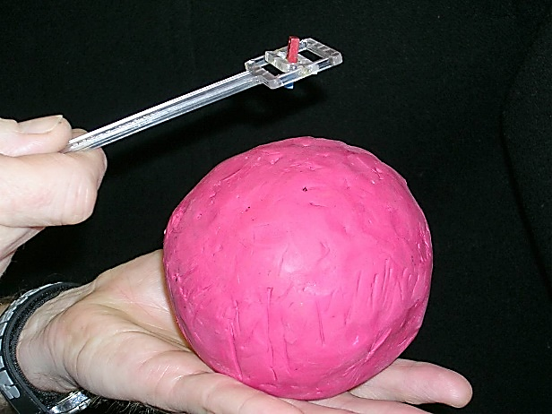
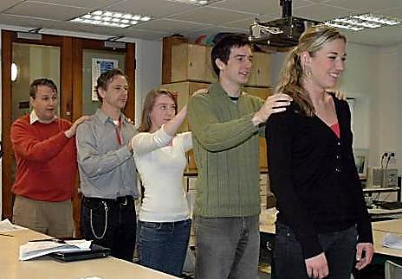
Investigating Earth’s structure
Carry out risk assessments before the following activities:
Wave motion – pupil molecules
Magnetic Earth
Magnetic Earth using a sponge ball globe
Magnetic stripes
‘Brickquake’ – can earthquakes be predicted?
How predictable are volcanic eruptions? - party popper simulation
© ESEU
© ESEU
© ESEU

Slide 12
Teaching Earthlearningideas
The plate tectonic story
The big picture and the ‘facts’ of plate tectonics
Go to: https://www.earthlearningidea.com/Video/V21_Big_picture.html hyperlink

Slide 13
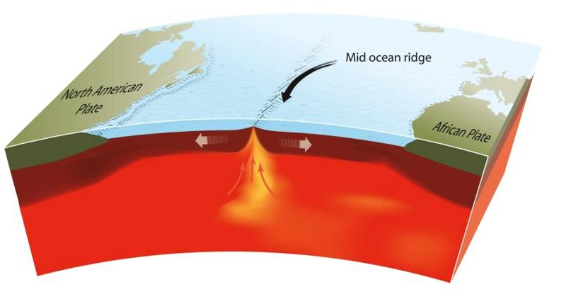
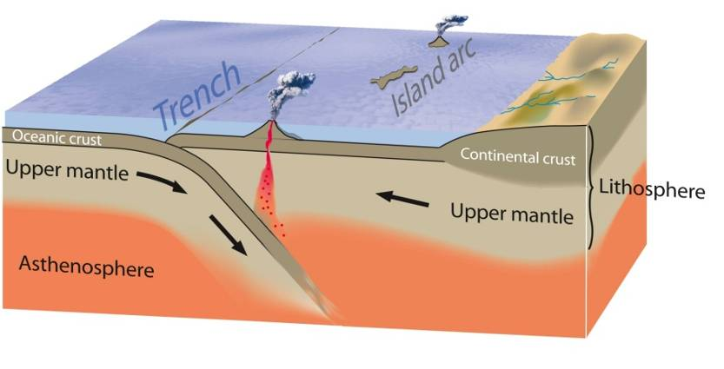
The big picture
and the ‘facts’ of plate tectonics
An oceanic ridge © Press & Siever, redrawn by ESEU
Continental plate collision zone. Reproduced with kind permission of USGS,
redrawn by ESEU

Slide 14
The Earth has a crust, mantle, outer and inner core
Crust
Mantle
Outer core
Inner core
The Internal structure of the Earth - reproduced with kind permission of USGS, redrawn by ESEU

Slide 15
The upper part of the mantle and the crust look like this
Over geological time the mantle can flow
Diverging plates
Converging plates
Mantle
The upper part of the mantle and the crust © Chris King and Dee Edwards, redrawn by ESEU

Slide 16
A subduction zone looks like this
When one plate goes down -
partial melting occurs and volcanoes are produced
Subduction zone (‘partially melts and volcanoes are produced’ ‘molten rock cools down below the surface’)
- reproduced with kind permission of USGS, redrawn by ESEU

Slide 17
A subduction zone with a continent on one plate
Sometimes the molten rock cools down below the surface
Subduction zone (‘partially melts and volcanoes are produced’ ‘molten rock cools down below the surface’) - reproduced with kind permission of USGS, redrawn by ESEU

Slide 18
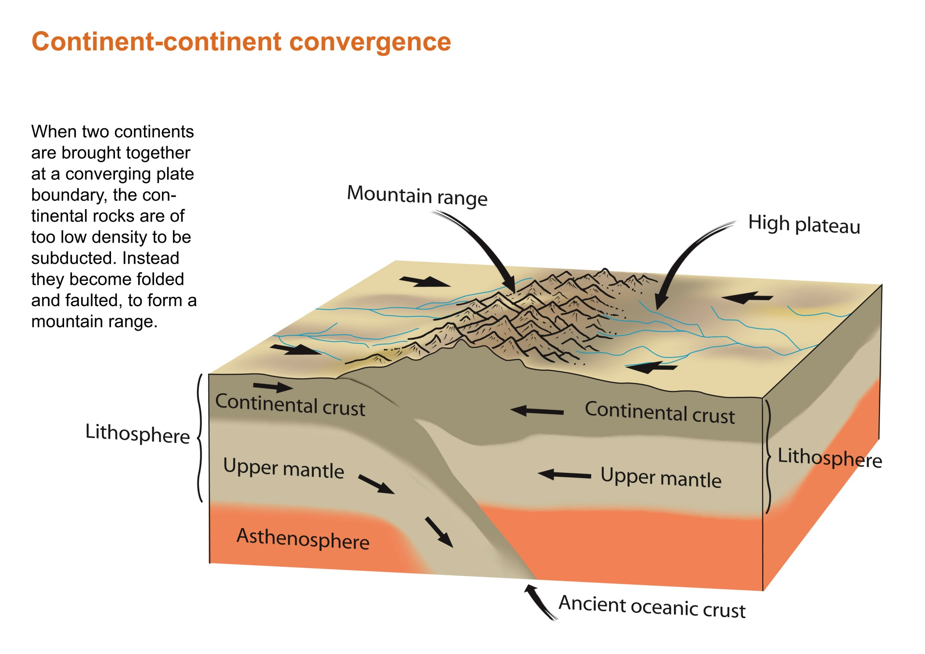
A subduction zone with continents on both plates
When two plates carrying continents collide – mountain chains are built
Continental plate collision zone. Reproduced with kind permission of USGS, redrawn by ESEU
Notes:
.

Slide 19
An oceanic ridge
If plates are converging, there must be somewhere on Earth where plates are moving apart, or diverging – where new plate material is being made
An oceanic ridge © Press & Siever, redrawn by ESEU

Slide 20
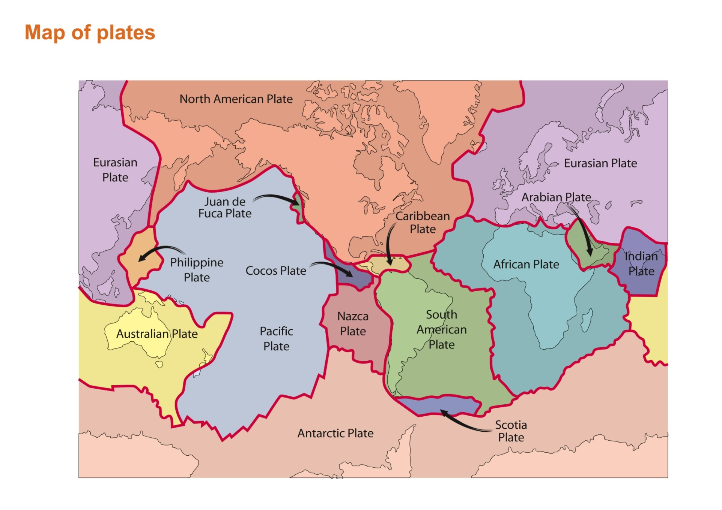
Map of plates
The result is - the map of plate margins today
Map of plates - reproduced with kind permission of USGS, redrawn by ESEU

Slide 21
So – that is the ‘big picture’ of plate tectonics
But plate tectonics is not a series of facts, as suggested in the story above, but is a theory supported by evidence
But what is this evidence and how does it support the theory?
Note: The theory of plate tectonics is outlined in narrative form as the ‘Story for teachers: plate tectonics’ on an early page of the ‘The plate tectonic story’ booklet.

Slide 22
Teaching Earthlearningideas
The plate tectonic story
Earthquake and volcano distribution evidence
Go to: https://www.earthlearningidea.com/Video/V21_Equ_volc_evid.html hyperlink

Slide 23
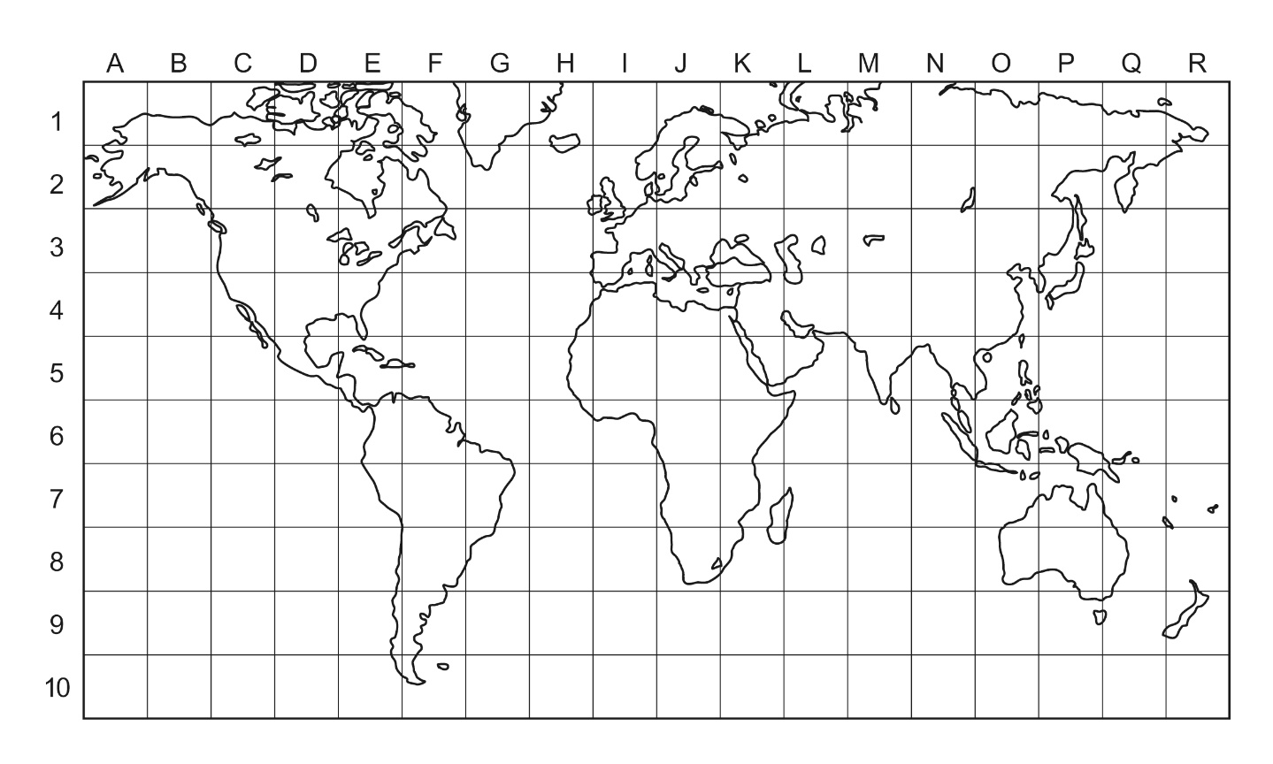
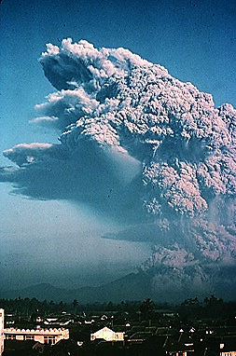
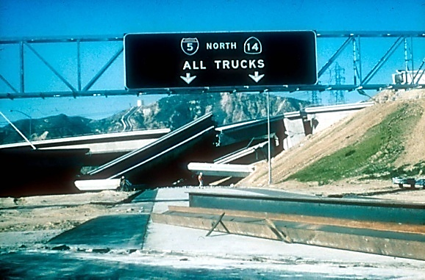
Where on Earth are earthquakes and volcanoes?
- geobattleships
Battleship grid for Geobattleships © Dave Turner
Galunggung eruption by USGS, public domain
‘North All Trucks’ © USGS

Slide 24
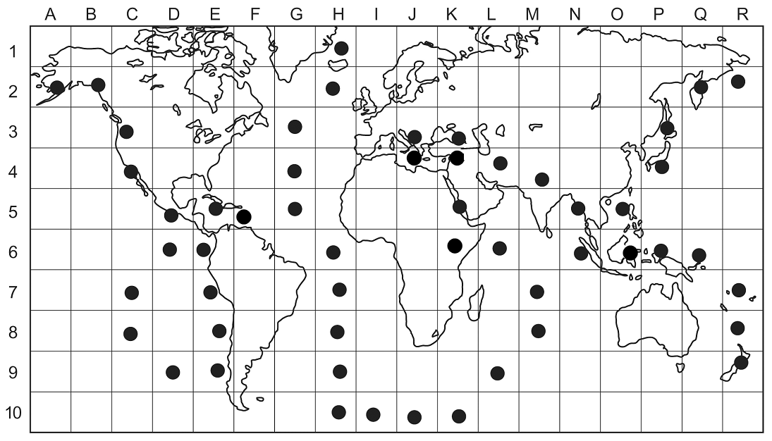
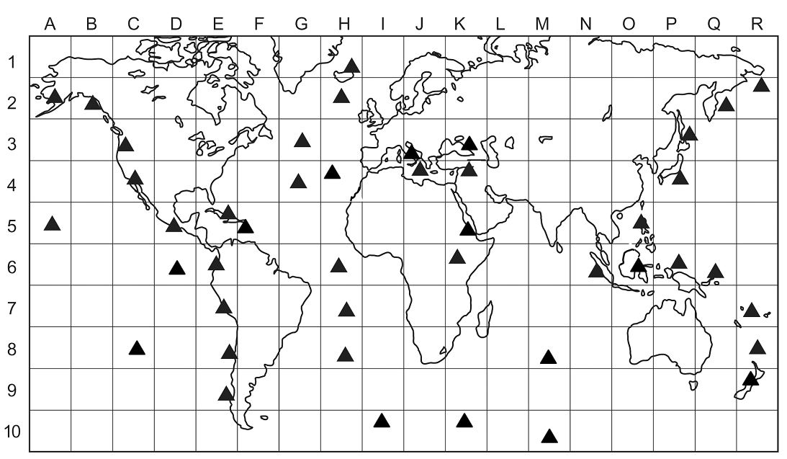
Where on Earth are earthquakes and volcanoes?
- geobattleships
Earthquakes
Volcanoes
Battleship grid for Geobattleships © Dave Turner

Slide 25
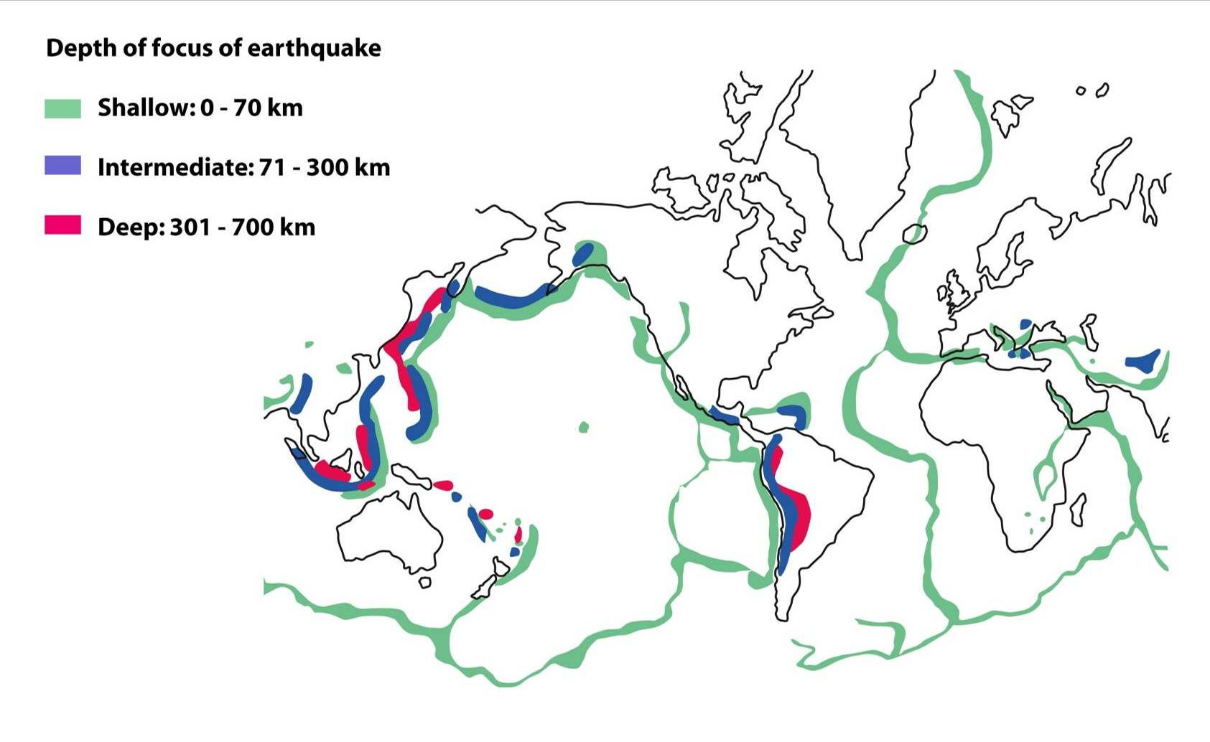
Distribution of earthquakes – what does the distribution show?
Distribution of earthquakes – source unknown, redrawn by ESEU

Slide 26
Distribution of earthquakes – what does the distribution show?
divergent
Distribution of earthquakes – source unknown, redrawn by ESEU

Slide 27
Teaching Earthlearningideas
The plate tectonic story
China plate summary
Go to: https://www.earthlearningidea.com/Video/V21_China_plate.html hyperlink

Slide 28
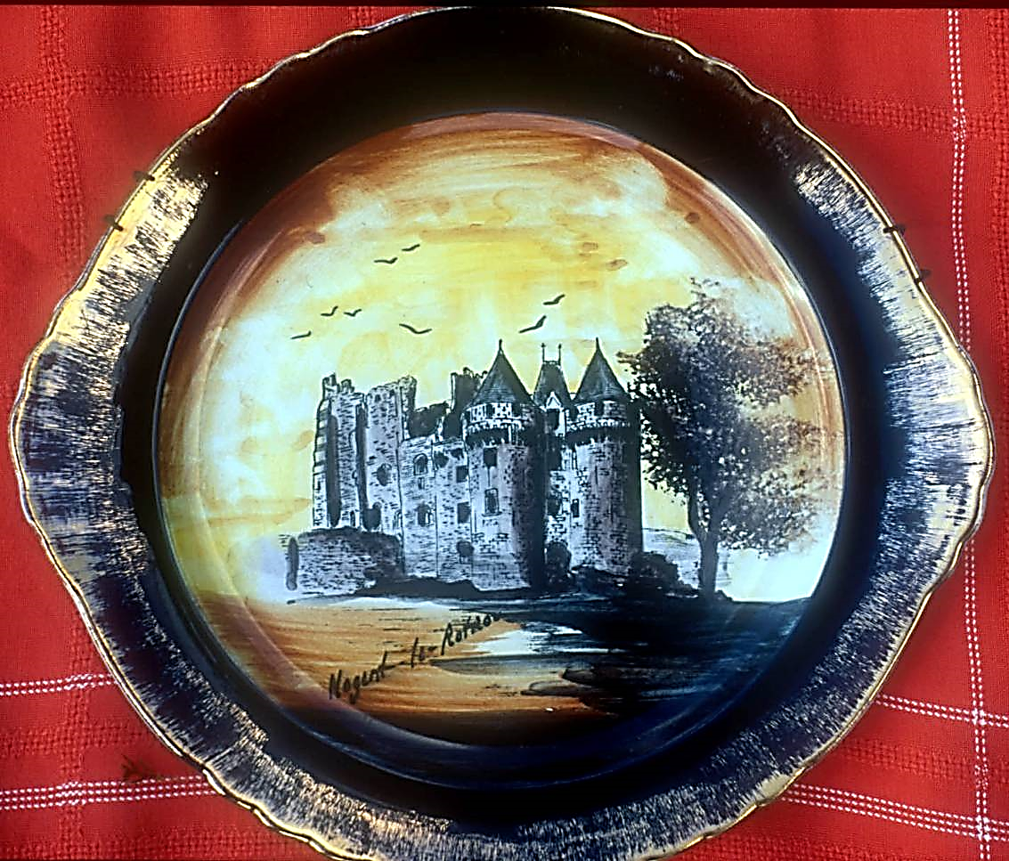
Why are the Earth’s tectonic plates called plates?
Picture of a plate © Peter Kennett
Notes:
Thin, rigid, brittle, all action at edges

Slide 29
Teaching Earthlearningideas
Earth’s structure
From clay balls to the structure of the Earth
Go to: https://www.earthlearningidea.com/Video/V20_Clay_balls.html hyperlink

Slide 30
From clay balls to Earth’s structure
Two spheres, different colours - other differences?
One ball seems heavier than the other
How could you find out if you are right?

Slide 31
From clay balls to Earth’s structure
To find out if one ball is heavier than the other, you could:
Weigh both balls – you would find that one has a greater mass than the other
Spin or roll the balls – one should spin or roll better than the other because it is heavier and has more inertia
The spin/roll test doesn’t work because the Plasticine™ will not allow free spinning/rolling
One ball is heavier than the other. Why? There are five different ideas (hypotheses) that could account for this – discuss the possibilities

Slide 32
From clay balls to Earth’s structure
One feels heavier, and it is - reasons could be:
something heavy in the centre of the heavy one
something light in the centre of the light one
one gets steadily lighter towards the centre
one gets steadily heavier towards the centre
one is made of heavier ‘stuff’ than the other
How could you find out which is right - without destroying the ball?

Slide 33
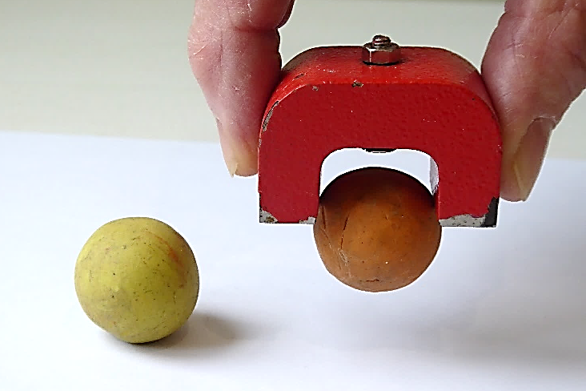
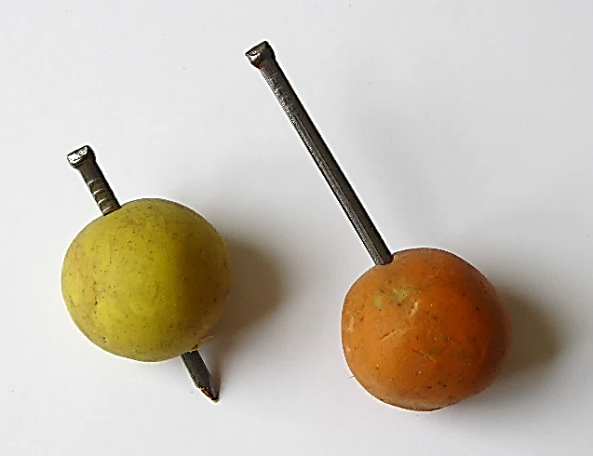
Model Earth – Plasticine™ balls
How could you find out which is right - without destroying the ball?
Stick a pin in
Take a small piece of the surface and test its density
Test with a magnet
Test its inertia
Test it with ultrasound
X-ray it
Test it with ionising radiation (α, β, γ)
The pin would stop at the ball bearing
The densities would be the same
The magnet would attract the ball bearing
The inertia test does not work with clay
Ultrasound would find the ball bearing
X-rays would find the ball bearing
Ionising radiation would find the bearing
Which of these could you use on the Earth in an attempt to find out what is in the middle?

Slide 34
From clay balls to Earth’s structure
Which of these could you use on the Earth to find in an attempt to find out what is in the middle?
Stick a pin in - no, can’t drill that deep
Measure density - yes, crustal density less than whole Earth density
Magnetism - yes, measure and interpret effects
Inertia - yes, measure and interpret effects
Ultrasound - no, can’t penetrate that far
Sound (sonar) - no, bounces off seafloor
Infra-sound - yes, low frequency sound = seismic waves – gives
the best evidence for the core
X-ray - no, can’t penetrate that far
Ionising radiation - no, can’t penetrate that far
*
*
*
*
* Gives evidence for the Earth’s core
Note: The activity is fully explained in, King, C. (2002) The secrets of Plasticine balls and the structure of the Earth: investigation through discussion, published in Physics Education, 37 (6), 485 – 491.

Slide 35
From clay balls to Earth’s structure
Through this activity – have we been learning about science/geography or ‘doing science/geography’?
When learning about the Earth’s core, you might have been asked to draw and label a diagram like this:
mantle
outer core
inner core
crust
…. or you could have done the activity we have just done

Slide 36
From clay balls to Earth’s structure
Through this activity – have we been learning about science/geography or ‘doing science/geography’?
When scientists or geographers ‘do’ science/geography they:
ask questions
come up with ideas to answer these questions (develop hypotheses)
think of ways of testing these ideas (observations or experiments)
think about what these are likely to tell us
… just as we have been doing here
So – is this way of exploring Earth’s core ‘doing science/ geography’ – or just learning about it?

Slide 37
Teaching Earthlearningideas
Earth’s structure
From an orange to the whole Earth
Go to: https://www.earthlearningidea.com/Video/V23_Orange_to_Earth.html hyperlink

Slide 38
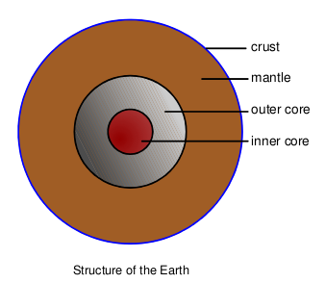
From an orange to the whole Earth
© redrawn by ESEU

Slide 39
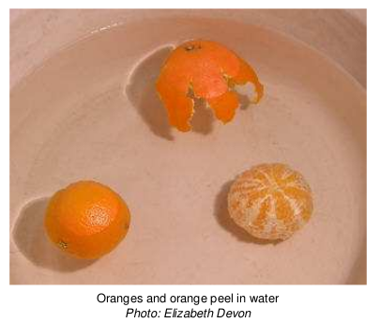
From an orange to the whole Earth
© Elizabeth Devon

Slide 40
From an orange to the whole Earth
Density of the Earth and its layers – the figures:
Earth Layer | Density, gcm⁻³
Crust | 2.7 (oceanic) – 2.9 (continental)
Mantle | 3.3 – 5.7
Outer core | 9.9 – 12.2
Inner core | 12.6 – 13.00
Whole Earth | 5.5

Slide 41
Teaching Earthlearningideas
Earth’s structure
Earthquakes – the slinky simulation
Go to: https://www.earthlearningidea.com/Video/V22_Slinky_simulation.html hyperlink

Slide 42
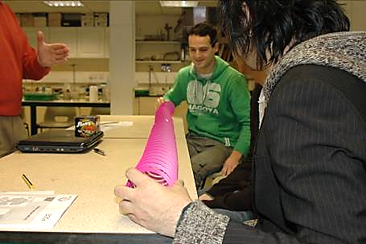
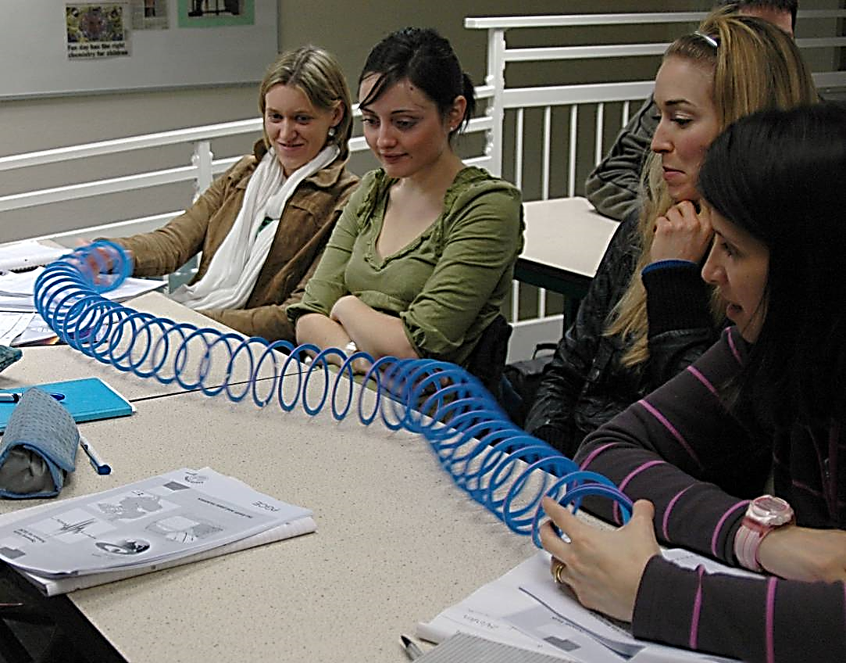
Earthquakes - the slinky simulation
How earthquakes produce P- and S-waves
© ESEU

Slide 43
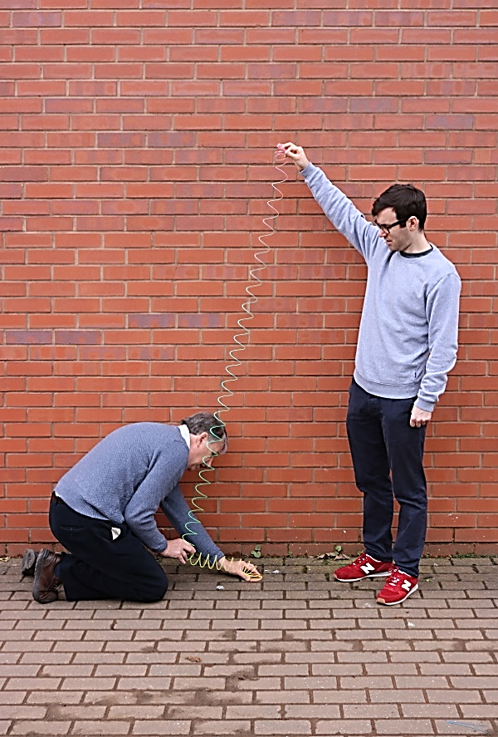
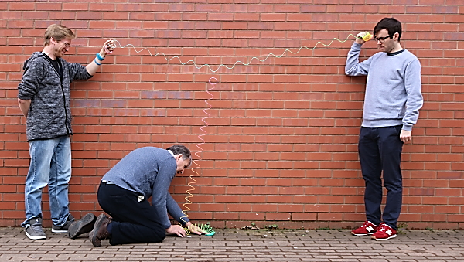
Earthquakes - the slinky simulation
How earthquakes produce P- and S-waves

Slide 44
Seismic wave summary
Wave type | Primary wave | Secondary wave
Name meaning | fastest wave, so arrives first, called primary | slower wave, arrives second, called secondary
Other names | longitudinal – travels by vibration along the material | transverse – travels by lateral movement
 | push/pull wave; comPressional wave | shake wave; shear wave; sideways wave; slow wave
Transmission | through solids and fluids (liquids and gases) | through solids only
Earthquake damage is caused mainly by seismic surface waves, and not by primary or secondary waves

Slide 45
Teaching Earthlearningideas
Earth’s structure
Wave motion – pupil molecules
Go to: https://www.earthlearningidea.com/Video/V22_Pupil_molecules.html hyperlink

Slide 46
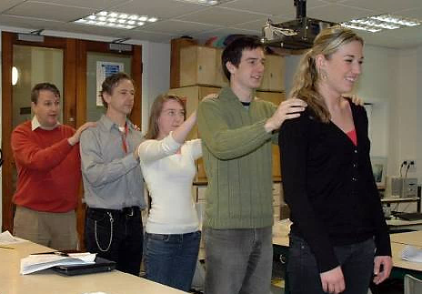
Wave motion – pupil molecules
How P- and S-waves are transmitted
© ESEU

Slide 47
Teaching Earthlearningideas
Earth’s structure
The seismic evidence
Go to: https://www.earthlearningidea.com/Video/V26_Seismic_evidence.html hyperlink

Slide 48
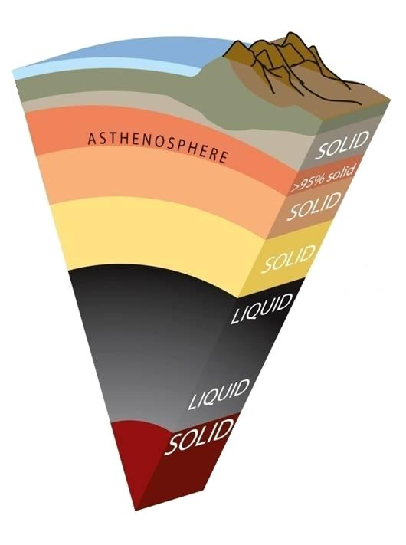
Seismic evidence
Seismic waves are shock waves that pass through and around the Earth
Seismic waves are generated naturally by earthquakes
There are three main types:
P-waves – travel through solids and fluids (liquids and gases); pass through the Earth
S-waves – travel only through solids (not fluids); pass through the Earth
Surface waves – formed when P- and S-waves reach the Earth’s surface; these cause most damage
The Structure of the Earth – from the seismic evidence – reproduced with kind permission of USGS, redrawn by ESEU

Slide 49
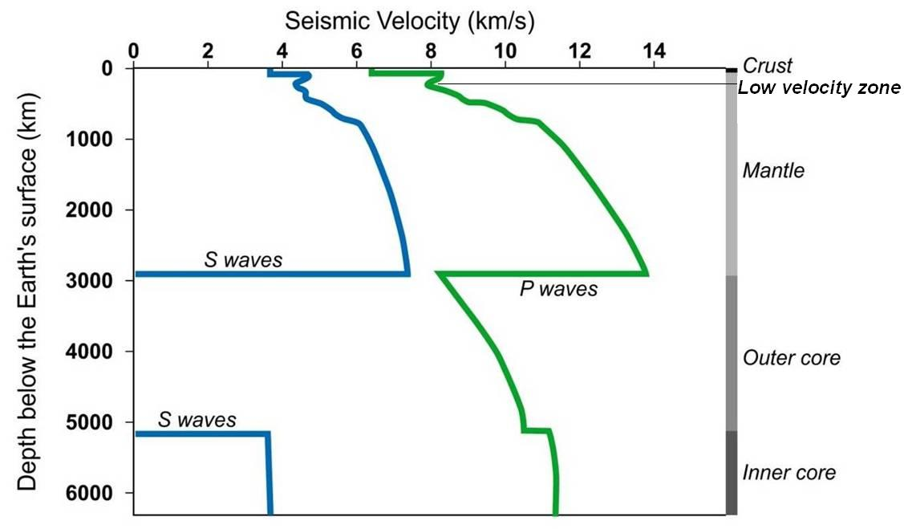
Velocities of P- and S-waves as they travel into the Earth
Graph of 'Velocities of P and S waves as they travel into the Earth © ESTA, redrawn by ESEU
P-waves – travel through solids and fluids (liquids and gases);
S-waves – travel only through solids (not fluids);
Notes:
Implications – solid mantle, liquid outer core. Dimensions. Note Low Velocity Zone

Slide 50
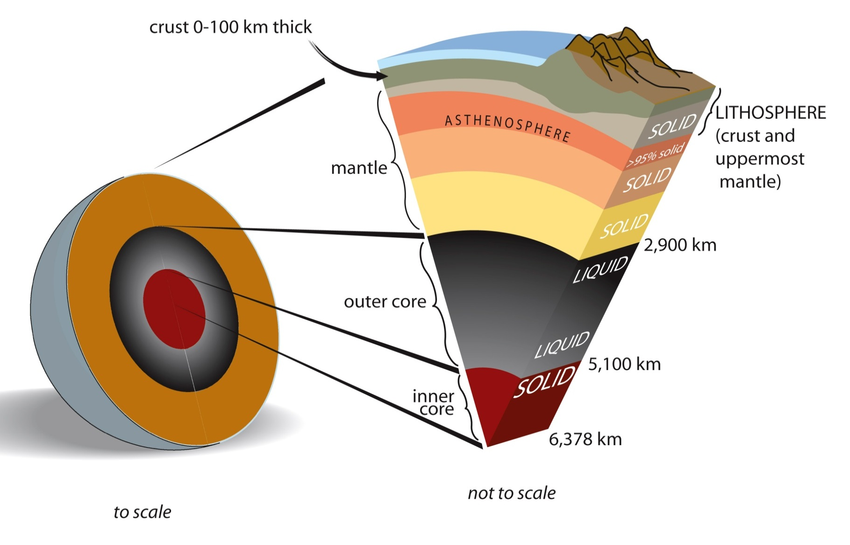
The structure of the Earth – from the seismic evidence
crust average 15 km thick
The Internal structure of the Earth - reproduced with kind permission of USGS, redrawn by ESEU
Notes:
Summarise evidence. Emphasise Lithosphere

Slide 51
Seismic evidence – summary
The outer core is liquid (no S-waves transmitted)
The inner core is solid (transmits S-waves)
The rest of the Earth is also solid – the crust, the lithosphere, the asthenosphere and the rest of the mantle (transmits S-waves)
Seismic waves slow down in the asthenosphere (low velocity zone) because the solid asthenosphere is near its melting point and so is plastic and can flow
The Structure of the Earth – from the seismic evidence – reproduced with kind permission of USGS, redrawn by ESEU

Slide 52
The lithosphere, asthenosphere and below:
Solid
Solid – but can flow
Solid – but can flow slowly
The lithosphere, asthenosphere and below © ESEU
Note 1. The crust has a mean thickness of 35 km beneath continents and 6 km beneath oceans giving an overall mean of about 15 km.
Note 2. The crust is too thin to form plates – plates are made of rigid lithosphere – around 100 km in thickness

Slide 53
Teaching Earthlearningideas
Earth’s structure
Solids that flow
Go to: https://www.earthlearningidea.com/Video/V26_Potty_putty.html hyperlink

Slide 54
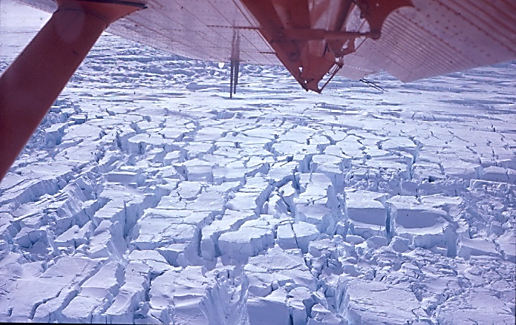
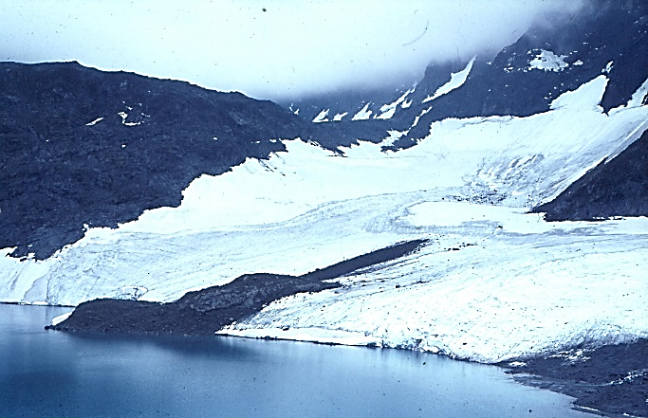
Can solids flow?
Can you think of a common solid that flows?
Answer = ice
Ice is solid – and can break (fracture)
Ice is solid – but when near its melting point in a glacier on a mountainside – it flows
It flows even in polar glaciers – which are frozen to the ground
Fractured ice – seen from a plane in Antarctica
A glacier flowing downhill in Norway

Slide 55
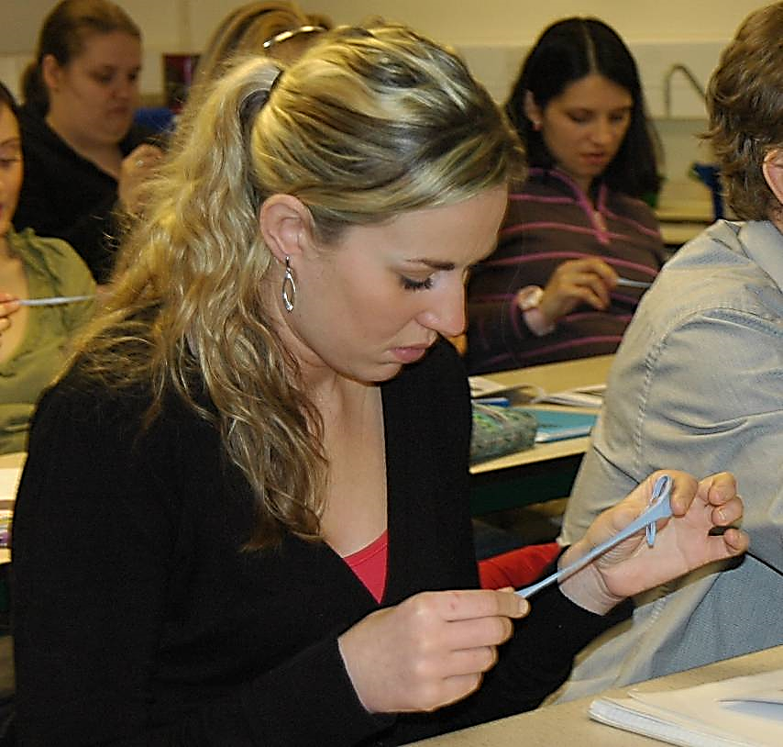
Properties of the mantle – potty putty™
Showing how the solid mantle can flow
Student pulling Potty Putty™ © ESEU

Slide 56
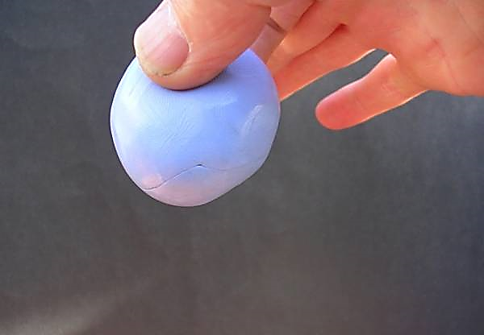
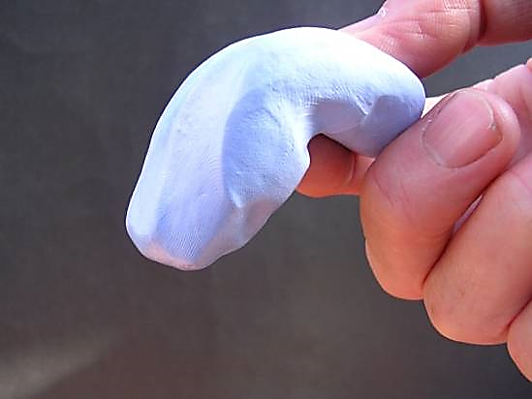
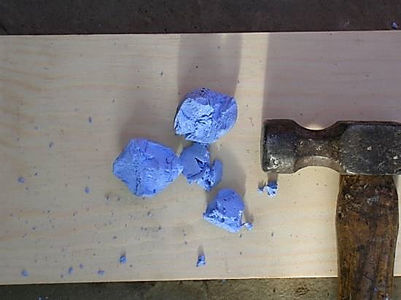
Modelling the mantle
Photographs of potty putty™ © Peter Kennett

Slide 57
Modelling the mantle - summary
How are ‘potty putty’ and the mantle similar?
Potty putty | The mantle
Breaks – brittle behaviour
Bounces – elastic behaviour
Bends, flows – plastic behaviour
Mantle in the lithosphere breaks – causing earthquakes
Transmits earthquake (seismic) P- and S-waves
Can flow (over geological time)

Slide 58
Teaching Earthlearningideas
Earth’s structure
Skateboard summary
Go to: https://www.earthlearningidea.com/Video/V26_Skateboard.html hyperlink

Slide 59
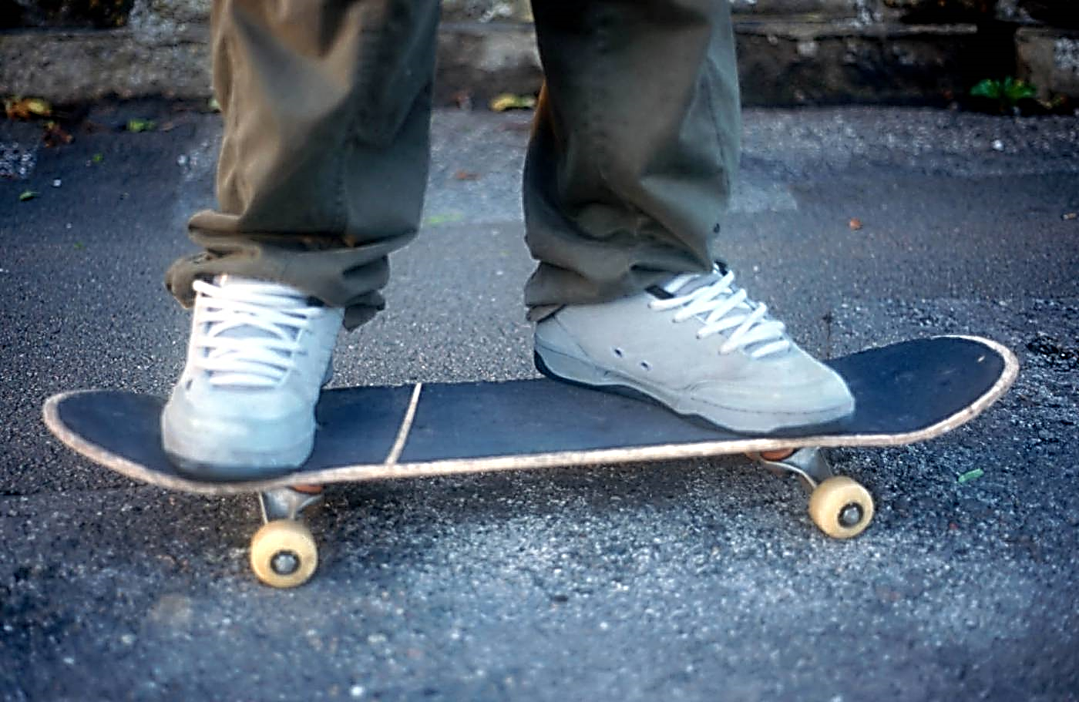
Modelling the lithosphere and asthenosphere (?)
Skateboard © Peter Kennett, ESEU
Notes:
Feet = crust: board = upper mantle: wheels = asthenosphere: pavement = rest of mantle. Apply to Earth.

Slide 60
Modelling the lithosphere and asthenosphere (?)
The crust – trainers
The extreme upper mantle – skateboard
The asthenosphere - wheels
Skateboard © Peter Kennett, ESEU
The asthenosphere (wheels) flows, carrying the plate of lithosphere = trainers (crust) + extreme upper mantle (skateboard) along
Notes:
Feet = crust: board = upper mantle: wheels = asthenosphere: pavement = rest of mantle. Apply to Earth.

Slide 61
Teaching Earthlearningideas
Earth’s structure
Journey to the centre of the Earth – on a toilet roll
Go to: https://www.earthlearningidea.com/Video/V27_Journey_toilet_roll.html hyperlink

Slide 62
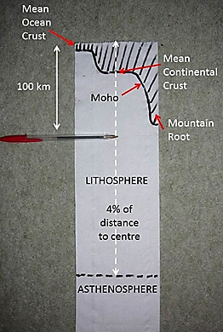
Journey to the centre of the Earth – on a toilet roll
© Pete Loader

Slide 63
Teaching Earthlearningideas
The plate tectonic story
What drives the plates?
Go to: https://www.earthlearningidea.com/Video/V25_What_drives_plates.html hyperlink

Slide 64
What drives the plates? – different theories
Ridge push – plates form on oceanic ridges, higher than the surrounding area – the plate slides off, pushing the plate along
Mantle drag – the convection current theory – a convection current flowing in the mantle drags the plate above along
Slab pull – the subducting plate material is more dense than the mantle beneath and so sinks and subducts, pulling the plate along
What does the evidence show is the best theory?
Theoretical driving mechanisms of plate movement © Pete Loader

Slide 65
What drives the plates? – different theories
Ridge push – plates form on oceanic ridges, higher than the surrounding area – the plate slides off, pushing the plate along
Mantle drag – the convection current theory – a convection current flowing in the mantle drags the plate above along
Slab pull – the subducting plate material is more dense than the mantle beneath and so sinks and subducts, pulling the plate along
plates where divergent margins form the greatest percentage of a plate margin should be moving fastest
plates on either side of diverging margins should be moving at the same speed
plates where subduction zones form the greatest percentage of a plate margin should be moving fastest

Slide 66
What drives the plates? – different theories
Little correlation – but this may be important for plates with little subduction
plates where divergent margins form the greatest percentage of a plate margin should be moving fastest
plates on either side of diverging margins should be moving at the same speed
plates where subduction zones form the greatest percentage of a plate margin should be moving fastest
Different speeds – plates on either side of divergent margins move at different speeds
Strong correlation – thought to be the main driving force for most plates
The convection current model, as still shown by many diagrams, has no evidence – our thinking has moved on

Slide 67
What drives the plates?
Oceanic ridge
Plate movement
Plate movement
Subduction zone
Stab pull © David Bailey

Slide 68
What drives the plates?
Oceanic ridge
Plate movement
Plate movement
Subduction zone
For more information about these processes, consult the: ‘All models are wrong – but some are really wrong: plate-driving mechanisms’ Earthlearn-ingidea
Stab pull © David Bailey

Slide 69
Teaching Earthlearningideas
Earth’s structure
Frozen magnetism
Go to: https://www.earthlearningidea.com/Video/V24_Magnetism1.html hyperlink

Slide 70
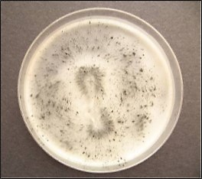
The magnetic evidence
From magnetic globe to magnetic rock evidence
Petri-dish magnetic field preserved in iron filings in wax © Michèle Bourne, ESEU
Model magnetic Earth (ESEU)

Slide 71
Teaching Earthlearningideas
Earth’s structure
Magnetic Earth
Go to: https://www.earthlearningidea.com/Video/V24_Magnetism2.html hyperlink

Slide 72
Model magnetic Earth
Model magnetic Earth (ESEU)

Slide 73
Model magnetic Earth
How many degrees does the magnet on the Magnaprobe™ rotate through as it is moved from one pole to the other?
360º or back to the start = 0º

Slide 74
Model magnetic Earth
If a volcano erupted at the North Pole, what angle (dip) would the magnetism recorded there have (the remanent magnetisation)?
Vertical (90º)
If a volcano erupted at the South Pole, what dip would the remanent magnetisation there have?
Also vertical (90º)
If a volcano erupted at the Equator, what dip would the remanent magnetisation there have?
Horizontal (0º)
Some lavas of Carboniferous age in the UK have horizontal magnetisation. Where was the UK when the lavas erupted?
On the Equator

Slide 75
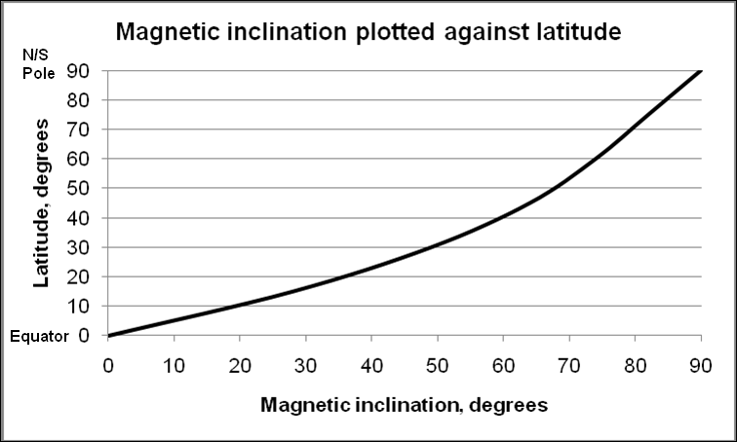
Preserving remanent magnetisation
Petri-dish magnetic field preserved in iron filings in wax © Michèle Bourne, ESEU
Magnetic inclination plotted against latitude (graph) © Chris King
Notes:
75

Slide 76
Teaching Earthlearningideas
Earth’s structure
Magnetic Earth using a sponge ball globe
Go to: https://www.earthlearningidea.com/Video/V24_Magnetism3.html hyperlink

Slide 77
Recipe for a magnetic Earth and a magnetic detector
Collect a needle and thread, a small magnet and an ‘Earth’ stress ball.
Thread the needle with the piece of thread.
Make the needle into a magnet, by laying it flat on the table, holding a magnet upright, and stroking it in the same direction ten times, as in the photograph.
Push a sharp pencil or pen into the North Pole of the stress ball until it reaches just over half way
Remove the pencil/pen and push a small magnet into the same hole until it reaches half way
You now have a model magnetic Earth and a magnetised needle ‘magnetic detector’

Slide 78
Recipe for a magnetic Earth and a magnetic detector
Find one of the magnetic poles of the Earth by hanging the needle from the thread, and finding where the needle is pulled straight down
Find the pole on the other side of the model Earth, where the two magnets (the needle magnet and the one in the Earth) repel, so the needle is pushed away from the pole and circles around it at an angle
Find the Equator, where the needle is upright beside the side of the Earth
Note: We need to teach pupils that Earth’s magnetism is NOT caused by a bar magnet inside the Earth – the evidence is that it is caused by currents in the core. This is just a model of how Earth’s magnetism works

Slide 79
Teaching Earthlearningideas
The plate tectonic story
The heat flow evidence
Go to: https://www.earthlearningidea.com/Video/V28_Heat_flow.html hyperlink

Slide 80
The heat flow evidence
The pattern of heat flow from the Earth
The pattern of heat flow out of the ocean floor and the upper part of the mantle and the crust © Chris King and Dee Edwards, redrawn by ESEU
Notes:
High values occur over the oceanic ridges and low values over the deep trenches. Values rise again over volcanic island arcs. Convection?

Slide 81
The pattern of heat flow from the Earth
High heat flow – from rising current at ridge
Heat flow reducing as plate cools
Lowest heat flow at trench
High heat flow from volcanicity
The pattern of heat flow out of the ocean floor and the upper part of the mantle and the crust © Chris King and Dee Edwards, redrawn by ESEU
Notes:
High values occur over the oceanic ridges and low values over the deep trenches. Values rise again over volcanic island arcs.

Slide 82
Teaching Earthlearningideas
The plate tectonic story
The age of ocean floor and plate speed
Go to: https://www.earthlearningidea.com/Video/V28_Age_ocean_floor.html hyperlink

Slide 83
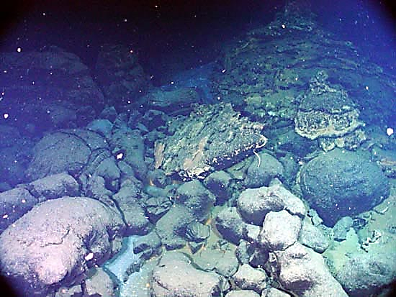
The age of the ocean floor evidence:
ocean floors are young where new plate is
being formed, becoming older outwards
‘Ancient pillow lava’ by US National Oceanic & Atmospheric Administration – image in the public domain

Slide 84
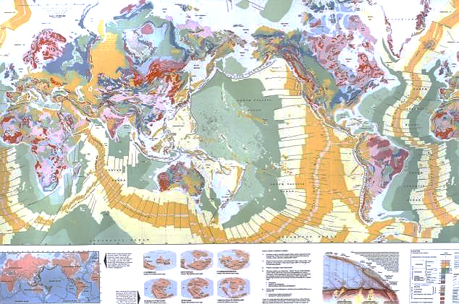
Evidence from the age of the sea floor
Photograph of 'The Geological Map of the World’. © Open University
Age of the sea floor – youngest = dark yellow, oldest = pale green

Slide 85
Which is the fastest-spreading oceanic ridge?
(Ma)
From: http://www.ngdc.noaa.gov/mgg/ocean_age/ocean_age_2008.html; National Geophysical Data Center, National Oceanic and Atmospheric Administration, U.S. Department of Commerce, http://www.ngdc.noaa.gov and licensed under the Creative Commons Attribution-Share Alike 3.0 Unported license.

Slide 86
The Earth and plate tectonics – online
End of Part 1
Earth Science for science and geography
– video workshop
Developed from the Earth Science Education Unit ‘The Earth and plate tectonics’ workshop, with permission
© Copyright is waived for original material contained in this workshop if it is required for use within the laboratory or classroom. Copyright material contained herein from other publishers rests with them. Any organisation wishing to use this material should contact the Earthlearningidea team.

